Slide 1
Action Verbs
Vocabulary and Language Week 1, Days 3-4

Slide 2
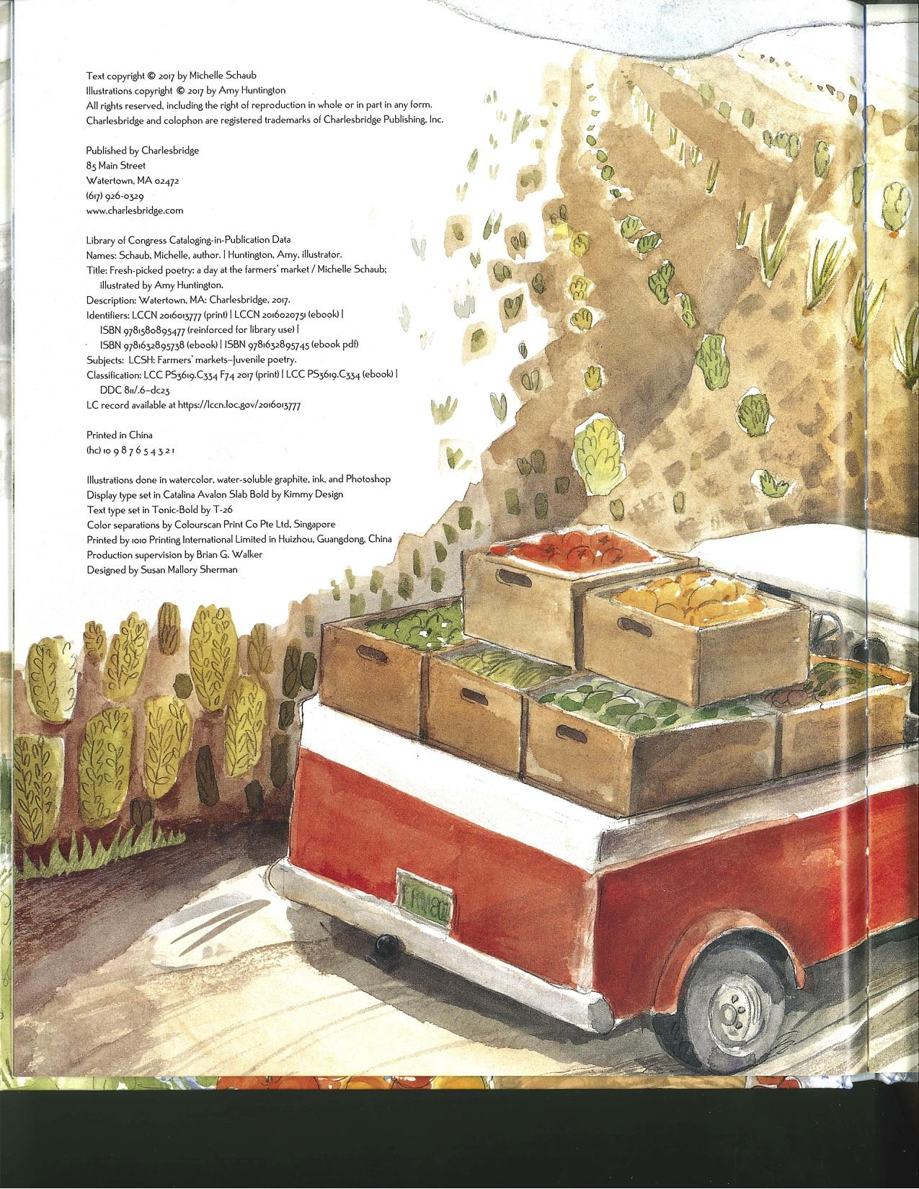
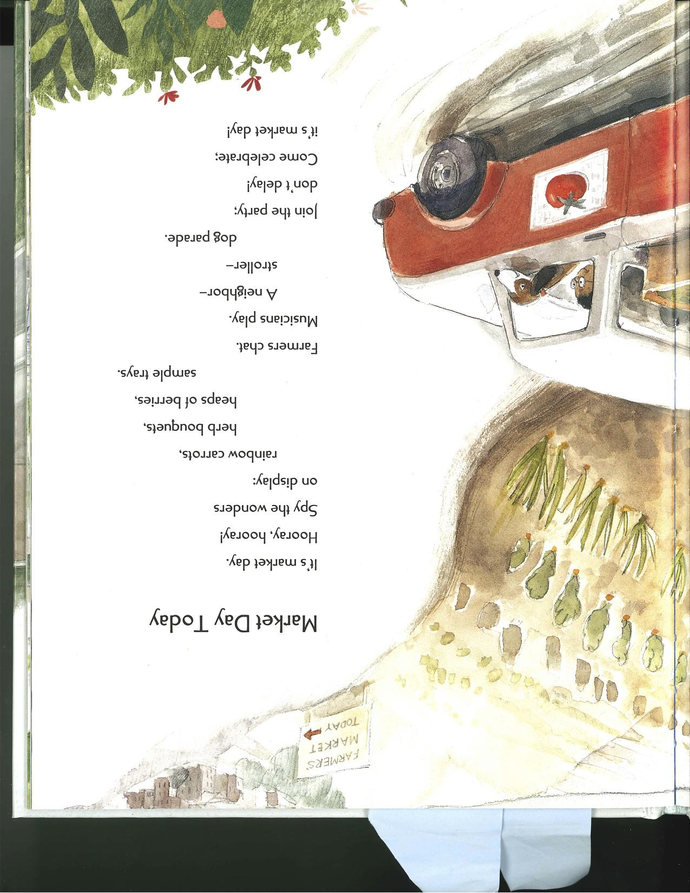
Slide 1

Slide 3
Slide 2
Market Day Today
It’s market day.
Hooray, hooray!
Spy the wonders
on display:
rainbow carrots,
herb bouquets,
heaps of berries,
sample trays.
Farmers chat.
Musicians play.
A neighbor-
stroller-
dog parade.
Join the party;
don’t delay!
Come celebrate;
it’s market day!

Slide 4
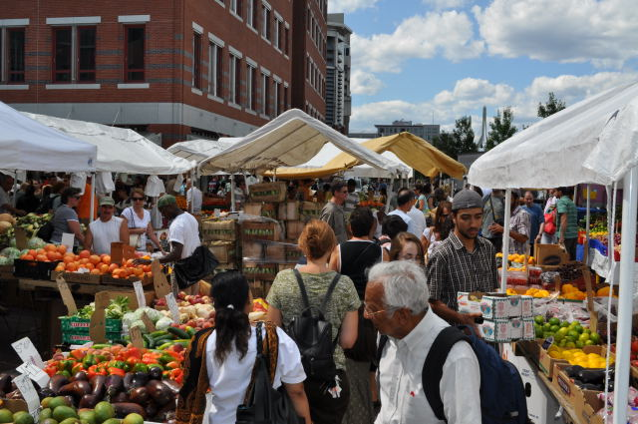
Slide 3
http://keithdalyphoto.blogspot.com/2010/08/haymarket-boston-ma.html

