Slide 1
2019-2020 Monitoring Cohort Training
Office of Special Services
Monitoring Team

Slide 2
WELCOME AND INTRODUCTIONS
Dr. Roberta Lucas: Federal Programs Coordinator
Dan Hemdal – Educational Specialist III
Leora Byras – Educational Specialist II
Colette Sullivan – Educational Specialist II
Julie Pelletier: Office Associate II

Slide 3
DOCUMENTS
Documents in your packet:
Copy of this PowerPoint
IEPs (sanitized)
B-11 Initial Evaluation Timeline materials
Electronic Monitoring Tool (EMT) in Word format
Monitoring Timeline
B13 Invoice for Reimbursement

Slide 4
HOUSEKEEPING
Bathroom locations
Breaks
Cell phones

Slide 5
AGENDA FOR TODAY
Welcome to Cohort 19-20
Desk audit process
Timelines
Items
Self-assessment process and practice
Timelines
Electronic Monitoring Tool in Word and Excel
Notes:
RobertaReview the Letter of Instruction (LOI)
Desk audit process
Timelines
Items
Self-assessment process
Timelines
Electronic Monitoring Tool
Word version
Excel version

Slide 6
AUDIT PLANNING
OSEP Requirement (Memo 09-02)
Based on August 25, 2017 MUSER
Notes:
Roberta

Slide 7
PARENT SURVEY (B8)
Explanation of the process
Local administration of Survey Monkey
Open for the full school year
Link will be provided via email
Analysis of data will be provided in June
If “n” size is met, district specific results will be provided
Notes:
Roberta

Slide 8
STAFF SURVEY
Survey Monkey that will be sent to directors/coordinators
Designed for special educators, but can be provided to all special education and related service staff
Likert scale and open ended questions (10 minutes)
If “n” size is met, district specific results will be shared

Slide 9
INFORMATION
Electronic Monitoring Tool (EMT):
Word version states item, evidence, and corrective activities
Excel version is used to complete self-assessment
Resident district remains responsible for FAPE
Tuition
Special Purpose Private School
60/40 schools
Alternative Organizational Structures (AOS)
Notes:
Roberta
EMT – reviewed
CWS – Communities with out schools – have a separate criteria based on legislation - 2013 AOS 90 – each location will be reviewed independent of each other
OOU – out of unit children – sending SAU’s are responsible for FAPE – when reviewing OOU files

Slide 10
INFORMATION
Evidence
Desk Audit:
Evidence submitted to Maine DOE for review.
Will be outlined in the Letter of Notification and Instruction
Self-Assessment:
Items you will review and assess compliance at your districts.
Will record on the EMT – Excel.
Notes:
Roberta
All monitored items are listed on the electronic monitoring tool (EMT- Word), and have a code. You can view the EMT-W anytime at the monitoring website on the previous slide. This EMT is a word format and includes the CAP activities for the monitored item.
Desk audit will include only those items which are requested to be sent to the DOE by 12/30/15
Make sure all required forms are the most current form being used by your staff. Speech/Language, AE, SLD, SOP
Self assessment will be on 20 % of your self chosen files.
Evidence for some items will be sent by your district to the Maine DOE for review here. Other items will be reviewed by you through a self assessment with the results logged on to the condensed EMT. The condensed EMT will be sent to you, and will have only the items for which you are performing your self-assessment. Unlike the EMT on the Integrated Monitoring Activities website, the condensed EMT is an excel spreadsheet and will calculated performance as you input your data.

Slide 11
CODES
Examples of EMT Codes
INR1- Initial Referral
LRE1- Least Restrictive Environment
DIB1 – Disability/IEP Alignment
MIS2 – Fund Authorization Letter

Slide 12
DESK AUDIT
B-11: Child Find (initial referral)
B-13: Transition Plans
Eligibility Forms
SLD, AE, S/L
Accuracy Document
Fund Authorization Letter(s)
Certification

Slide 13
B-11: CHILD FIND & ELIGIBILITY FORMS
Child Find (B-11): INR3
Initial evaluations completed within 45 school days of parental consent received by SAU.
The first 10 parental consents to evaluate for initial evaluations received during the 2018-2019 school year.
Notes:
Roberta

Slide 14
B-11: CHILD FIND & ELIGIBILITY FORMS
Child Find (B-11): INR3
This is a SPP indicator, requiring a set of evidence that demonstrates compliance.
Initial Evaluations Tracking Tool (provided)
Signed parental consents for each reviewed file with date received by SAU.
Cover of each evaluation identified (i.e., date stamp “received” by SAU, not the date sent to parent).
Notes:
Roberta

Slide 15
B-11: CHILD FIND & ELIGIBILITY FORMS
Child Find (B-11): INR3
Evidence of acceptable reasons for delay.
Copy of 17-18 and 18-19 school calendar including snow days.
Procedural Safeguards: INR1
Documentation of the notification of initial referral
AWN, WN, enclosure with parental consent
Notes:
Dan

Slide 16
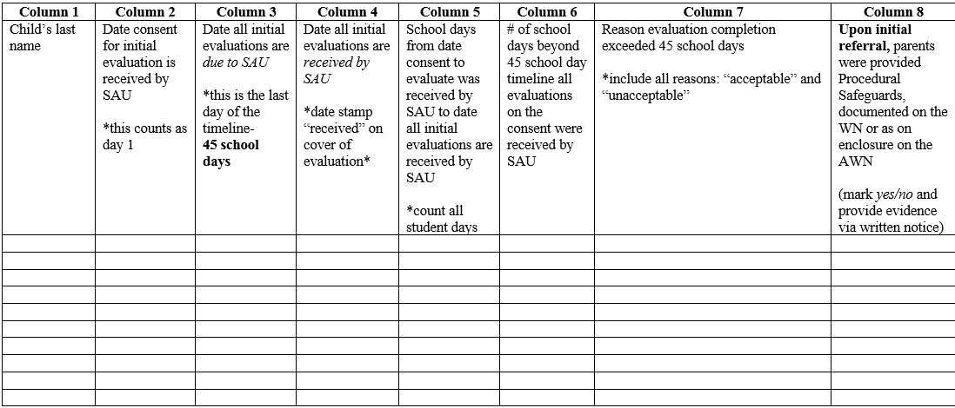
B-11 TIMELINE TRACKING TOOL

Slide 17
B-11 – OVER 45 SCHOOL DAYS
If evaluations are not completed within 45 school days of parental consent, document on the B11 tracking tool:
The reason for completion beyond 45 school day timeline based on one pager for guidance.
Document the number of school days beyond 45 school day timeline
If evaluations are not completed at the time of Desk Audit submission, contact Maine DOE when the evaluations have been completed.

Slide 18
ELIGIBILITY FORMS
Of the ten B-11 submissions, include eligibility forms used in the identification determination for 7 of the 10:
3 Specific Learning Disability Forms & WNs
3 Adverse Effect Forms & WNs
1 Speech/Language Impairment Form & WN
If you do not have these forms, please contact a member of the Monitoring Team.

Slide 19
B-13: TRANSITION PLANNING
Send in 2 submissions as a screener
AWN
WN
Full IEP
Submissions will determine next steps either:
Final Submissions
Professional Development

Slide 20
B-13: TRANSITION PLANNING
Final submissions based on child count (Oct. 1)
AWN, WN, and IEP
16 years or older
Not graduating seniors (June 2020)
Child Count | Number of Final Submissions
0-50 | 2
50-200 | 4
200-400 | 6
400-750 | 8
More than 750 | 10

Slide 21
SUMMARY OF PERFORMANCE
Submit a letter of assurance to the Maine DOE stating:
The district will select one Summary of Performance (SOP) from School Year 2018-2019.
The district will review the SOP and as a result will provide staff with any professional development needed to ensure the creation of effective and compliant SOPs.

Slide 22
B-4 : MANIFESTATION DETERMINATIONS
Only applies to districts that have a disproportionate rates for the suspension or expulsion of children with disabilities
Specific districts will be contacted directly regarding evidence

Slide 23
SELF-ASSESSMENT
Self-assessment (EMT) should include a variety of:
Disabilities (Multiple Disability explained)
Ages (including transition plans)
Case Managers
Ethnicities
Schools within SAU
Graduating seniors (not preferred)
Files from School Year 2018-2019

Slide 24
SELF-ASSESSMENT
Number of files reviewed is based on child count (Oct. 1).
Child Count | Number of Files
0-50 | 15
50-200 | 20
200-400 | 30
400-750 | 50
More than 750 | 75

Slide 25
SELF-ASSESSMENT – OUT OF UNIT
Utilizing the Out-of-Unit EMT
Complete a self-assessment:
One from each placement you send that have been placed within the last two years

Slide 26
LET’S TAKE A STRETCH!
Notes:
Mini

Slide 27
ELECTRONIC MONITORING TOOL - WORD
Walk through of the Electronic Monitoring Tool (EMT)
Desk audit items
Self assessment items
Notes:
Roberta
Open up screen share of the EMT-W, Roberta to lead,
Review item by item
Refer to already addressed items (desk audit items)

Slide 28
ELECTRONIC MONITORING TOOL - EXCEL
EMT-E for reporting your results
Excel version
Notes:
Roberta-two sanitized IEPs and we’ll go through the excel version

Slide 29
EXCEL EMT
The following suggestions and advice on using the Excel version of the EMT was using a PC. If you are using a MAC, some of the directions may differ.

Slide 30
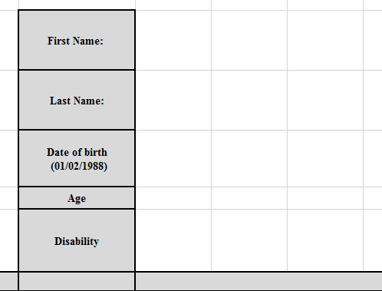
EMT DIRECTIONS
In the column to the right of the gray box fill in the child’s information.
1) First name
2) Last name
3) Date of Birth
4) Age
5) Disability
Enter the birthday using the format - 01/09/1998
Notes:
Next slide shows the ######## and the correct birthdate in upper left corner.

Slide 31
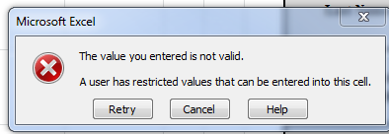
EMT DIRECTIONS
Each cell is a drop down menu and the only accepted entries are “+”, “-”, and in some cases “NA”.
If anything else is entered this message will pop up:

Slide 32
EMT DIRECTIONS
You will see the data automatically populate in the boxes to the right of the criteria.
You can move around the sheet with arrow keys or tab keys, but when entering data you must click “enter” after you enter “+” or “-” in the cell for it to log.

Slide 33
SAVE
Remember to save often.
Saving after every child’s file is a good guideline.
Remove EMT from flash drive and save it to your computer.

Slide 34
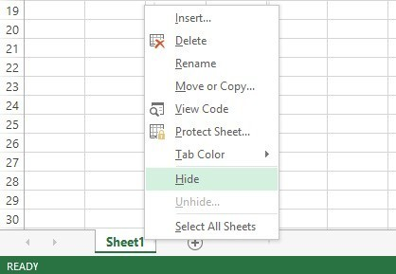
EMT DIRECTIONS
You can hide rows and columns.
Hover the cursor over the first column or row you want hidden and move to the last column or row you want hidden.
Right click and select “hide” on the menu.
You can unhide the same way.

Slide 35
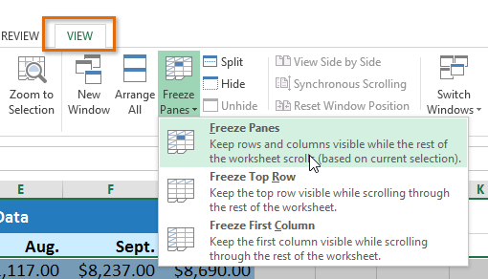
EMT DIRECTIONS
You can “freeze panes” to keep the Child Name column visible and allow the subsequent columns with the child’s information to scroll.
Click on column “I” (the first child’s information column)
Click on “view” in menu bar
Click on “freeze panes”
You can unfreeze panes with
the same process.

Slide 36
Practice EMT

Slide 37
SUBMISSION OF SELF-ASSESSMENT
Submit Self-Assessment (Excel EMT)
Along with the EMT, each district will submit to the Maine DOE:
5 submissions of evidence
IEP
WN
AWN
Files will be reviewed for accuracy and will be used to determine next steps

Slide 38
SELF-ASSESSMENT
Results will be utilized to determine if an On-Site Visit will occur.
An On-Site Visit will occur if:
evidence is submitted after Oct. 31, 2019
% of children with Multiple Disabilities is 2 SD above the national average
district’s LRE percentage is:
Regular class less than 40% (19.82% or higher)
Regular class more than 80% (30.31% or lower)

Slide 39
ON-SITE VISIT
DOE Monitoring Team will visit school district to:
verify children’s files from the self-assessment
sit down with staff to review files (encouraged, but not required)
visit special education programming within the school

Slide 40
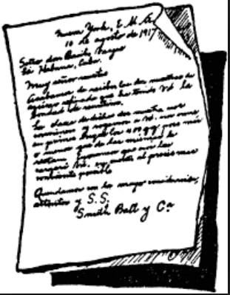
POST ON-SITE VISIT
Could include:
Identification of Pre-Findings (What are Pre-Findings?)
Guidance based on file review
Explanation and corrective action of DIB1s

Slide 41
TIMELINES
October 31st, 2019
Desk Audit
B-11 & Eligibility Forms
B-13 Screener
Self-Assessment including 5 submissions
October 31st-December 18th
DOE will review submissions
December 19th & 20th
DOE will make determinations about on-site visits

Slide 42
SUMMARY OF FINDINGS (SOF)
This is a summary of all findings (Desk Audit, Self-Assessment, and On-Site Visit).
The timeline for each SOF is unique to individual SAUs.
The SOF will be sent to the SAU upon completion of Desk Audit, On-Site Pre-Findings, and B13 submissions.

Slide 43
CORRECTIVE ACTION PLAN (CAP)
Will be sent to each SAU within 21 days of the date of the SOF.
Will identify areas of non-compliance and their corrective activities.
Closed within one year of the SOF.

Slide 44
SUBMISSION OF EVIDENCE
Please clearly label with EMT notation (ex. APG1).
Please organize by type of evidence (ex. Desk Audit, Pre-Findings, CAP, IDs, etc.).
Evidence can be submitted by email or snail mail.
monitoring.doe@maine.gov
Please NO faxes.

Slide 45
SUBMITTING DOCUMENTS
Evidence can be submitted by email to:
monitoring.doe@maine.gov
Evidence can be sent in the mail to:
Department of Education
Attn: Julie Pelletier
23 State House Station
Augusta, ME 04333-0023
Notes:
Roberta
This is not the self-assessment, recorded on the condensed electronic monitoring tool. The condensed EMT can only be submitted electronically. Meaning, you may email it, or download to a flash drive and deliver.

Slide 46
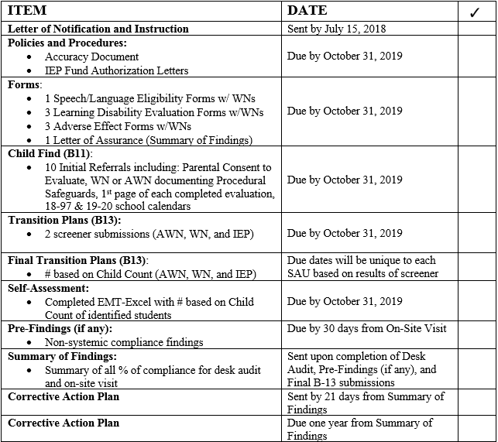
MONITORING TIMELINES (ONE PAGER)

Slide 47
SUMMARY OF FINDINGS (SOF)
This is a summary of all findings (Desk Audit, Self-Assessment, and On-Site Visit).
The timeline for each SOF is unique to individual SAUs.
The SOF will be sent to the SAU upon completion of Desk Audit, On-Site Pre-Findings, and B13 submissions.

Slide 48
CORRECTIVE ACTION PLAN (CAP)
Will be sent to each SAU within 21 days of the date of the SOF.
Will identify areas of non-compliance and their corrective activities.
Closed within one year of the SOF.

Slide 49
SUBMISSION OF EVIDENCE
Please clearly label with EMT notation (ex. APG1).
Please organize by type of evidence (ex. Desk Audit, Pre-Findings, CAP, IDs, etc.).
Evidence can be submitted by email or snail mail.
monitoring.doe@maine.gov
Please NO faxes.

Slide 50
SUBMITTING DOCUMENTS
Evidence can be submitted by email to:
monitoring.doe@maine.gov
Evidence can be sent in the mail to:
Department of Education
Attn: Julie Pelletier
23 State House Station
Augusta, ME 04333-0023
Notes:
Roberta
This is not the self-assessment, recorded on the condensed electronic monitoring tool. The condensed EMT can only be submitted electronically. Meaning, you may email it, or download to a flash drive and deliver.

Slide 51
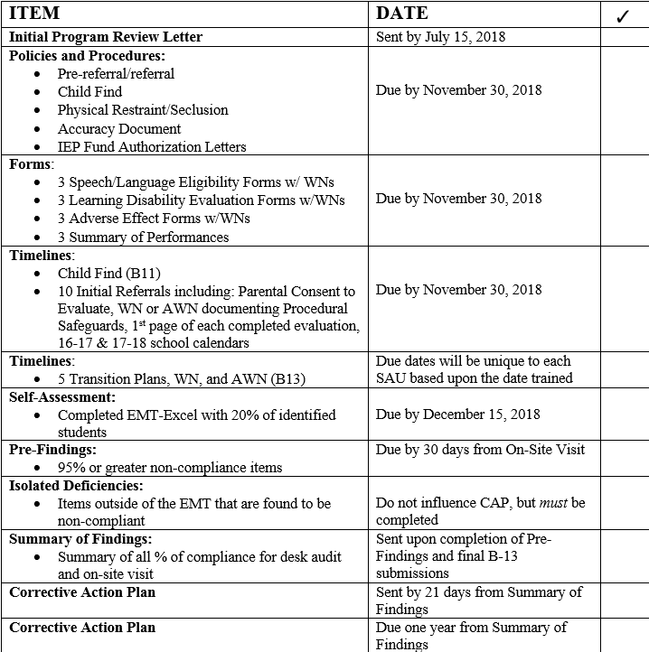
MONITORING TIMELINE

Slide 53
Contact Information
Dr. Roberta Lucas – Federal Programs Coordinator
roberta.lucas@maine.gov
Dan Hemdal – Educational Specialist III
daniel.hemdal@maine.gov
Leora Byras – Educational Specialist II
leora.byras@maine.gov
Colette Sullivan – Educational Specialist II
colette.soldati@maine.gov
Julie Pelletier – Secretary Associate
julie.pelletier@maine.gov

