Slide 1
How Best To Support Educators with Certification
June 8, 2022

Slide 2

Welcome - Introductions / Webinar Series
May 18 – How Did We Get Here?
May 25 – Overview of Chapter 115 Changes
June 8 @ 5PM – How to Best Support Educators with Certification

Slide 3


Agenda
AGENDA
Evaluation Letters
What do I apply for?
Course pre-approval
Ed Tech Upgrades
Processing Time
Best Practices

Slide 4
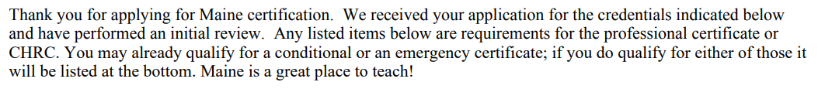
Evaluation Letters
What is it?
Access to evaluation letters
What generates a letter?
  Why did this educator receive multiple letters?
  Why is the letter wrong?
  Why do I have a new requirement on the most recent letter?
Examples

Slide 5
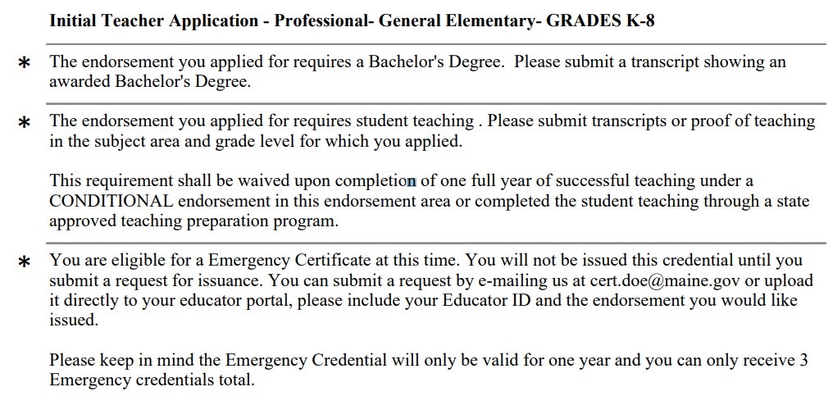
Evaluation Letters
Please note: These are current letters based off current regulations as of 6/8/22, used as examples

Slide 6
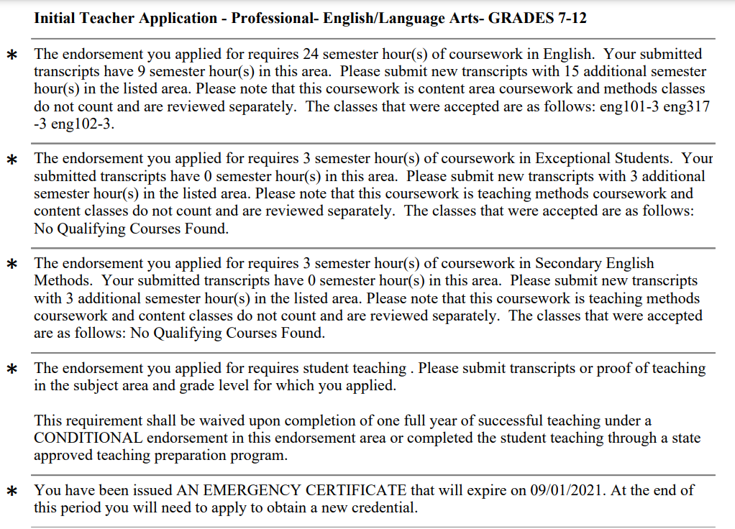
Evaluation Letters
Please note: These are current letters based off current regulations as of 6/8/22, used as examples

Slide 7
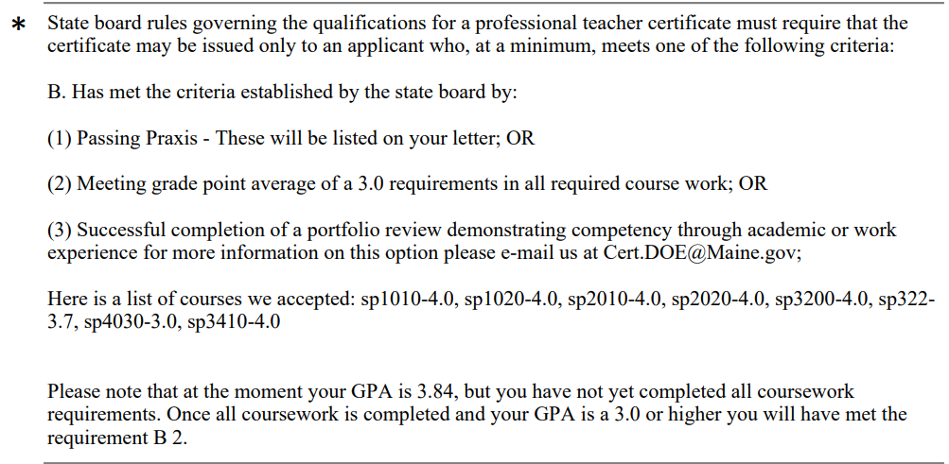
Evaluation Letters
Please note: These are current letters based off current regulations as of 6/8/22, used as examples

Slide 8
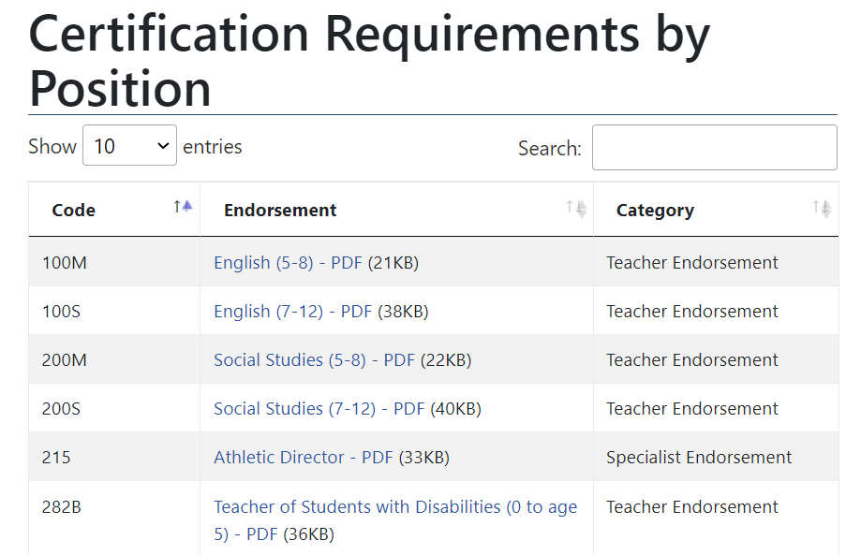
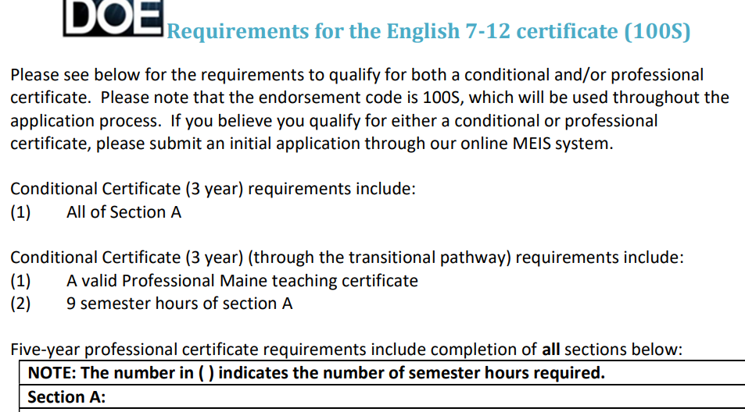
What do I apply for?
One application per endorsement, not separate for different certificates (Prof., cond., Ed Tech, etc.)
Qualifications vs. wants – preparing for success
Leveraging certification website - https://www.maine.gov/doe/cert/requirements

Slide 9

Course Preapproval
Authority: Maine DOE Certification Office
How: Email us at cert.doe@maine.gov
What: Include course title and course descriptions

Slide 10

Ed Tech Upgrades
Ed Tech I – diploma or GED
Ed Tech II – 60 sem. hours, 900 professional development training/contact hours, or a combination of the two
Ed Tech III – 90 sem. hours, 1,350 professional development training/contact hours, or a combination of the two
Notes:
A new application is required for upgrade
Please encourage applicants to track their own hours on tracking spreadsheet found on website
Please do not submit one contact hour a day, every day

Slide 11
Processing Time
Amount of re-opened applications
Amount of communications
Ease of use regulations
Processing Time
ME – 6 weeks
VT – 6-12 weeks
CA – 10 weeks
RI – 4-16 weeks
NH – 12 weeks
FL – 14-20 weeks
WI – 6-12 weeks
NY – 16 weeks
PA – 10 weeks
AZ – 6 weeks
CT – 8-12 weeks
Notes:
CA – five weeks
NH – 12 weeks
Rhode Island – 4 to 16 weeks
VT – 6-12 weeks

Slide 12

Best Practices – Help us Help You
Communications
Local application packets
Website as a resource
Submitting all documents at one time
Planning
Why Best Practices are so important
2021 Year in Review
22,281 Initial Apps
10,505 Renewals

Slide 13
Questions / Webinar Series
Please help us by keeping your questions broad, those that might help others, rather than specifics about an individual application or circumstance...

