Slide 1
New Rule Chapter 115: How Did We Get Here?
May 18, 2022

Slide 2
Welcome - Introductions / Webinar Series
May 18 @ 5PM – How Did We Get Here?
May 25 @ 5PM – Overview of Chapter 115 Changes
June 8 @ 5PM – How to Best Support Educators

Slide 3
Agenda
AGENDA
What is the rule?
Why was a new version necessary?
Who was involved ?
When does it become effective?
Staying up to date

Slide 4
What is it?
Chapter 115 – The Credentialling of Education Personnel is a major substantive rule of the State Board of Education
There are two parts: Part I includes overarching requirements, Part II includes specific requirements
The new rule was impacted by legislation in the 130th Session including primarily:
LD 1189 (statute changes necessary for the rule, element of choice for applicants)
LD 1933 (Resolve, requiring changes)

Slide 5
Why was a new version necessary?
The Maine Department of Education partnered with the State Board of Education to create a rule that balances the expectation for well-qualified individuals with the desire for a robust (i.e., skilled, diverse, compassionate, engaged, inspiring, motivating, caring) educator workforce
Our priorities: Make the rule clear, simple, flexible

Slide 6
Who was involved?
Maine Department of Education
Maine State Board of Education
Consensus-based Rulemaking Committee
Professional Standards Board
Education and Cultural Affairs Committee
The public

Slide 7
How does the process work?
Professional Standards Board annual recommendations
State Board certification committee decides if changes are needed
DOE works with both for drafting, editing, process, communication
State Board committee presents draft language for public comment
Changes may be added to draft based on comments
State Board committee votes to bring draft 115 to full State Board of Education
State Board of Education votes to submit draft legislation
Education and Cultural Affairs Committee is assigned LD
Legislative Public Hearing and Work Session(s) are held

Slide 8
How does the Process Work?
If Committee votes “Ought to Pass”, bill must make it through house, senate and appropriations
Proposed document is then sent back to State Board of Education for review and final vote
If State Board votes to adopt final version of Ch. 115, it is then filed with the Sec. of State
New regulations become effective 30 days after filing
Implementation to field

Slide 9
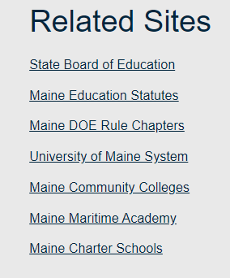
When does it become effective?
New rule was adopted by the State Board
New rule is effective June 11
All DOE-related statutes and regulations can be found on our website here:

Slide 10
How can I stay informed?
Awareness
Sign up for our newsletters
Follow us on social media

Slide 11
Keys to Remember
The certificate(s) you now have, you can always renew. Just don’t let them lapse.
New regulations will go into effect June 11, 2022.
The certification team is hard at work making all necessary changes, including changes to the website.
If you don’t find your answers on the certification page, the best way to reach us is by email at cert.doe@maine.gov
www.maine.gov/doe/cert

Slide 12
Don't forget our next sessions -
May 25 @ 5PM – Overview of Chapter 115 Changes
June 8 @ 5PM – How to Best Support Educators

