Slide 1
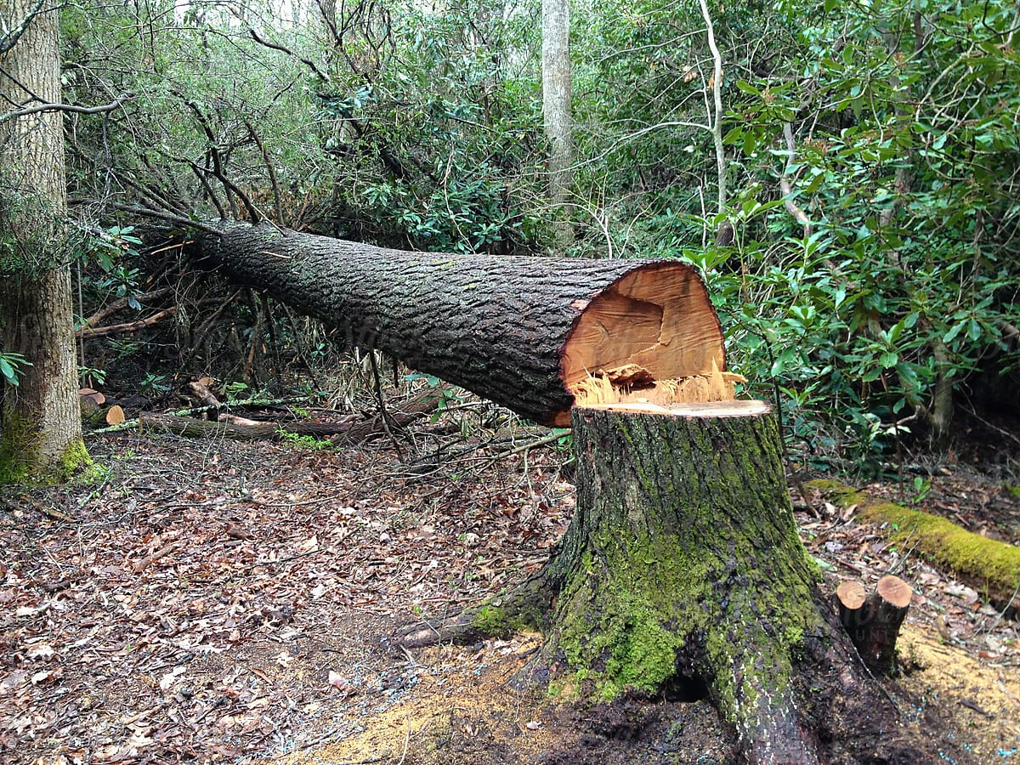
A Cut Down Tree

Slide 2
Jack and Beth went in the woods
To chat and play together.
They had a shock,
They heard chop, chop,
A tree went thud! A disaster!

Slide 3
Quick, they went to save the tree,
No luck, the big tree was down.
They sat on the log,
With the woodchopper too,
And Jack made a big, sad frown.

Slide 4
“Please do not chop,
We love the trees!
Instead, let’s plant some seeds!”

