Slide 1
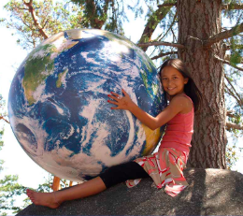
Have a Ball
by Joe Mohr

Slide 2
When I was born I was given a ball.
The ball was green and blue.
My mom said, “Share,
and take good care,
it belongs to others, too.

Slide 3
Keep it clean.
Keep the green parts green.
Try to make the blue parts bluer.
If you love this ball,
it will never grow old.
In fact, it may grow newer.”

Slide 4
So I did all that.
And I did some more,
‘Cuz I love this ball a lot.
And I hope that you will love it too…
It’s the only ball we’ve got.

