Slide 1
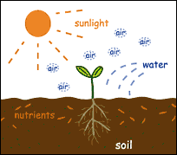
A Seed Needs

Slide 2
I see you are a seed!
Please tell me what you need.

Slide 3
First I need dirt to grow,
Then I need the sun to glow.
Water to make me wet,
Air for my leaves to get.
Room for my roots to spread
Into my soil bed.
After a while you will see,
A plant I shall be!

