Slide 1
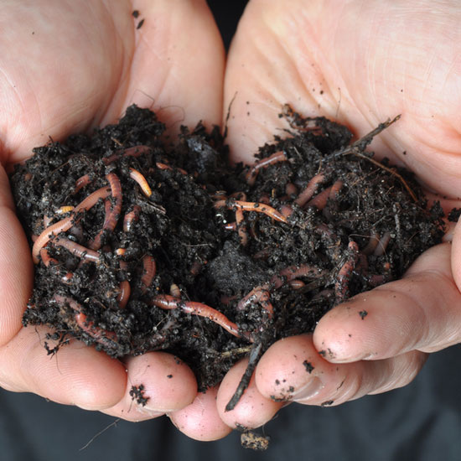
Worms

Slide 2
Fat worms, thin worms,
Long worms, too,
See them wiggle,
That’s what they do.

Slide 3
Dig and dig in the wet, dark soil,
They all like to work and toil.
Fat worms, thin worms,
Long worms, too,
See them wiggle,
That’s what they do.

