Slide 1
Reduce, Reuse, Recycle

Slide 2
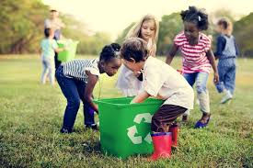
Reduce, reuse, recycle,
that's what we must do.
We need to save or fix the Earth.
It's up to me and you!

Slide 3
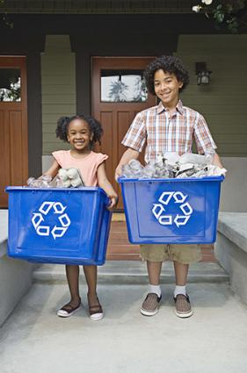
We all can do a little
to help our Earth feel good.
We can save the planet
right from our neighborhood!

