Slide 1
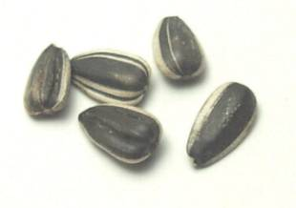
Five Little Seeds

Slide 2
Five little seeds,
What will they be?
Under the land,
Under rocks and sand,
Five little seeds,
Wait patiently!

Slide 3
The sun fills the sky,
Rain drips from high,
Roots grow into the ground,
Stems grow upward bound!

Slide 4
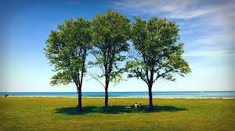
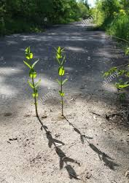
Five little seeds,
What will they be?
Three will make trees,
And two will make weeds,
That’s what the seeds will be!

