Slide 1
Unit 4 Mid-Unit Assessment
The Gift of the Tree and The Great Kapok Tree
Unit 4, Week 5

Slide 2
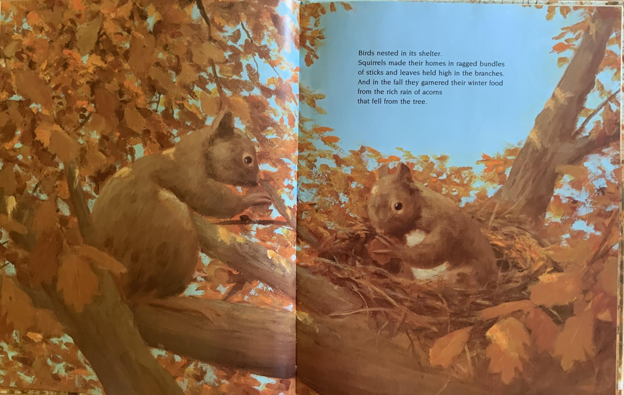

3

Slide 3
How does the squirrel depend on the tree to survive?
Use details from the illustration to support your ideas.

Slide 4
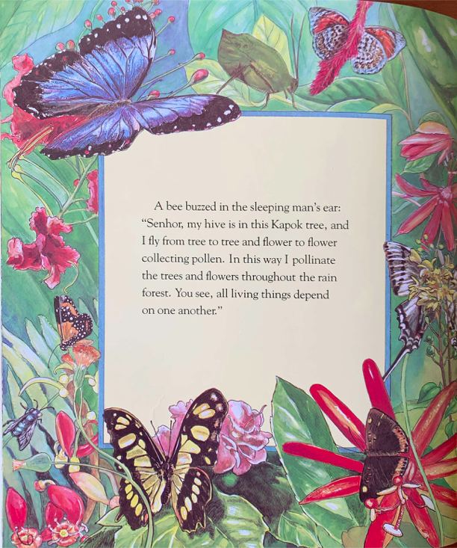
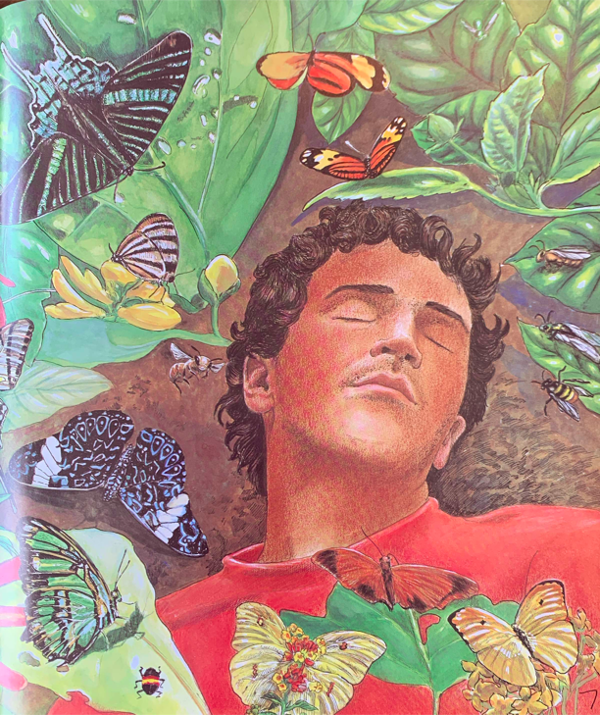

Slide 5
2. How does the bee depend on the tree?
3. How do bees and other insects help trees and flowers?
Use details from the words and illustrations to support your ideas for both questions.

