Slide 1
Unit 4 End of Unit Assessment
Excerpts from
Cristal Martinez: Caretaker of Our Earth
Unit 4, Week 8

Slide 2
Listen to the words, and look closely at the photograph.

Slide 3
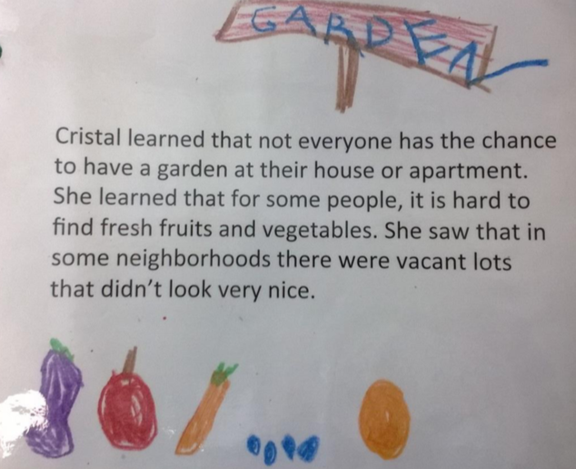

Slide 4
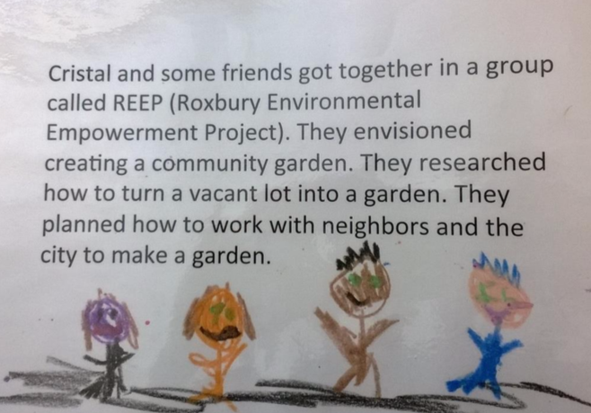

Slide 5
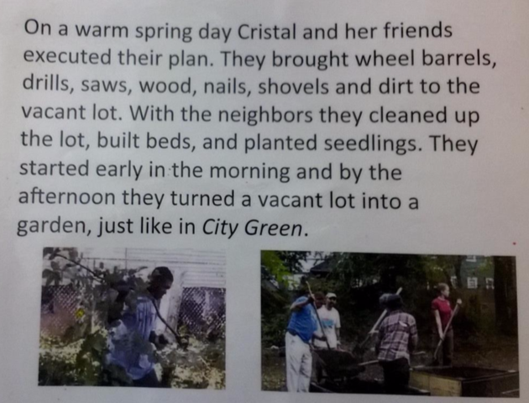

Slide 6
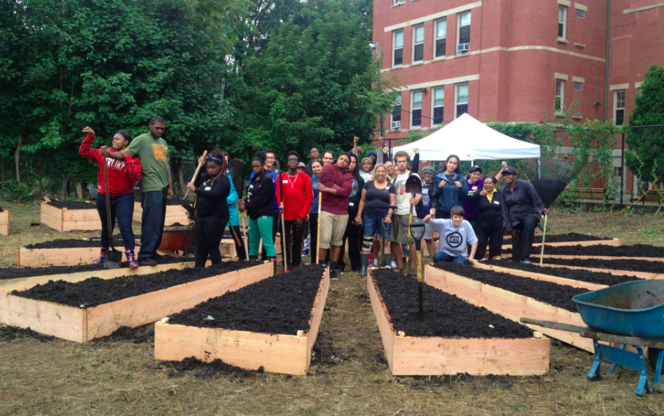

Slide 7
What steps did Cristal and her friends take to turn a vacant lot into a garden?
Use at least two details from the text.
How did Cristal and her friends work together to be Caretakers of the Earth?

