Slide 1
Talk Time
Unit 4, Week 8

Slide 2
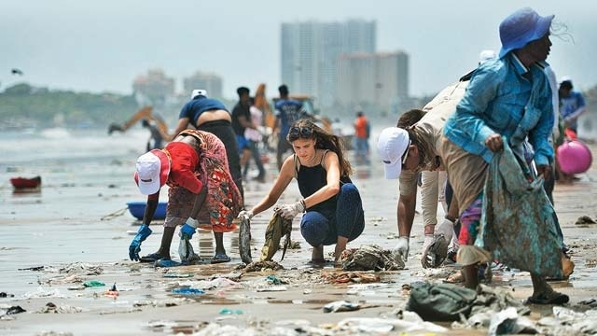
https://www.dnaindia.com/mumbai/report-speak-up-setting-a-precedent-for-beach-clean-up-drives-2461663
Notes:
What are these people doing?
Why is it important for people and other animals?

