Slide 1
Talk Time
Unit 4, Week 7

Slide 2
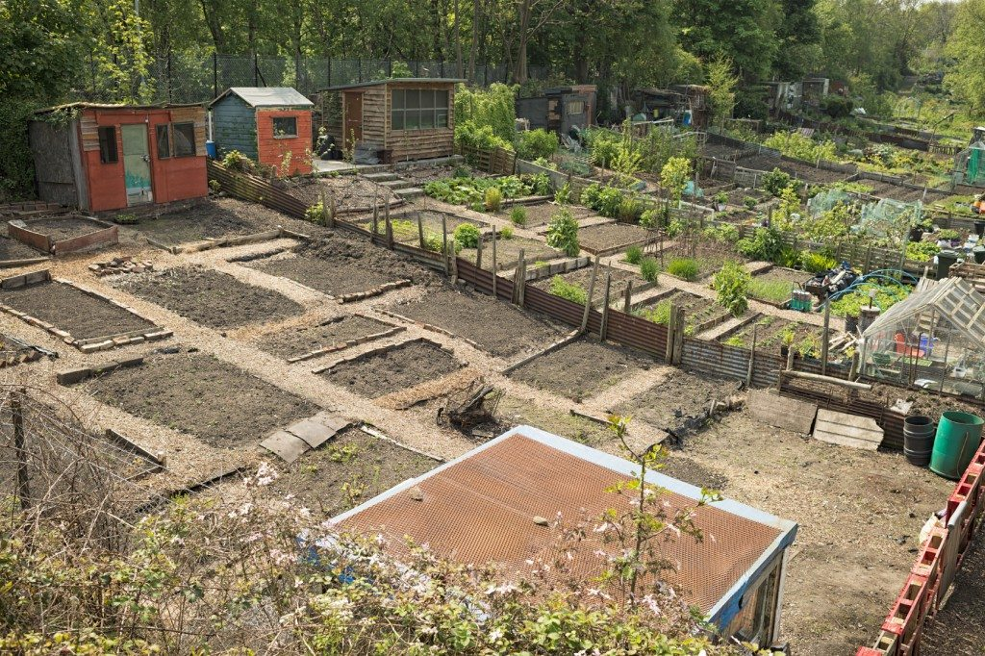
https://www.gardeningknowhow.com/special/urban/vacant-lot-gardening.htm
Notes:
What has already happened to turn this city lot into a garden?
What might need to happen next?

