Slide 1
Talk Time
Unit 4, Week 5

Slide 2
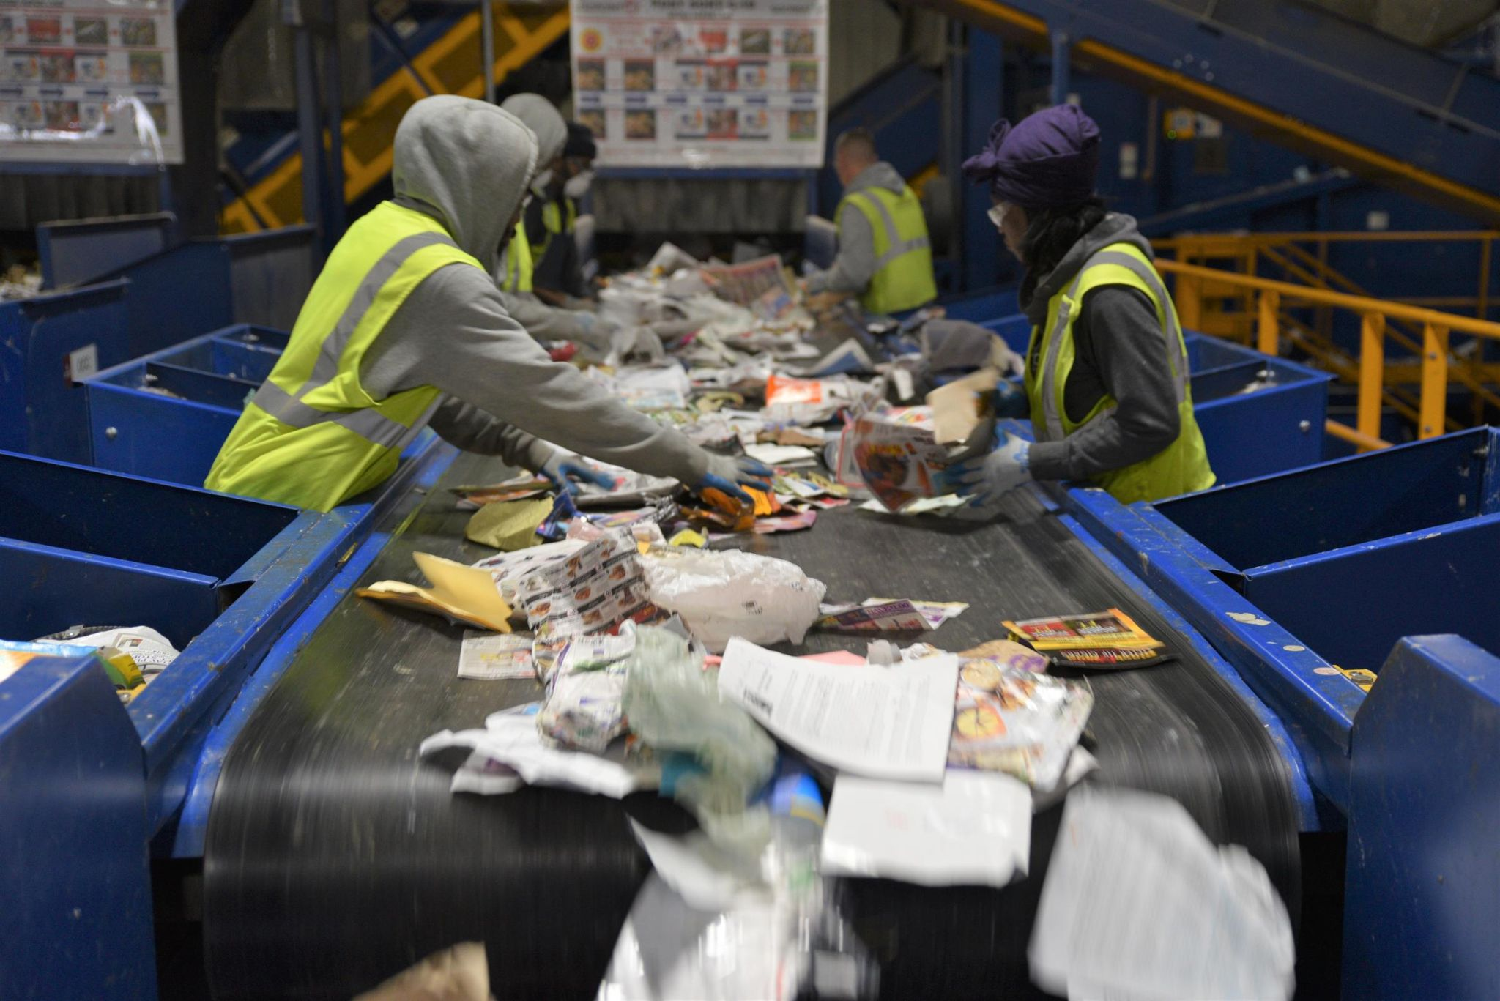
https://www.michiganradio.org/post/some-michigan-cities-may-abandon-recycling-due-higher-costs
Notes:
What is going on in this picture?
What questions would you like to ask these workers?

