Slide 1
Talk Time
Unit 4, Week 4

Slide 2
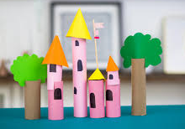
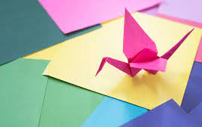
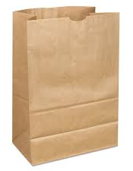
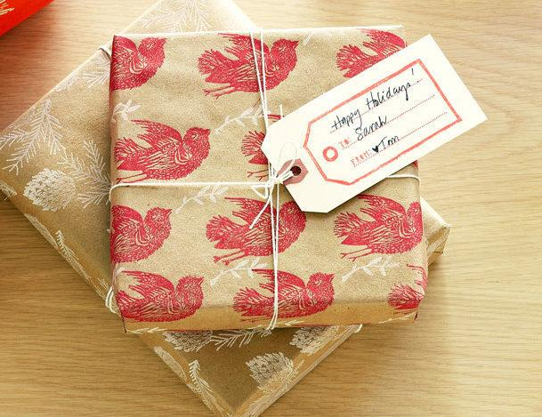
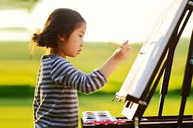
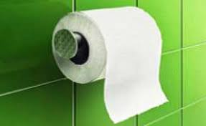
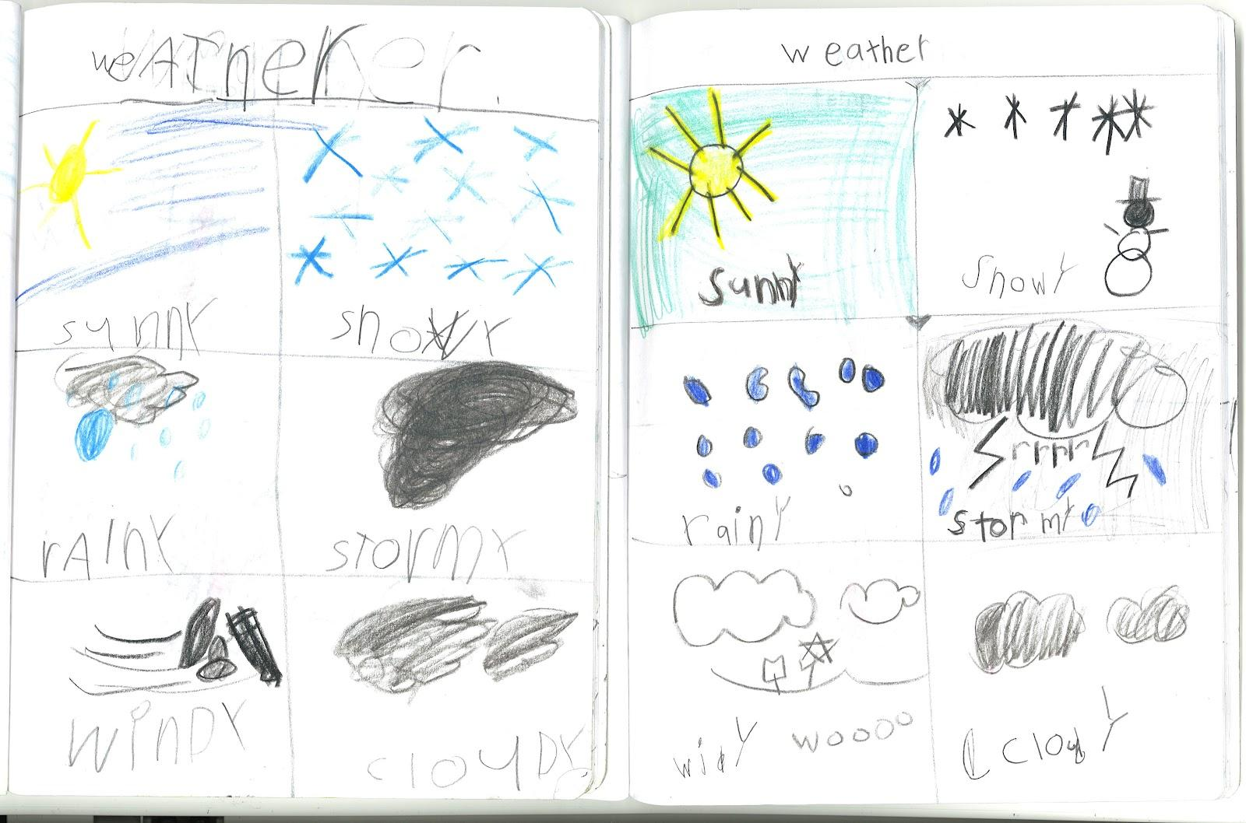
5 Kids Crafts Using Paper Towel Rolls, Behind the label: Recycled Toilet Tissue, Science Notebook Week - Friday, Top 10 Origami Projects for Beginners, Kids' Art Easels for All Ages | LoveToKnow, Sustainable Gift Wrap Ideas for the Holidays
Notes:
How is paper used in these pictures?
What are some other ways you can think of to use paper?

