Slide 1
Talk Time
Unit 4, Week 3

Slide 2
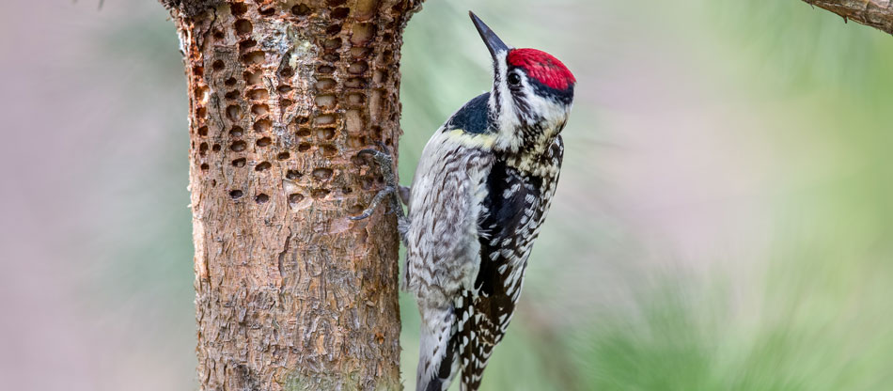
https://organicplantcarellc.com/why-are-woodpeckers-making-holes-in-my-trees/#:~:text=Why%20do%20woodpeckers%20drill%20into,the%20surface%20of%20tree%20bark.
Notes:
What do you know about how woodpeckers use trees?
What would you like to find out?

