Slide 1
Talk Time
Unit 4, Week 2

Slide 2
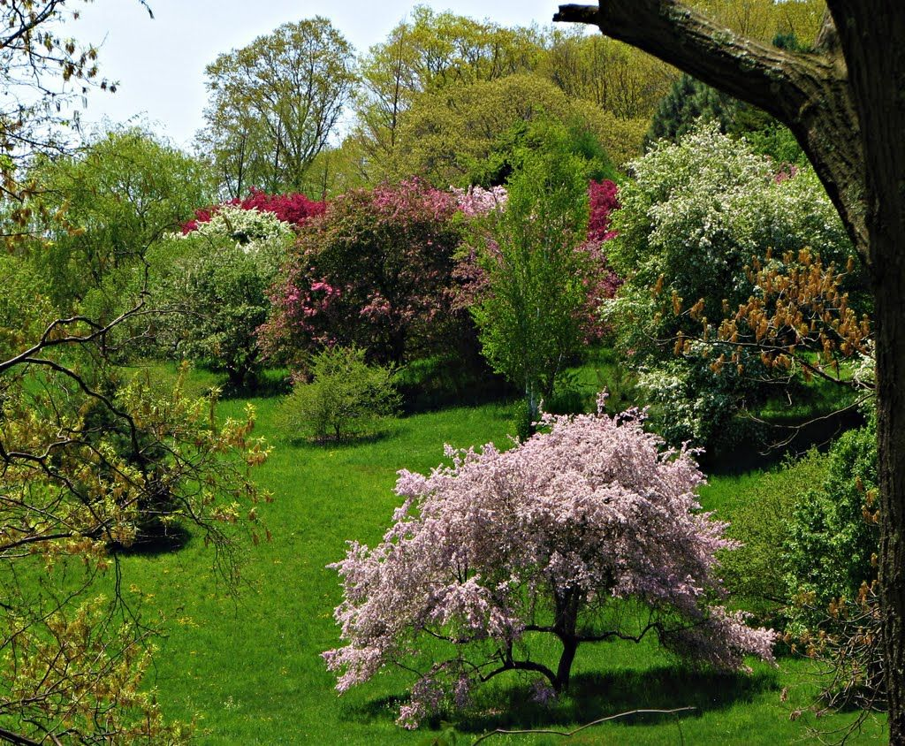
https://www.pinterest.com/pin/460070918163907920/
Notes:
The Arnold Arboretum is a tree museum in Boston.
Why would a city have a tree museum?
What season does this photo show? How do you know?

