Slide 1
Talk Time
Unit 4, Week 1

Slide 2
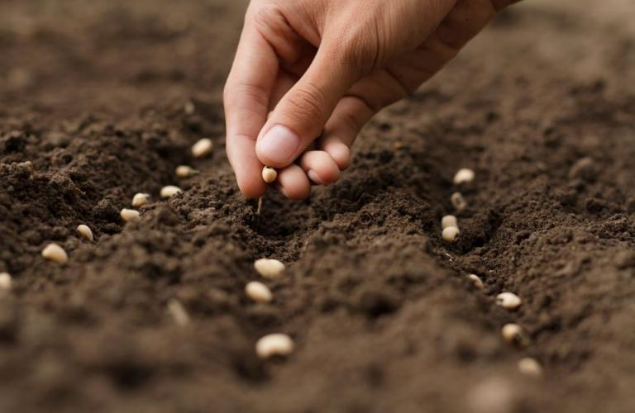
https://ccs.in/does-seeds-bill-2019-undermine-farmers-rights
Notes:
What do you notice?
What do you think the farmer will do next?
What will the seeds need to grow?

