Slide 1
Rainbow Fish, Red Frog
Writing Unit 3 Week 8 Day 2

Slide 2
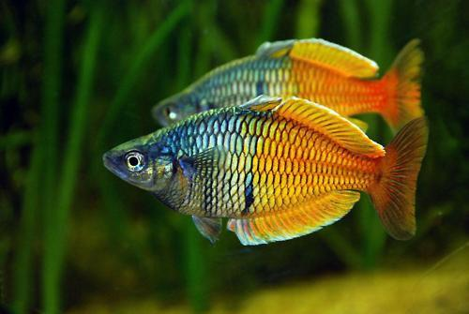
One fish, two fish
There go the rainbow fish
Racing through seaweed.

Slide 3
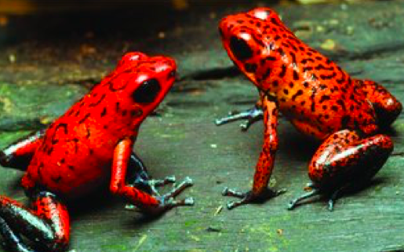
One frog, two frogs
Ruby-red, ribbiting frogs
Resting on a red, rough log.

Slide 4
Rainbow Fish, Red Frog
One fish, two fish
There go the rainbow fish
Racing through seaweed
One frog, two frogs
Ruby-red ribbiting frogs
Rest on a red, rough, log

