Slide 1
“Things”
by Eloise Greenfield
Writing Unit 3 Week 7 Day 3

Slide 2
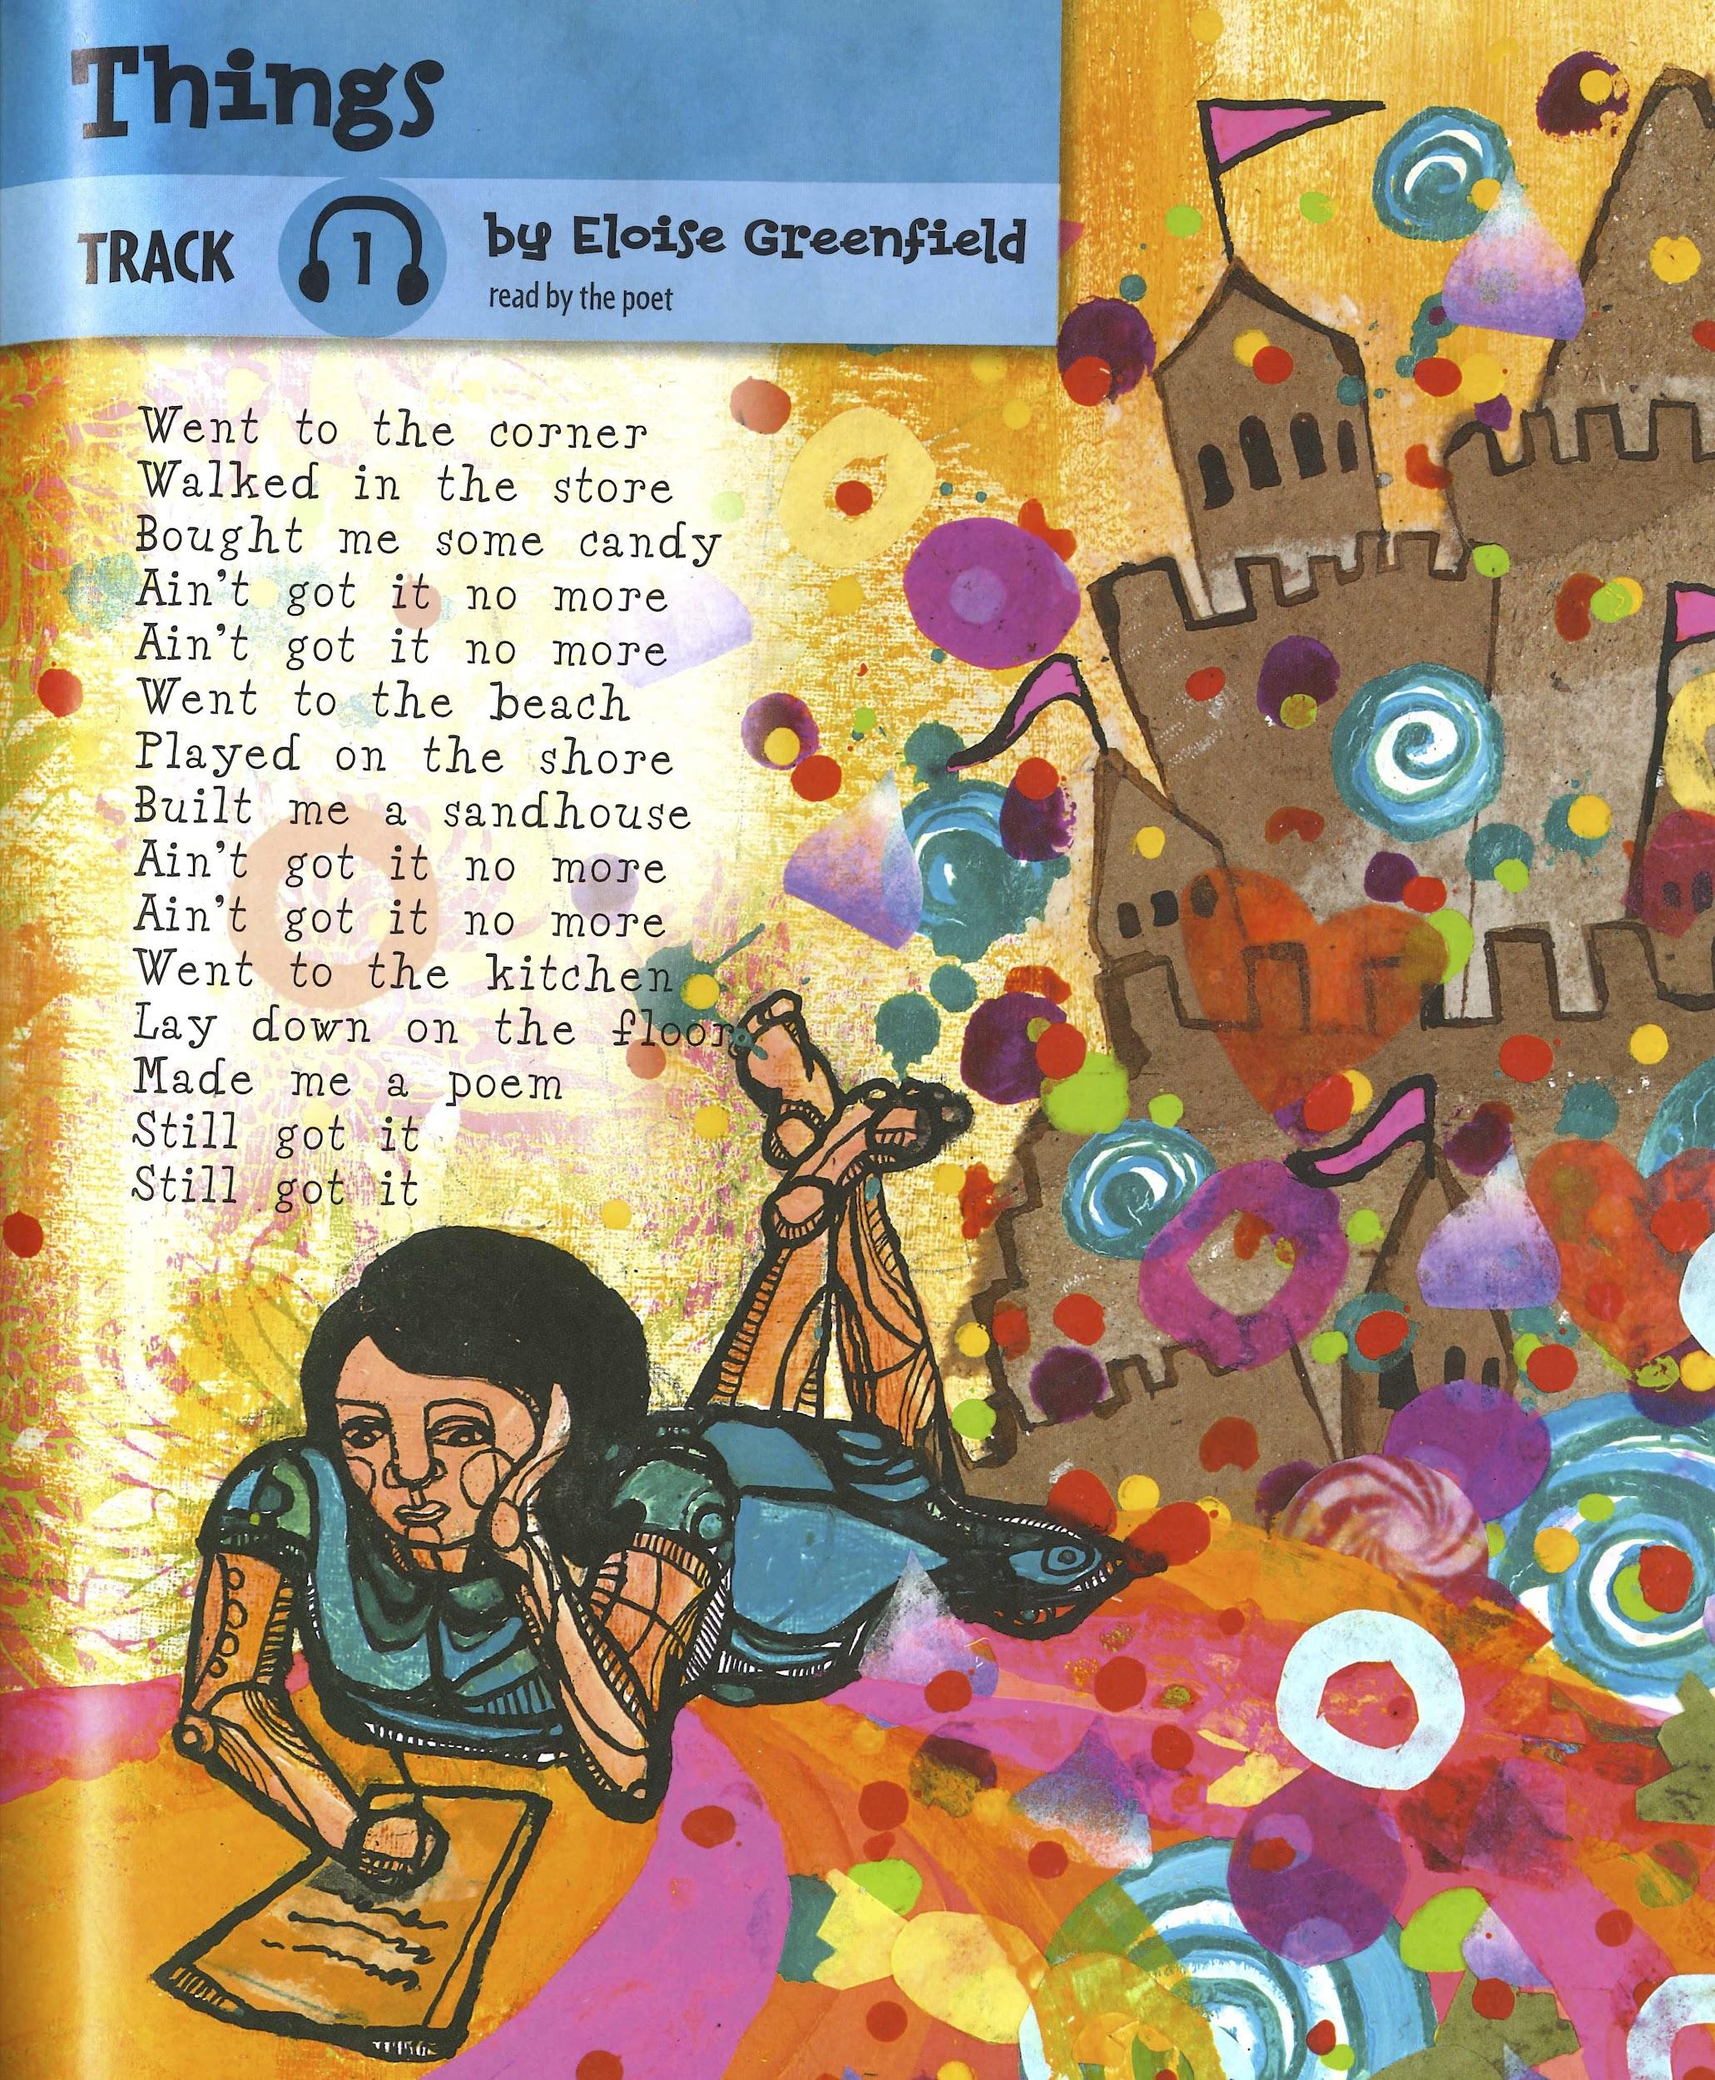

Slide 3
Things
by Eloise Greenfield
Went to the corner
Walked in the store
Bought me some candy
Ain’t got it no more
Ain’t got it no more

Slide 4
Went to the beach
Played on the shore
Built me a sandhouse
Ain’t got it no more
Ain’t got it no more

Slide 5
Went to the kitchen
Lay down on the floor
Made me a poem
Still got it
Still got it

Slide 6
Things
by Eloise Greenfield
Went to the corner
Walked in the store
Bought me some candy
Ain’t got it no more
Ain’t got it no more
Went to the beach
Played on the shore
Built me a sandhouse
Ain’t got it no more
Ain’t got it no more
Went to the kitchen
Lay down on the floor
Made me a poem
Still got it
Still got it

Slide 7
Ain’t got it no more
Ain’t got it no more
Still got it
Still got it

