Slide 1
“Good Luck Gold”
by Janet S. Wong
Writing Unit 3 Week 7 Day 2

Slide 2
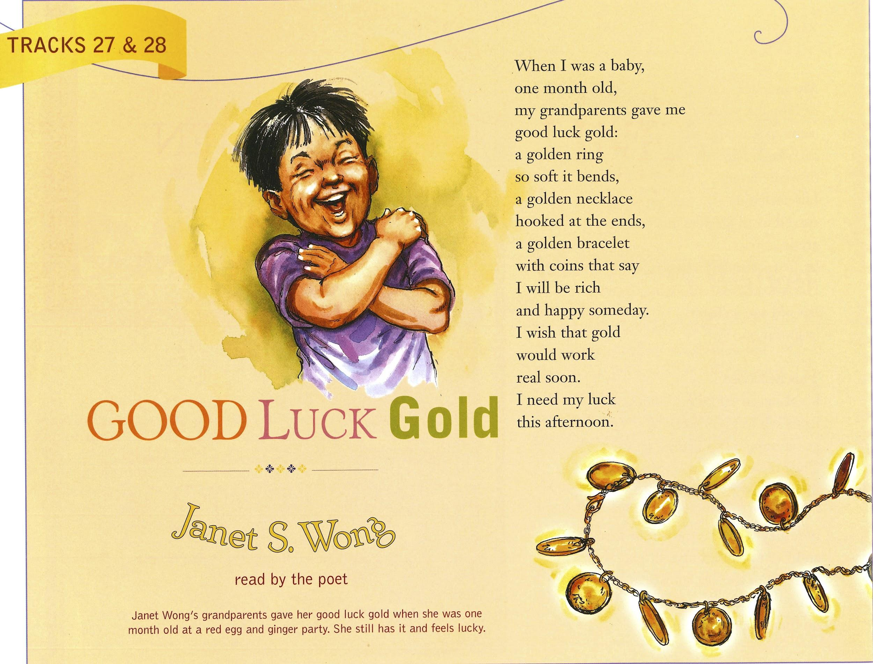

Slide 3
Good Luck Gold
by Janet S. Wong
When I was a baby,
one month old,
my grandparents gave me
good luck gold:
a golden ring
so soft it bends,
a golden necklace
hooked at the ends.
a golden bracelet
with coins that say
I will be rich
and happy someday.
I wish that gold
would work
real soon.
I need my luck
this afternoon.

Slide 4

Click this one.
Then this one.

Slide 5
Good Luck Gold
by Janet S. Wong
When I was a baby,
one month old,
my grandparents gave me
good luck gold:
a golden ring
so soft it bends,
a golden necklace
hooked at the ends.
a golden bracelet
with coins that say
I will be rich
and happy someday.
I wish that gold
would work
real soon.
I need my luck
this afternoon.

