Slide 1
Sample Posters
Writing Week 6, Day 4

Slide 2

Slide 1
https://www.flickr.com/photos/usfsregion5/7699041718

Slide 3
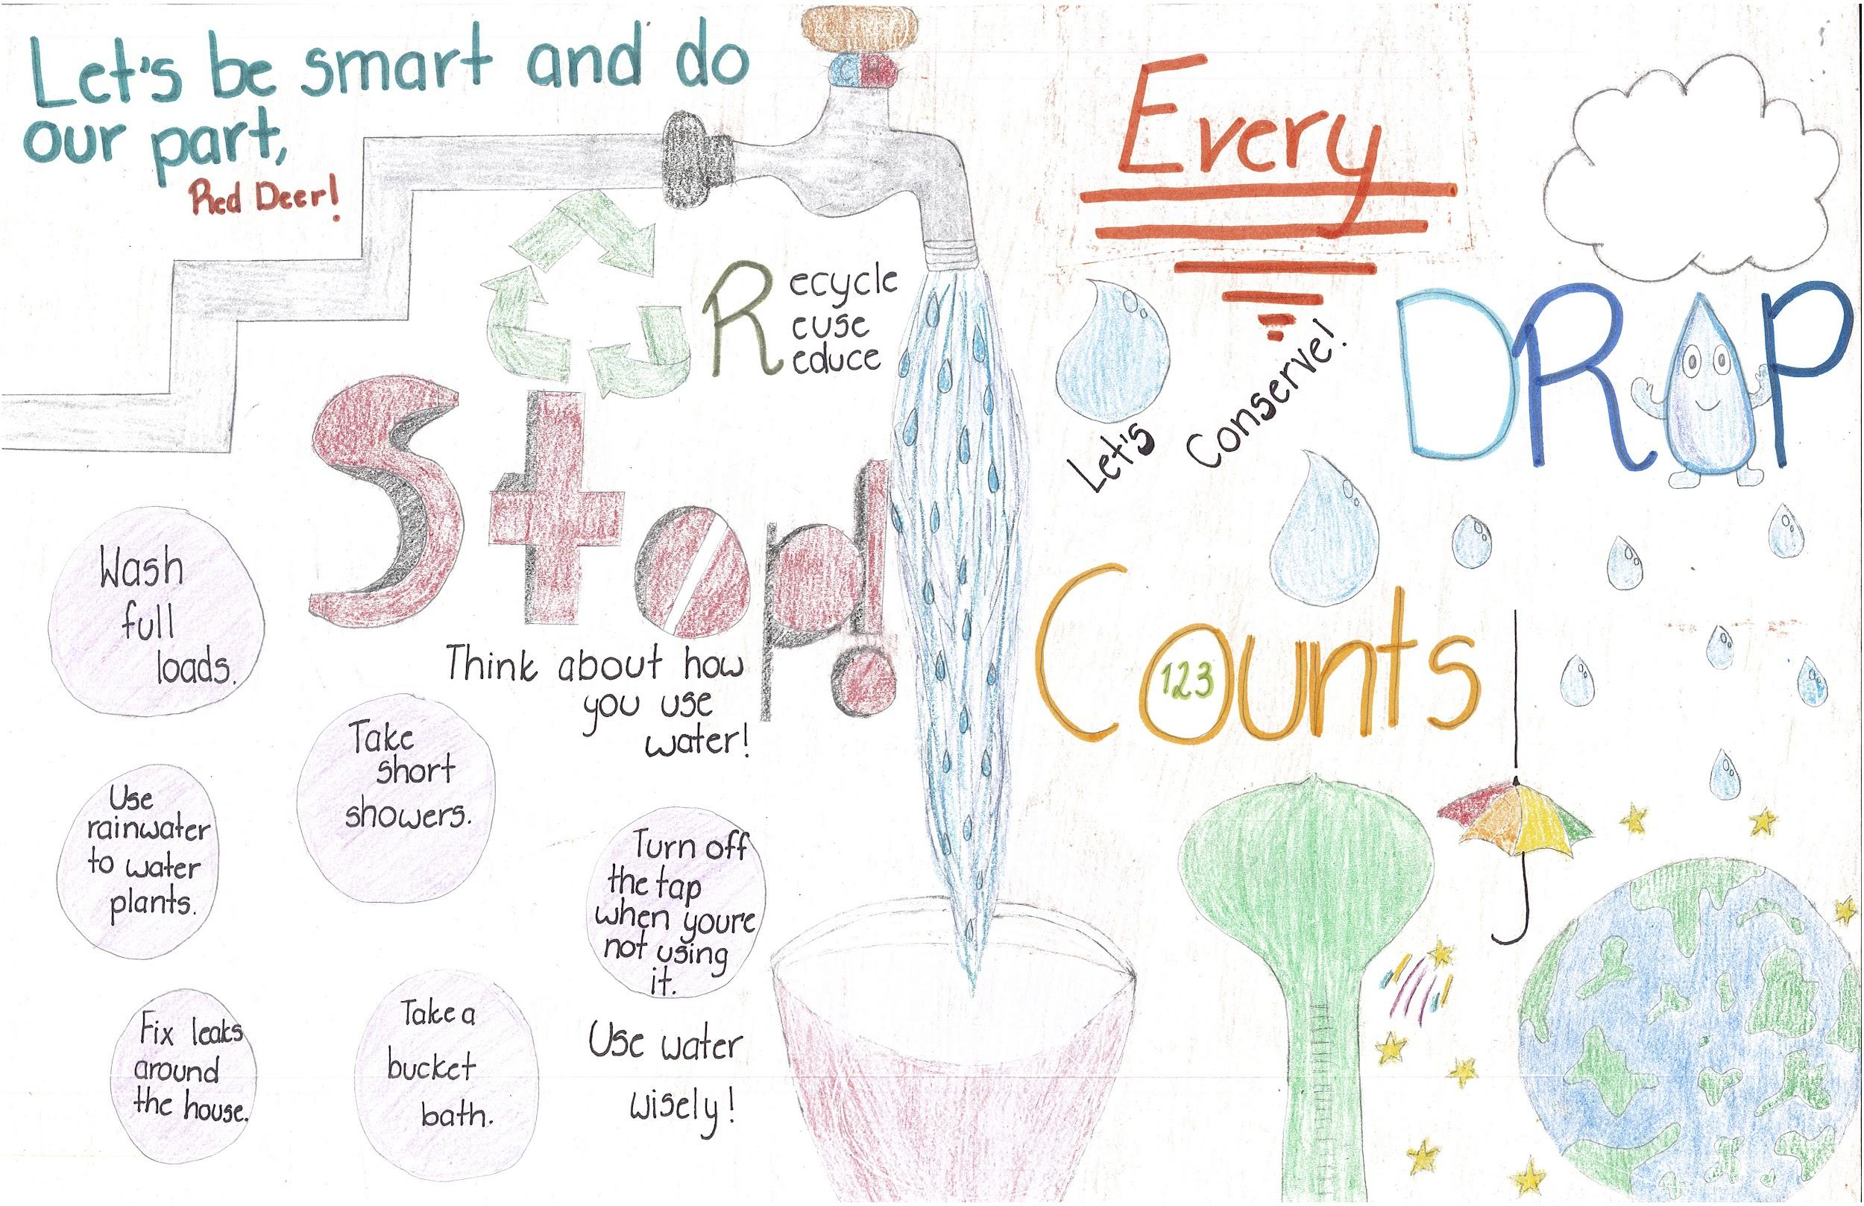
Slide 2
http://www.reddeer.ca/city-services/environment-and-conservation/your-school/poster-contest/2018-poster-contest/

Slide 4

Slide 3
https://www.flickr.com/photos/upsuportsmouth/4603115077

Slide 5

Slide 4
https://www.flickr.com/photos/usepagov/15820074441

