Slide 1
Library & Listening
Unit 4, Week 6

Slide 2
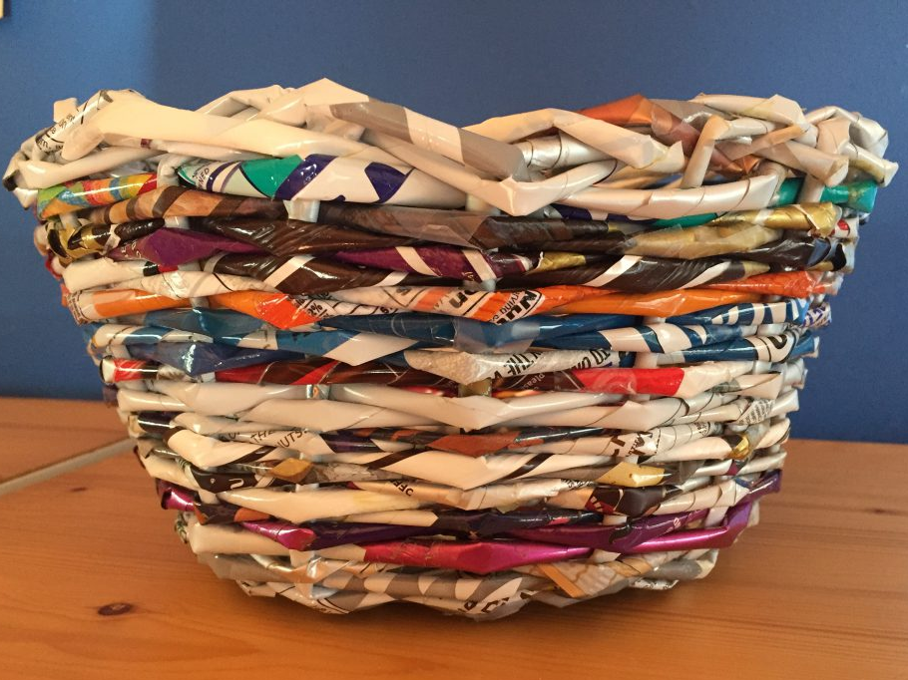
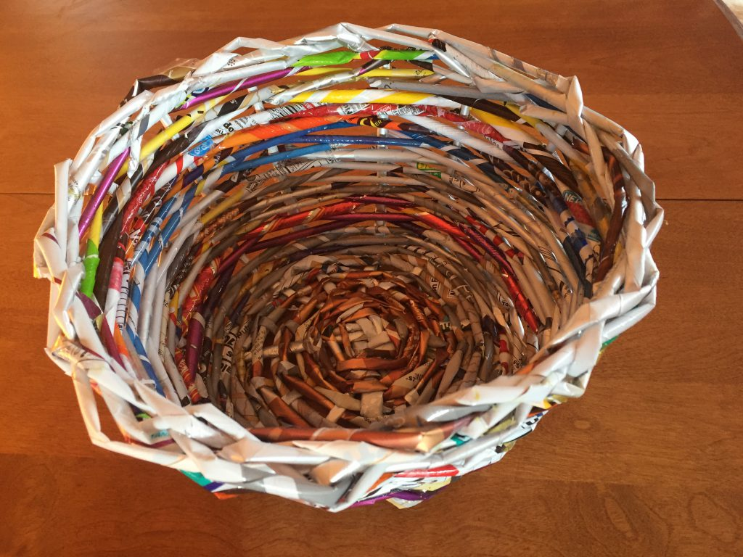
Basket made with plastic bags
https://stabletableandcrafts.com/basket-weaving-with-plastic-bags-instructions/

Slide 3
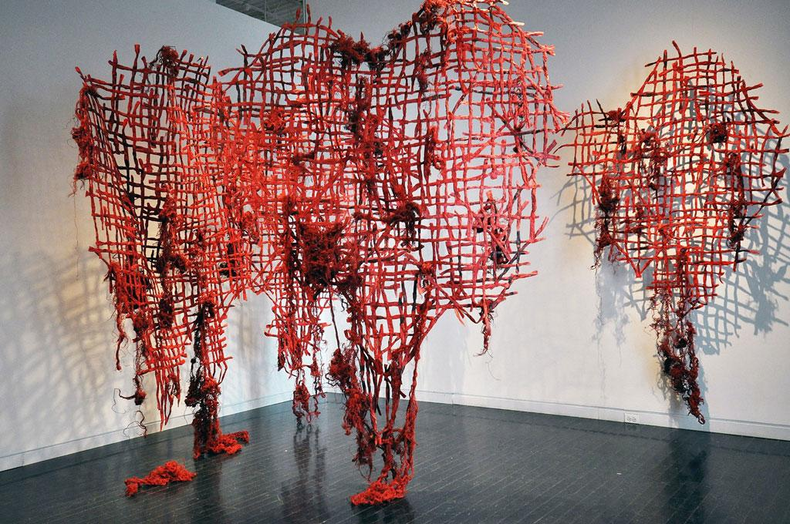
Nnenna Okore
Wall weaving with recycled materials
http://www.dreamideamachine.com/en/?p=57378

Slide 4
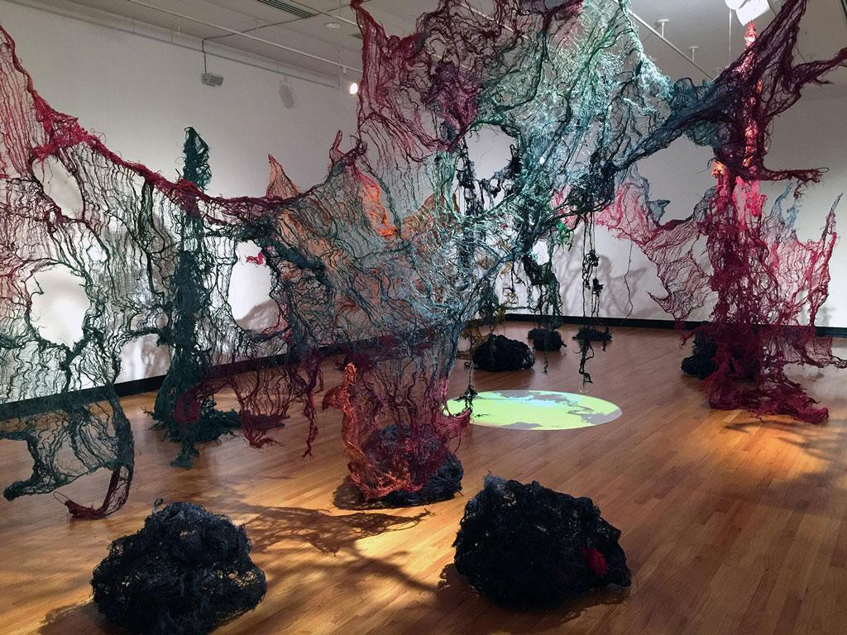
Nnenna Okore
Weaving with recycled materials
(see website below for more of Nenna’s work)
http://www.dreamideamachine.com/en/?p=57378

Slide 5
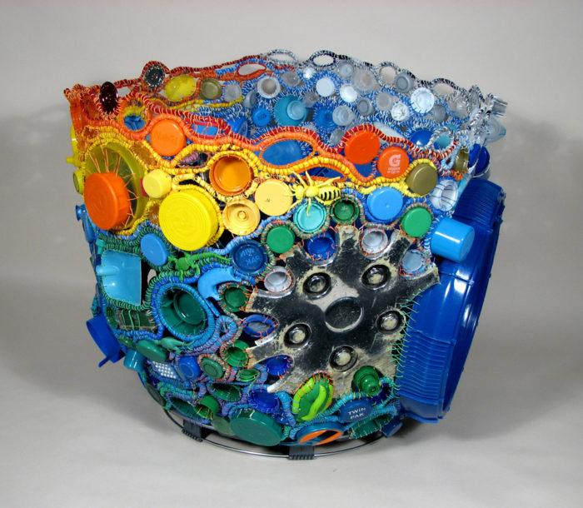
Julie Kornblum
Basket woven with recycled materials
https://www.rayela.com/?team=julie-kornblum-studio

Slide 6
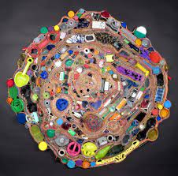
Julie Kornblum
Weaving with recycled materials
(see website below for more of Julie’s work)
https://nationalbasketry.org/julie-kornblum/

Slide 7
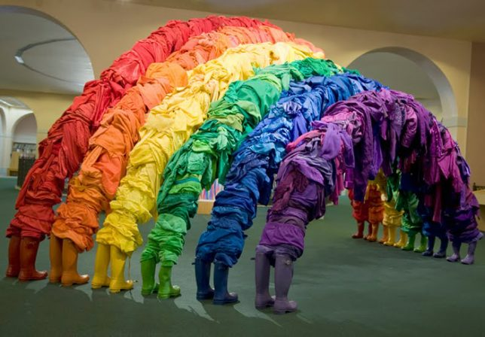
Alain Guerra and Neraldo de la Paz
Indradhanush
Made with recycled clothing
(see website below for more of Guerra & De la Paz’s work)
https://westharlem.art/2016/08/12/guerra-de-la-paz-installations/

Slide 8
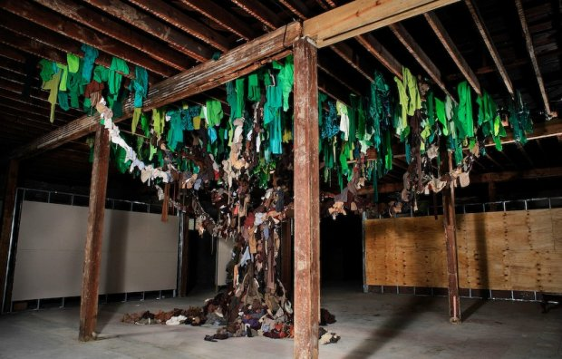
Alain Guerra and Neraldo de la Paz
Made with recycled clothing
(see website below for more of Guerra & De la Paz’s work)
https://blog.artsper.com/en/get-inspired/top-10-of-recycled-art/

Slide 9
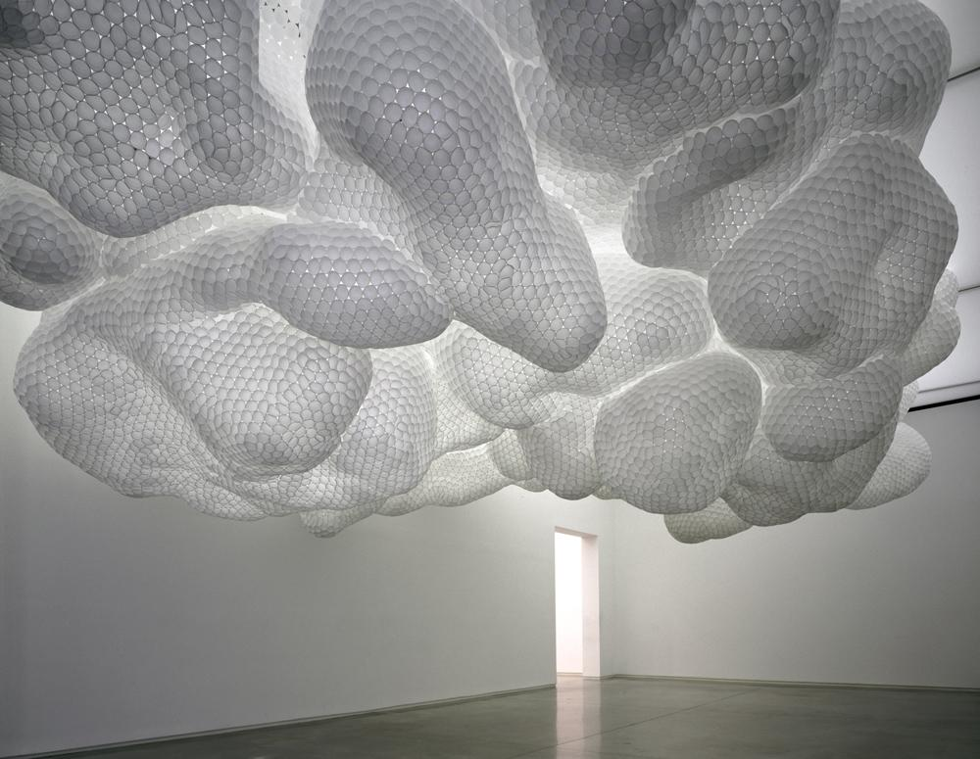
Tara Donovan
“Untitled”
Made with styrofoam cups
(see website below for more of Tara’s work)
https://www.frieze.com/article/tara-donovan

Slide 10
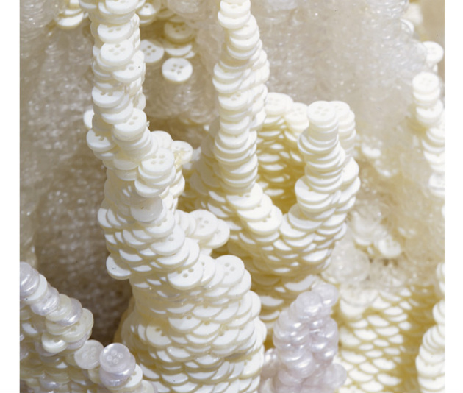
Tara Donovan
“Untitled”
Made with buttons
(see website below for more of Tara’s work includes a video)
https://outofthebluedesign.weebly.com/tara-donovan.html

Slide 11
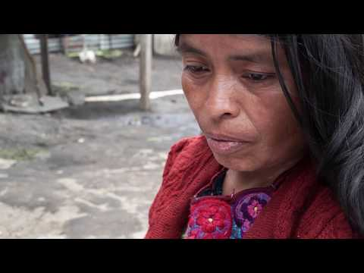
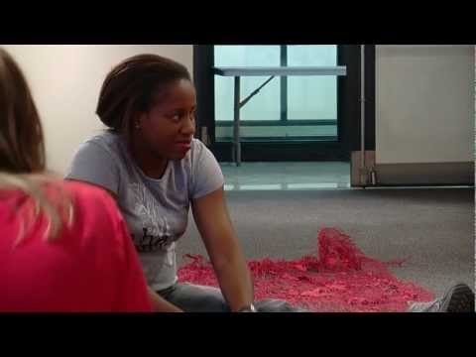
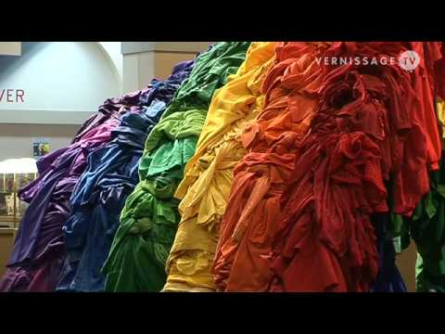
Video Resources
Mayan woman weaving with plastic bags
Nnenna Okore
Alain Guerra and Neraldo de la Paz

