Slide 1
Library & Listening
Unit 4, Week 5

Slide 2
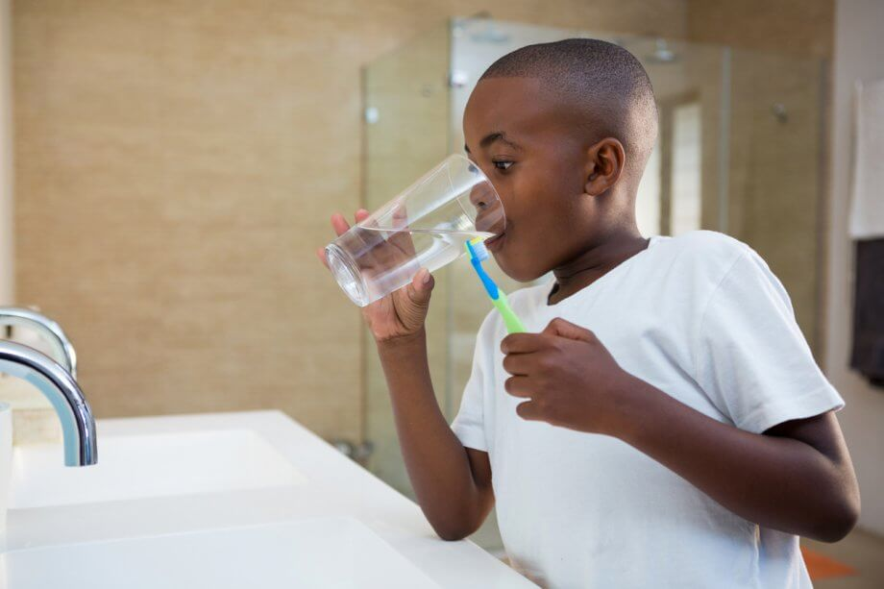
When you brush your teeth use a cup and turn the faucet off
https://www.smilemakersal.com/how-to-conserve-water-while-practicing-good-oral-hygiene/

Slide 3
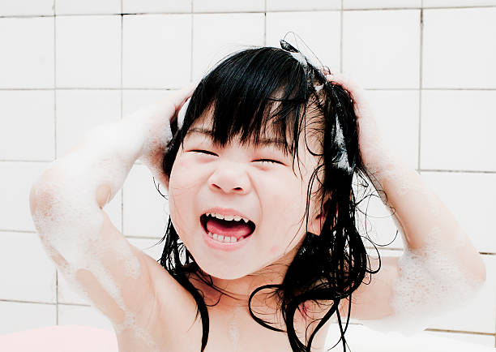
Take short “one song” showers. Turn the water off when you are washing
https://www.gettyimages.com/photos/kids-taking-a-shower

Slide 4
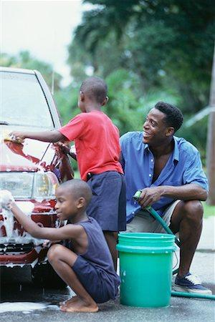
Use a bucket when washing a car rather than the hose
https://www.masterfile.com/search/en/black+people+car+wash

Slide 5
If the faucet leaks, fix it!
https://www.askmen.com/man_skills/home/how-to-fix-a-leaky-faucet.html

Slide 6
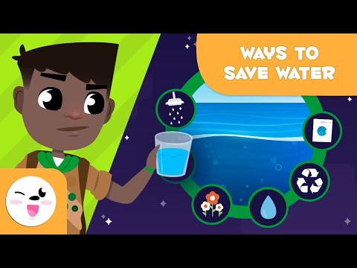
Water Saving Tips and Tricks

Slide 7
Race to Save Water

