Slide 1
Library & Listening
Unit 4, Week 4

Slide 2
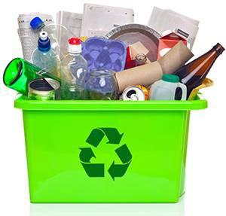
Recycle in your home
https://blog.upcyclerslab.com/2018/11/15/teach-your-kids-recycling-at-home-with-these-simple-diys/https://www.naturespath.com/en-us/blog/20-activities-kids-learn-sustainability/

Slide 3
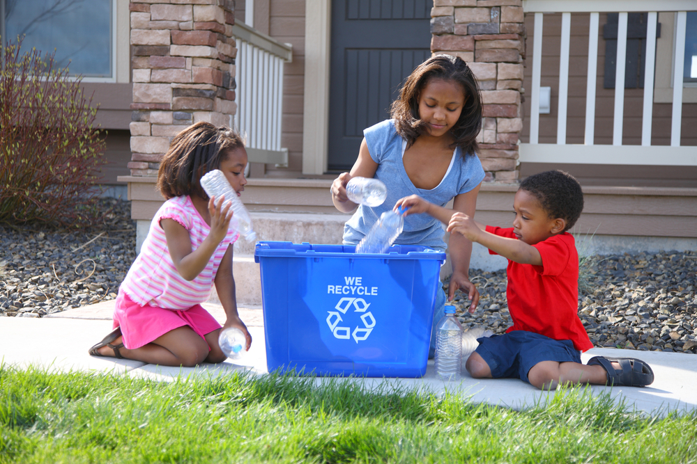
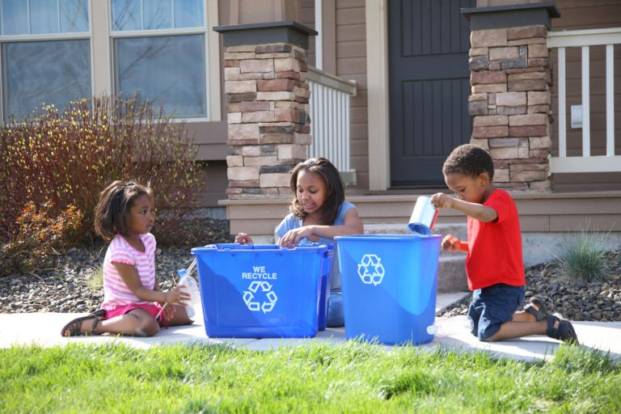
Put plastic, glass, tin and paper in the recycling bin
https://www.kiwico.com/blog/2020/04/17/recycling-tips-for-kids/

Slide 4
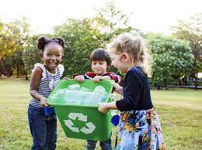
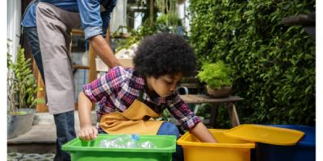
On recycling/trash day bring your recycling bin outside
https://www.naeyc.org/resources/pubs/yc/dec2020/young-champion-causel

Slide 5
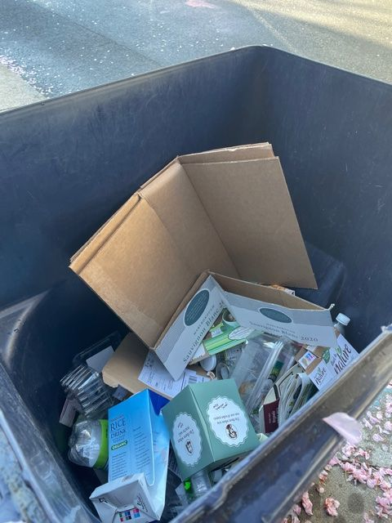
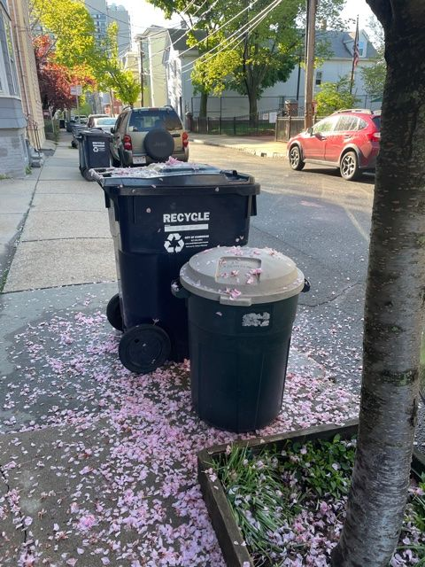
Dump the recycling into the big bin
Photos by Marina Boni

Slide 6
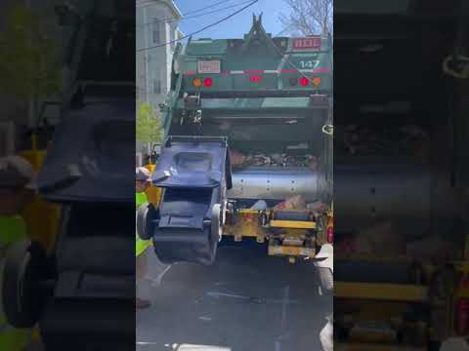
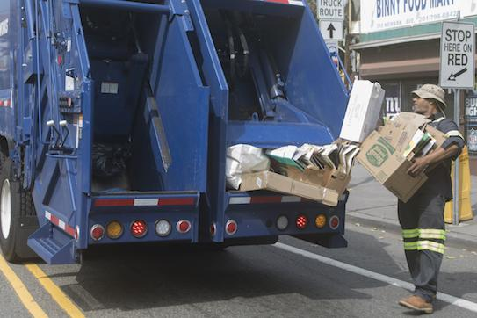
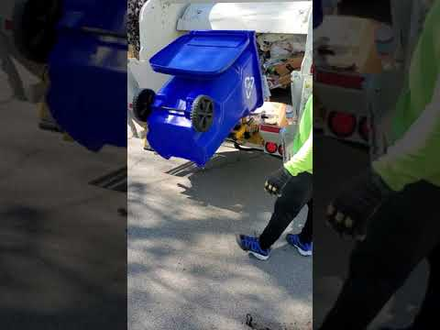
Here comes the recycling truck to pick up all your recycling!
Videos: Marina Boni & Michelle Pless-Joseph
https://jerseycitynj.gov/cityhall/dpw/sanitation

Slide 7
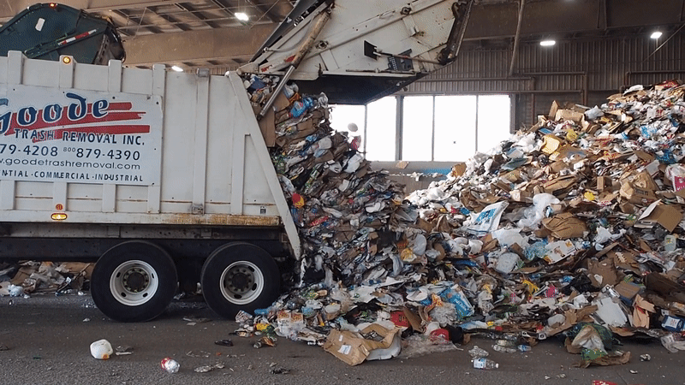
The truck dumps all of the recycling at the recycling plant
https://wamu.org/story/19/02/12/does-your-recycling-actually-get-recycled-yes-maybe-it-depends/

Slide 8
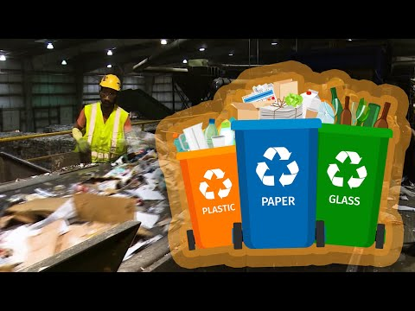
Recycling Plant Tour

Slide 9
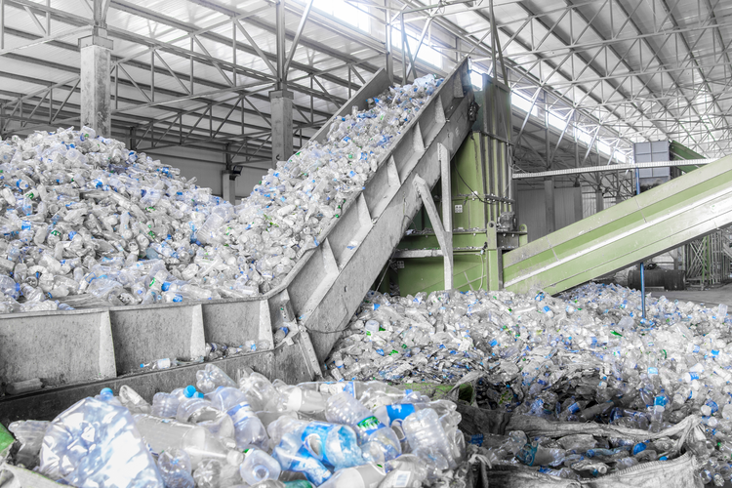
The recycling gets organized
https://www.thomasnet.com/insights/ai-could-improve-sustainability-through-smart-recycling-sorting/

Slide 10
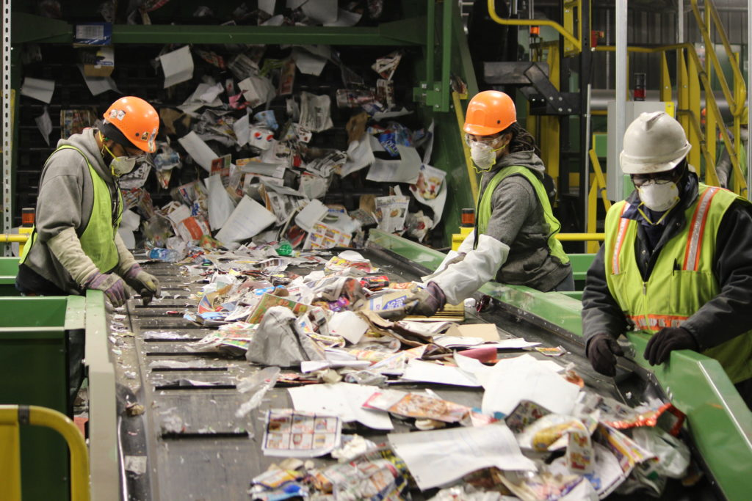
Workers sort the recycling
https://www.kci.com/resources-insights/innovator/new-recycling-facility-turns-green-gold/

Slide 11
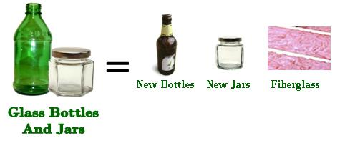
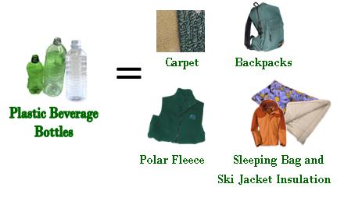
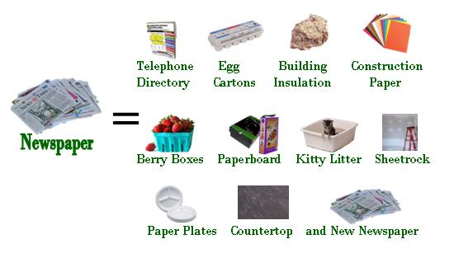
Recycling is turned into many other things
https://www.maine.gov/dep/waste/recycle/whatrecyclablesbecome.html

