Slide 1
Library & Listening
Unit 4, Week 3

Slide 2
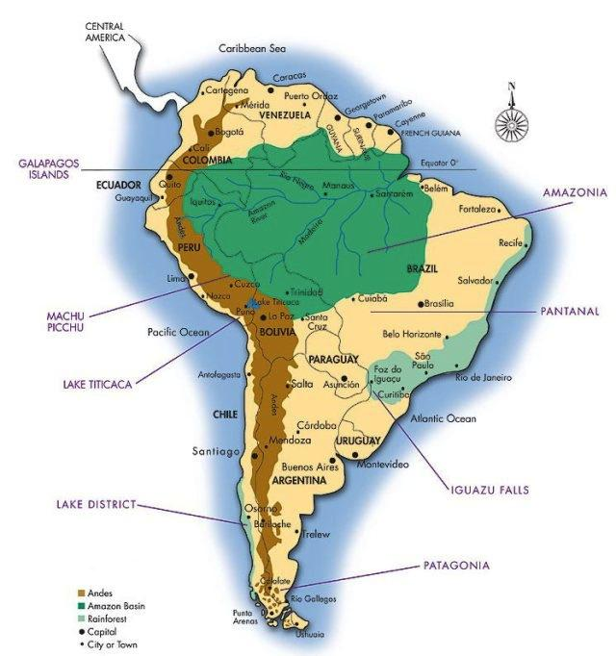
Amazon Rainforest Map
https://www.rainforestcruises.com/jungle-blog/where-is-the-amazon-rainforest-located

Slide 3
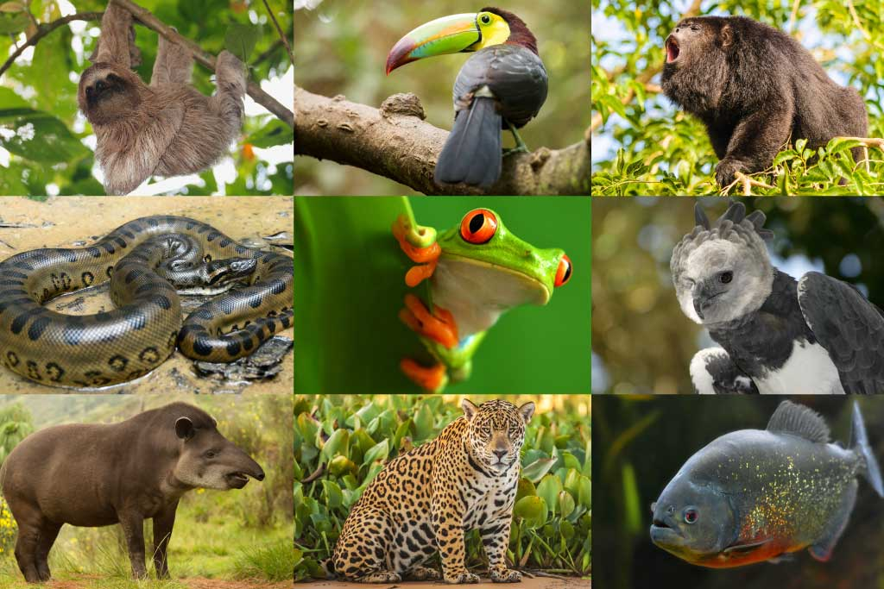
Amazon Rainforest Animals
https://www.activewild.com/rainforest-animals-list/

Slide 4
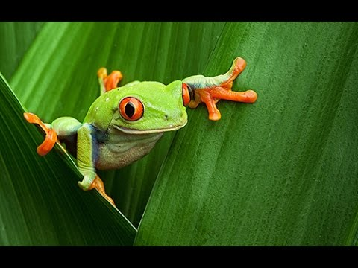
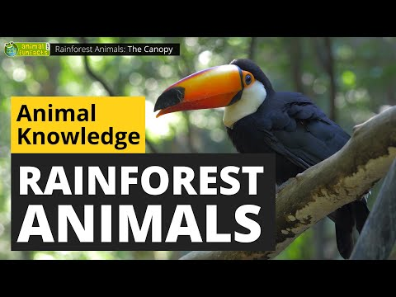
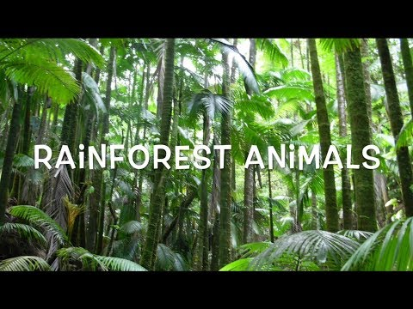
Amazon Rainforest Animal Videos

Slide 5
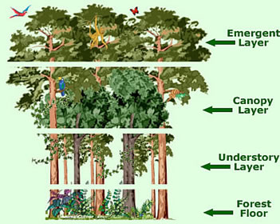
Rainforest Layers
https://animalcorner.org/rainforests/canopy-layers/

Slide 6
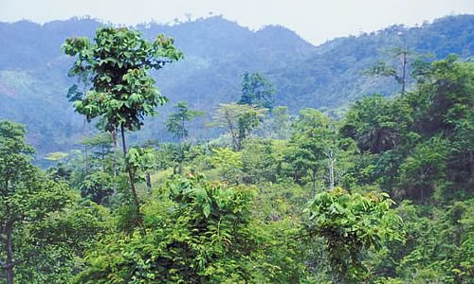
Emergent Layer
https://animalcorner.org/rainforests/canopy-layers/

Slide 7
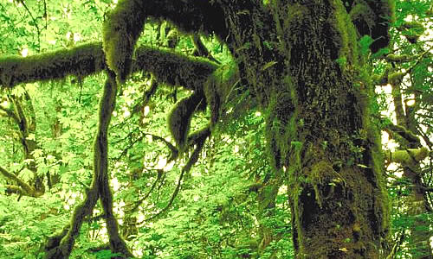
Forest Canopy
https://animalcorner.org/rainforests/canopy-layers/

Slide 8
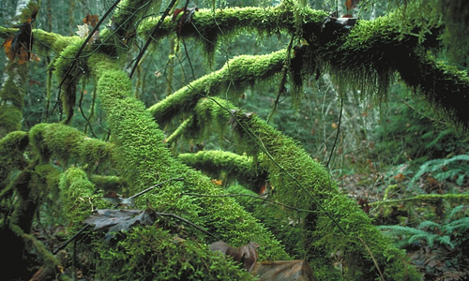
https://animalcorner.org/rainforests/canopy-layers/
Understory Layer

Slide 9
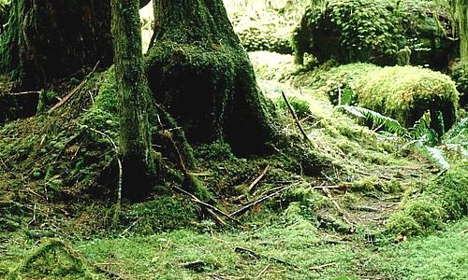
Forest Floor
https://animalcorner.org/rainforests/canopy-layers/

Slide 10
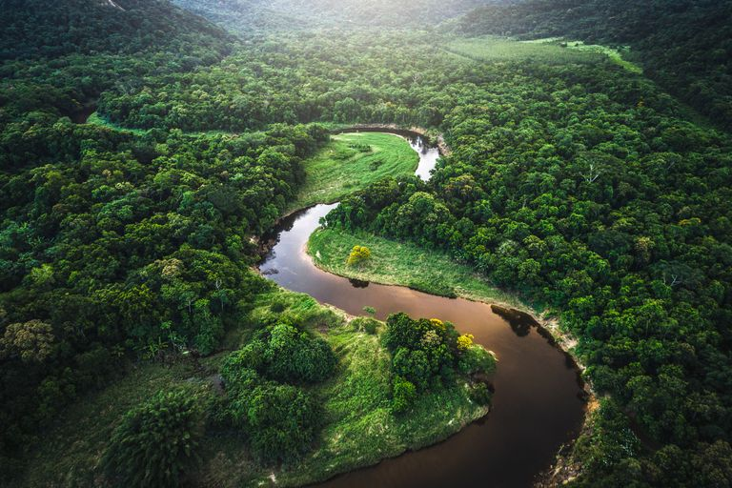
Amazon River
https://www.popularmechanics.com/science/environment/a28910396/amazon-rainforest-importance/

Slide 11
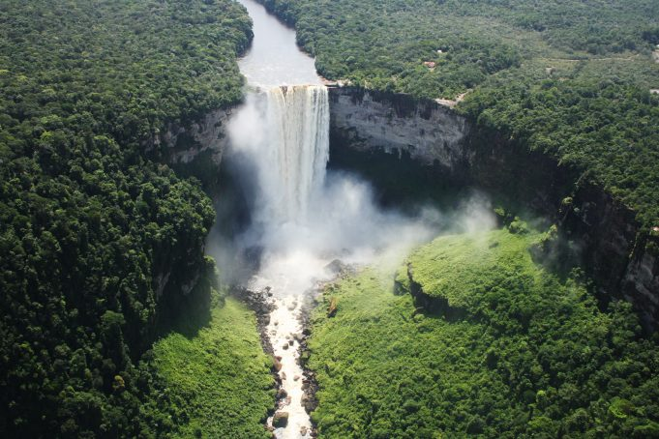
Kaieteur Falls
https://www.beautifulworld.com/wp-content/uploads/2016/10/kaieteur-falls-1.jpg

Slide 12
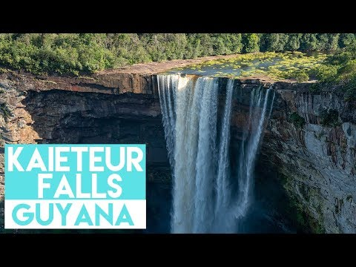
Kaieteur Falls, Guyana
World Tallest single drop Waterfall

Slide 13
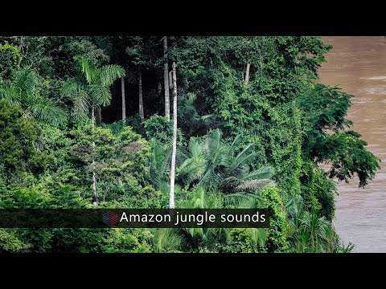
Amazon Rainforest Sounds

