Slide 1
Blocks
Unit 4 Week 5

Slide 2
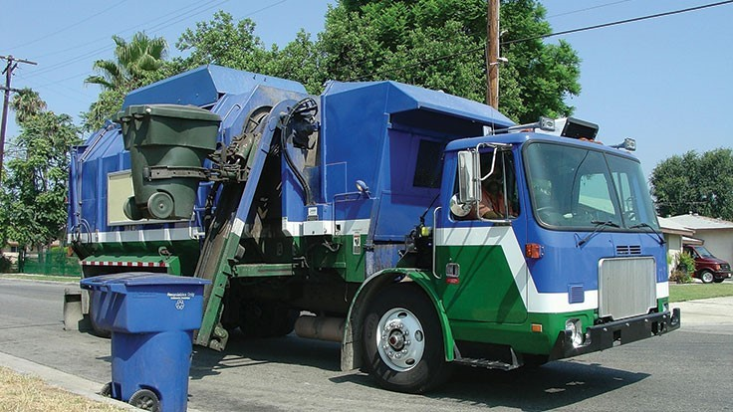
https://www.recyclingtoday.com/article/recycling-programs-phase-out-glass-2018/

Slide 3
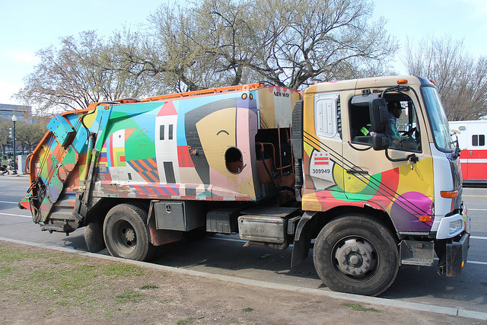
https://dcist.com/story/18/07/27/15-new-art-covered-recycling-trucks/

Slide 4
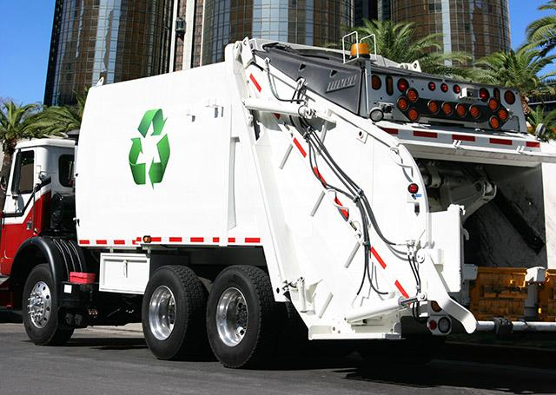
https://www.miheuprecision.com/blog/recycling-truckl

Slide 5
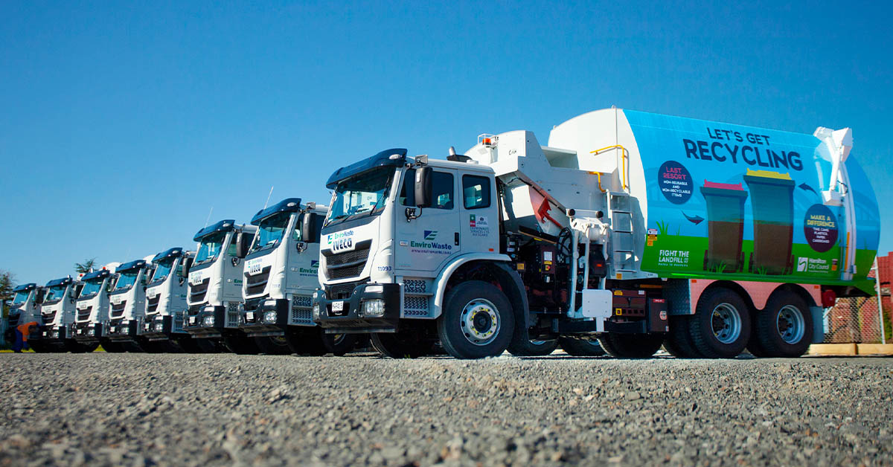
https://www.facebook.com/hamiltoncitycouncil/photos/our-new-rubbish-and-recycling-trucks-have-been-hitting-the-streets-testing-out-t/3330685893689389/

Slide 6
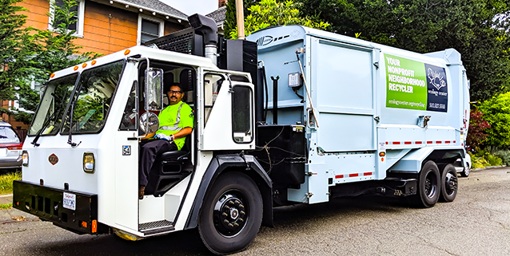
https://ecologycenter.org/recycling/

Slide 7
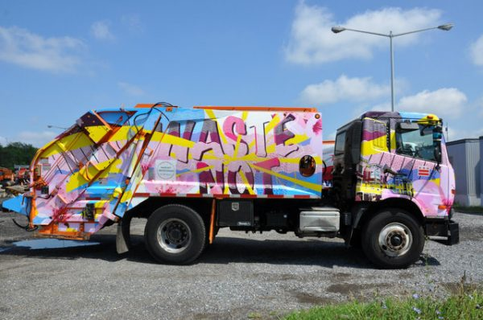
https://dcist.com/story/18/07/27/15-new-art-covered-recycling-trucks/

Slide 8
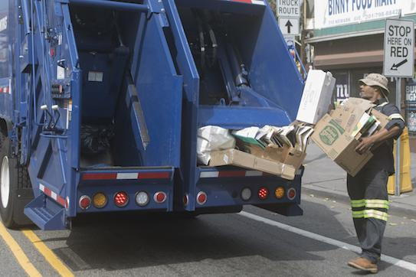
https://jerseycitynj.gov/cityhall/dpw/sanitation

Slide 9
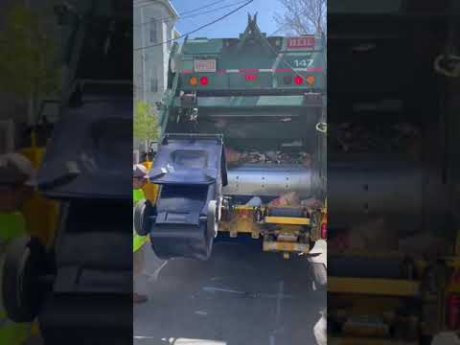
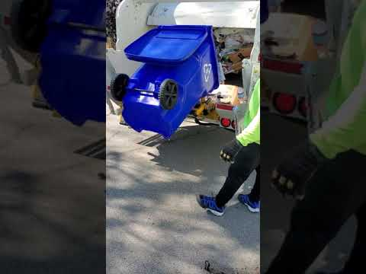
Videos by Marina Boni & Michelle Pless-Joseph

Slide 10
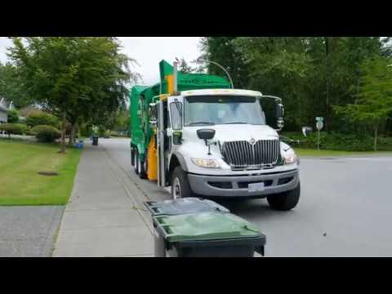
\https://www.youtube.com/watch?v=ORwPHerfkvQ

