Slide 1
A Walk In The Woods
Unit 4, Week 2
(a resource of a tree walk is not possible)
Photos and Words by Kathy D’Andrea

Slide 2
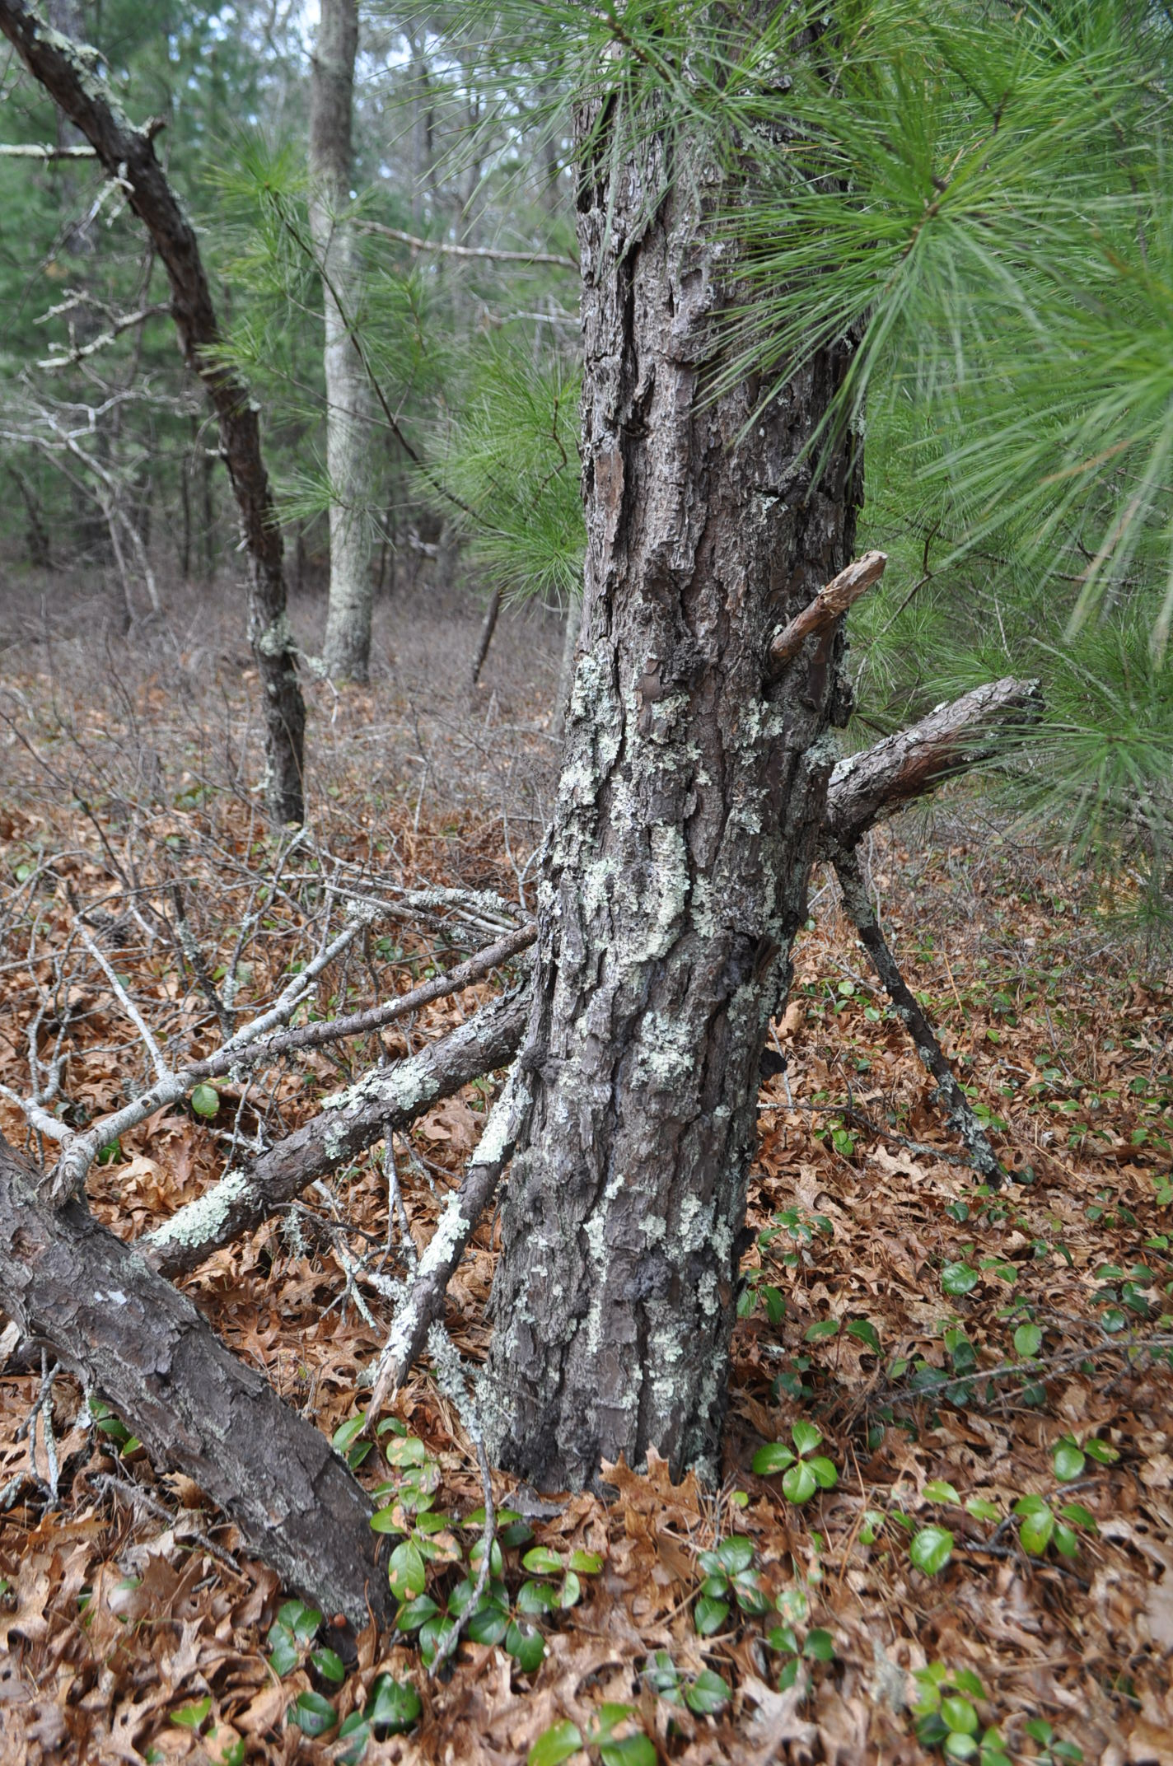
What do you see?
What do you notice?

Slide 3
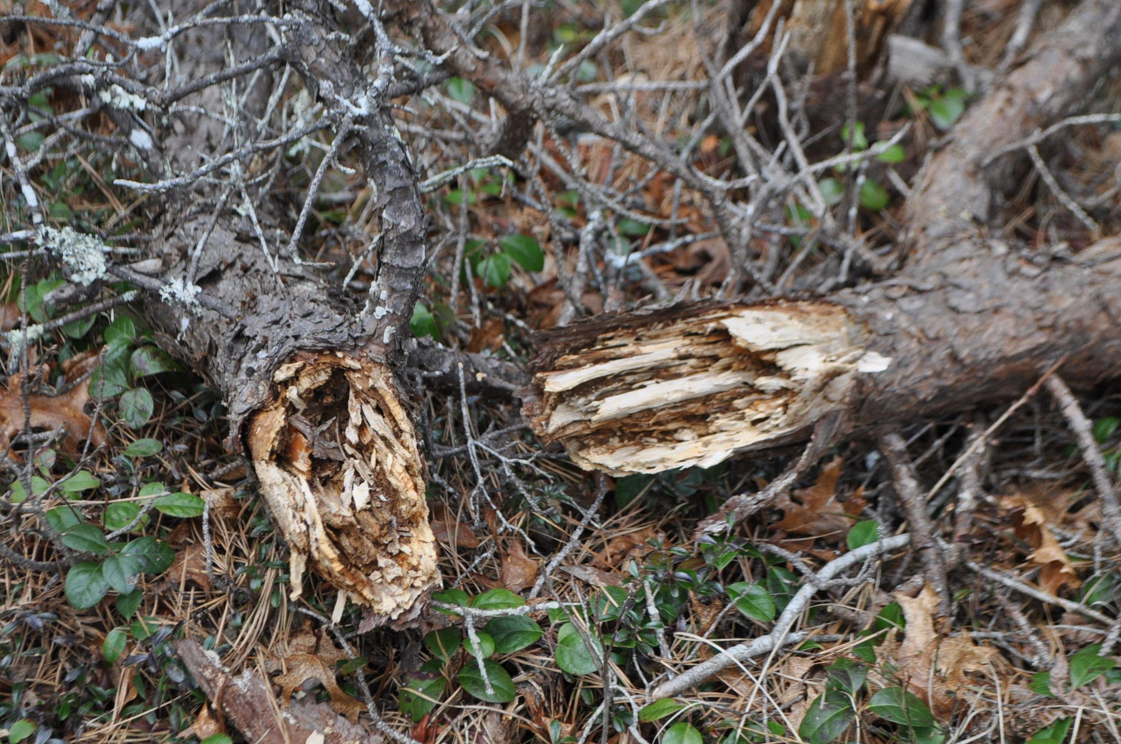

Slide 4
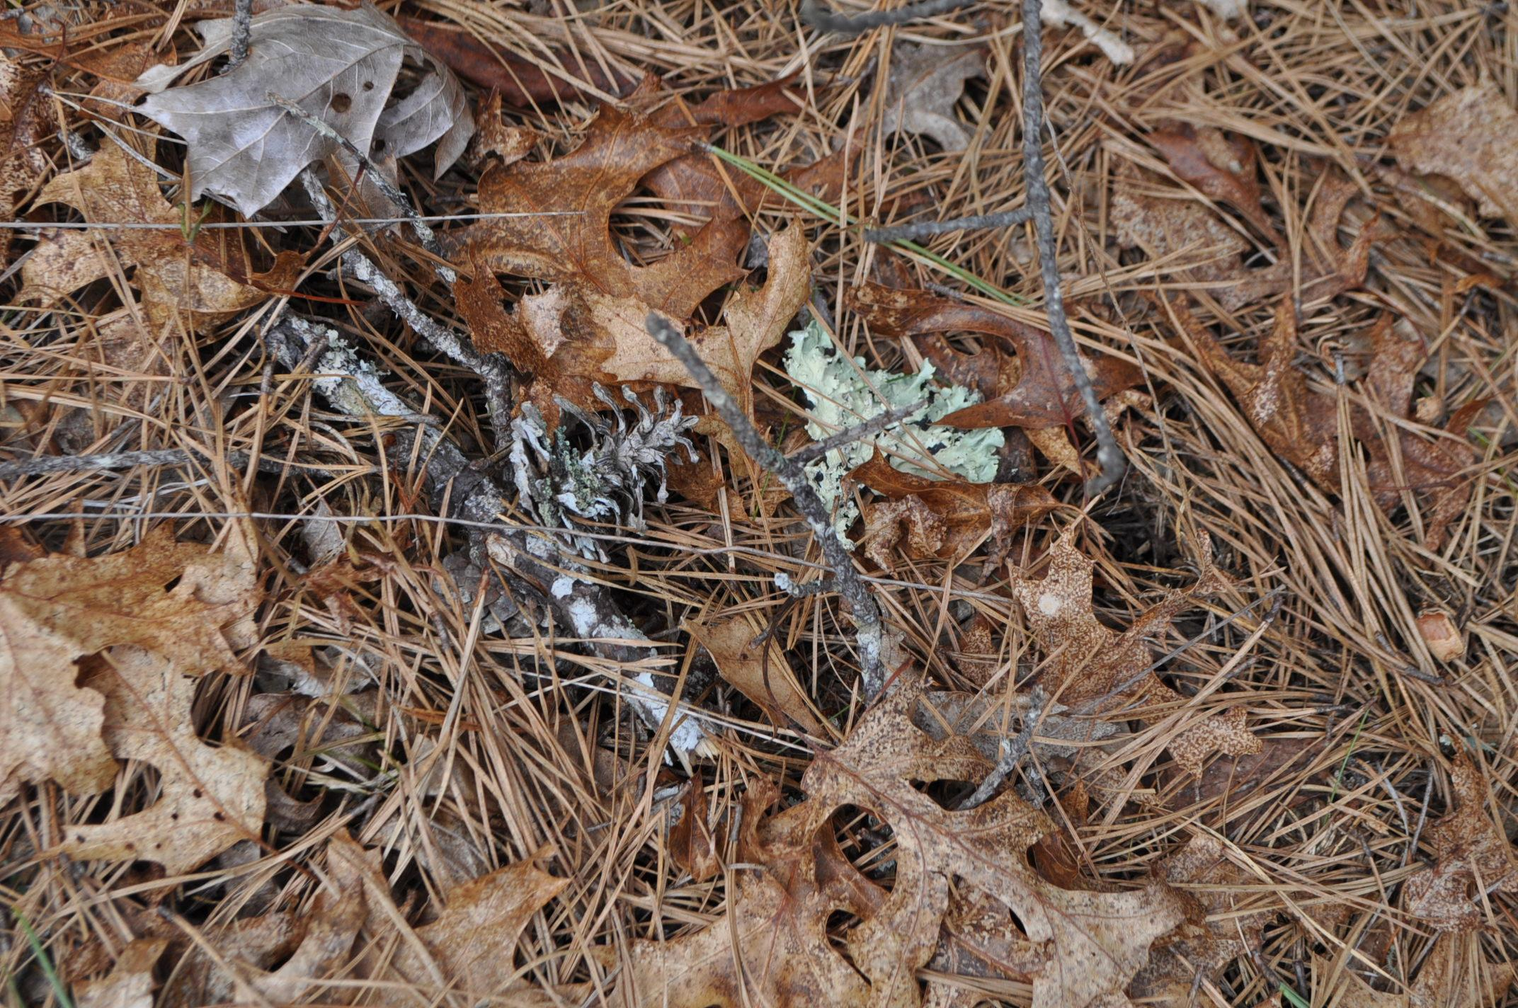
Why do you think there are leaves on the ground?

Slide 5
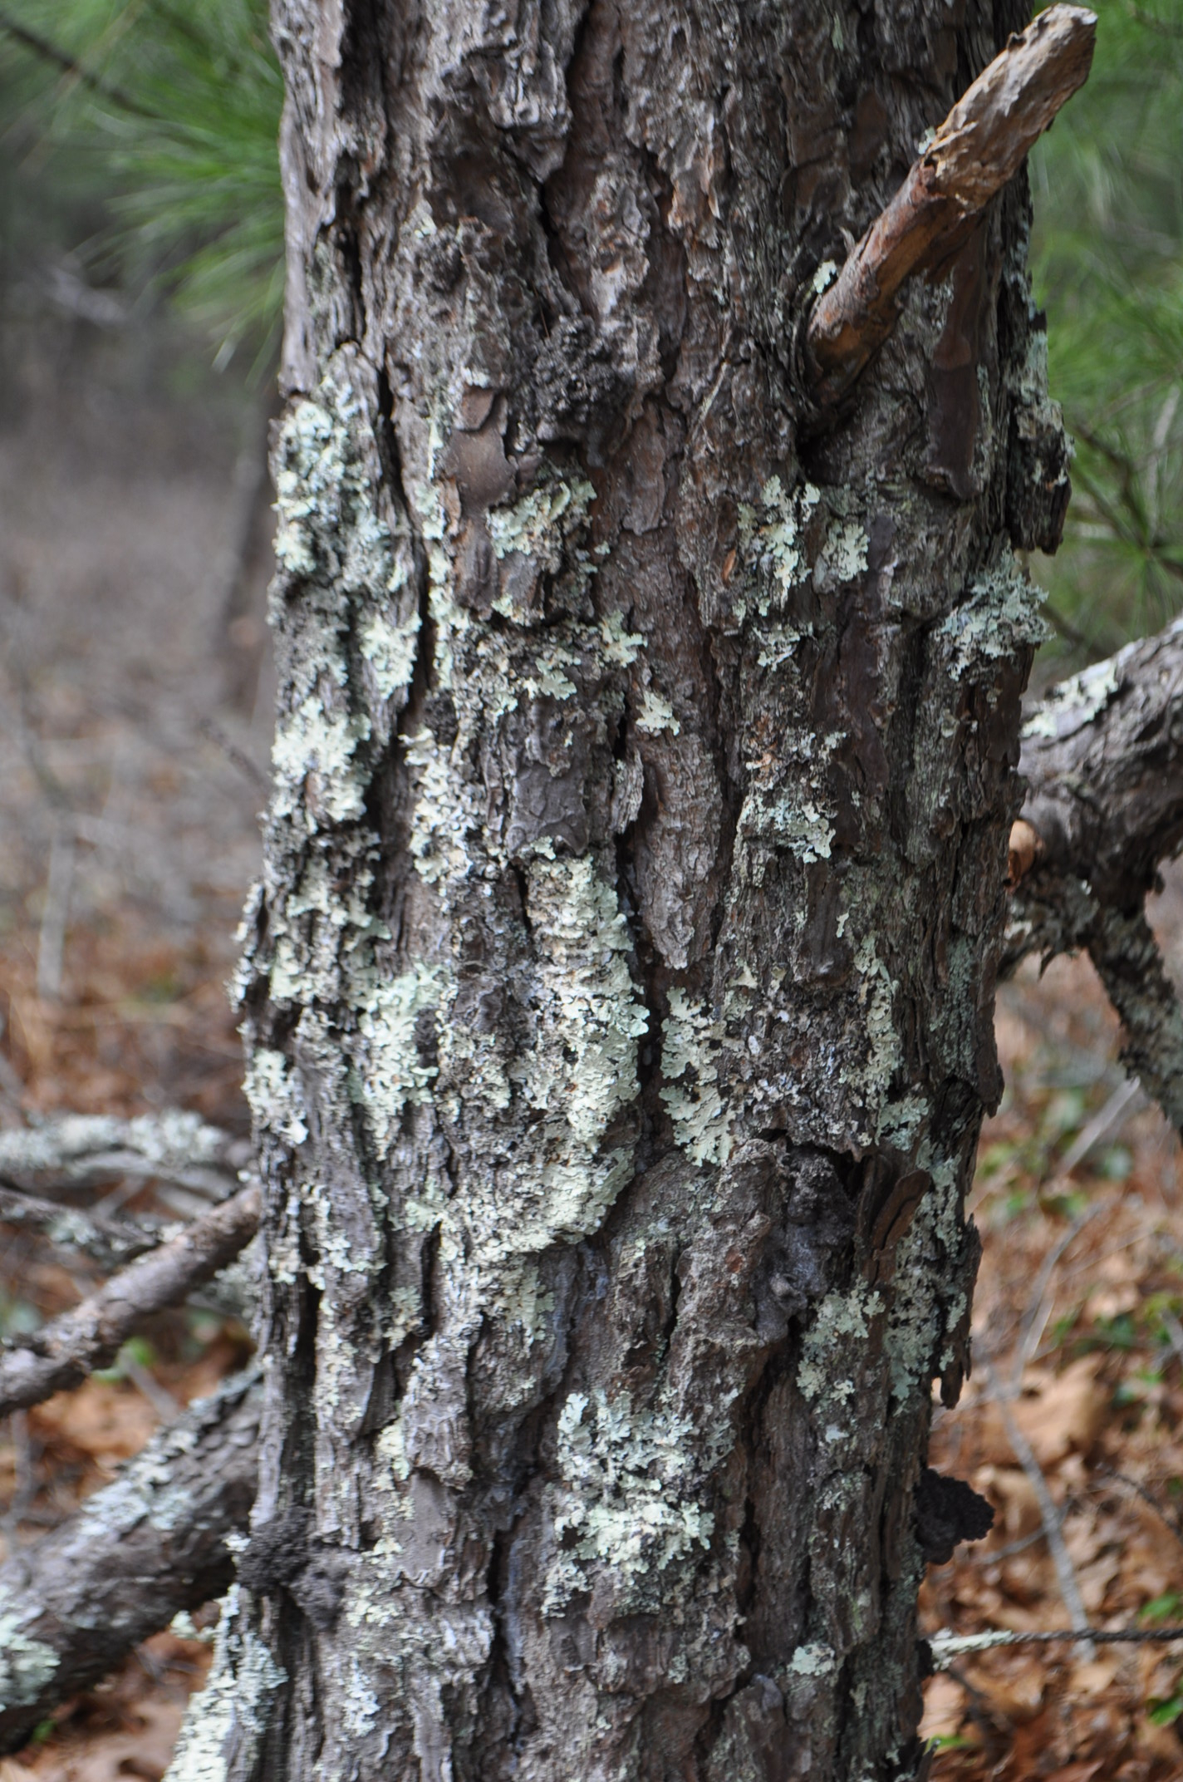
What do you notice about the bark of this tree?

Slide 6
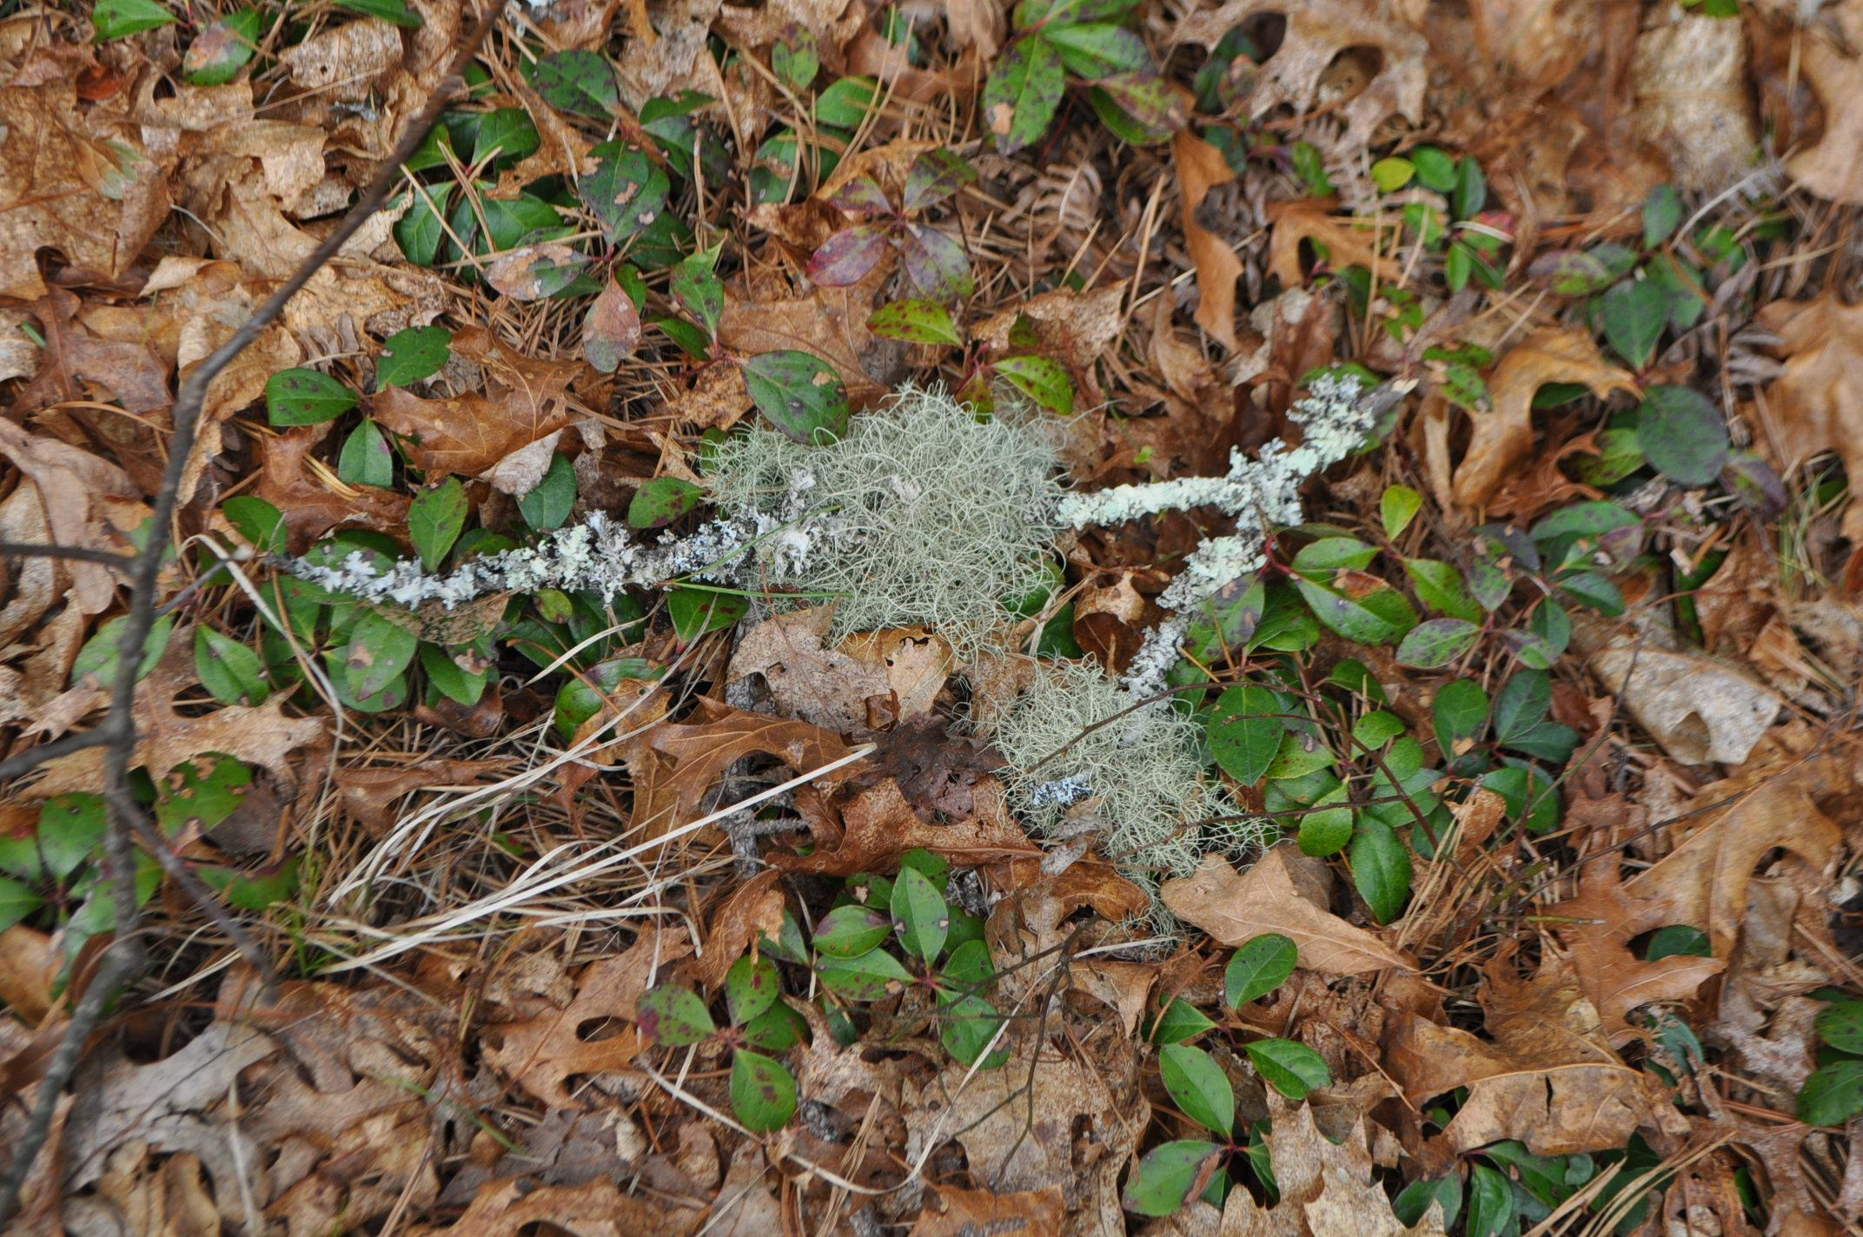

Slide 7
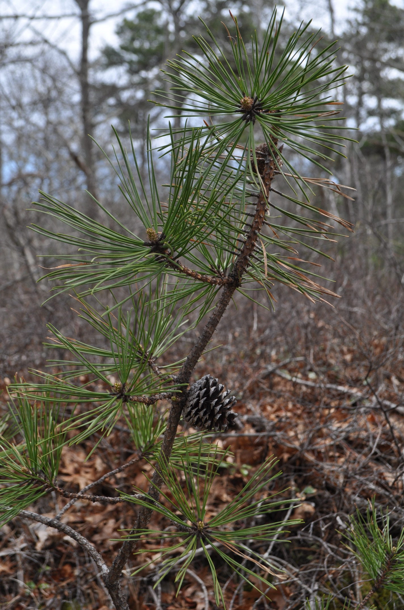
What do you notice that is the same? What do you notice that is different?

Slide 8
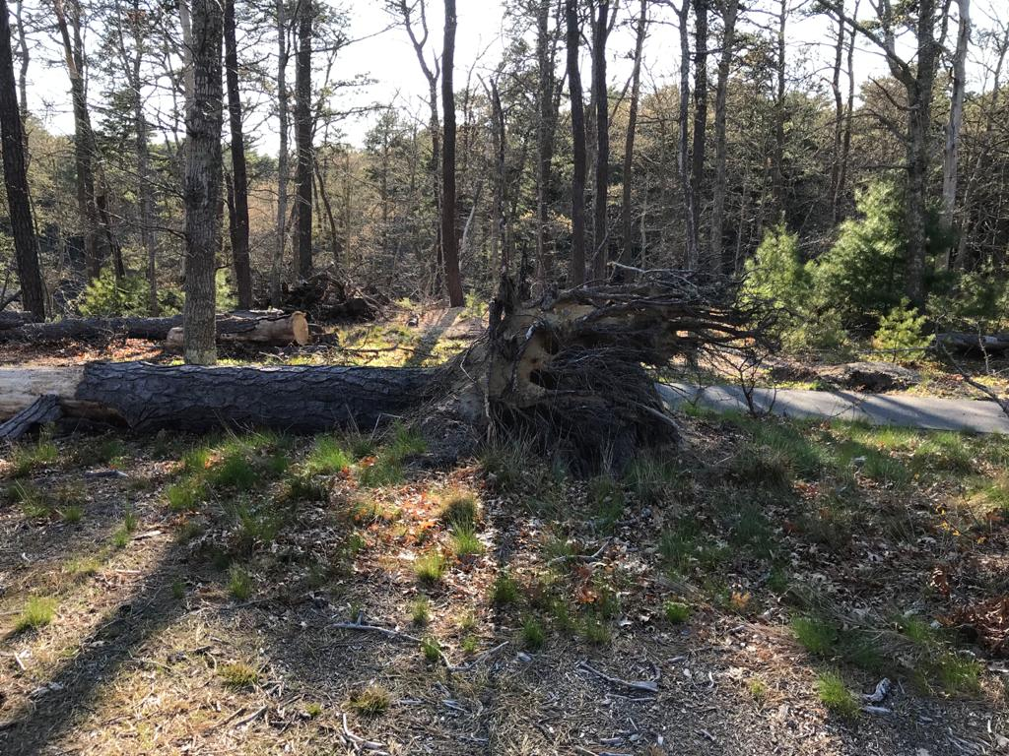
I wonder what happened. Why do you think the tree fell down?

Slide 9
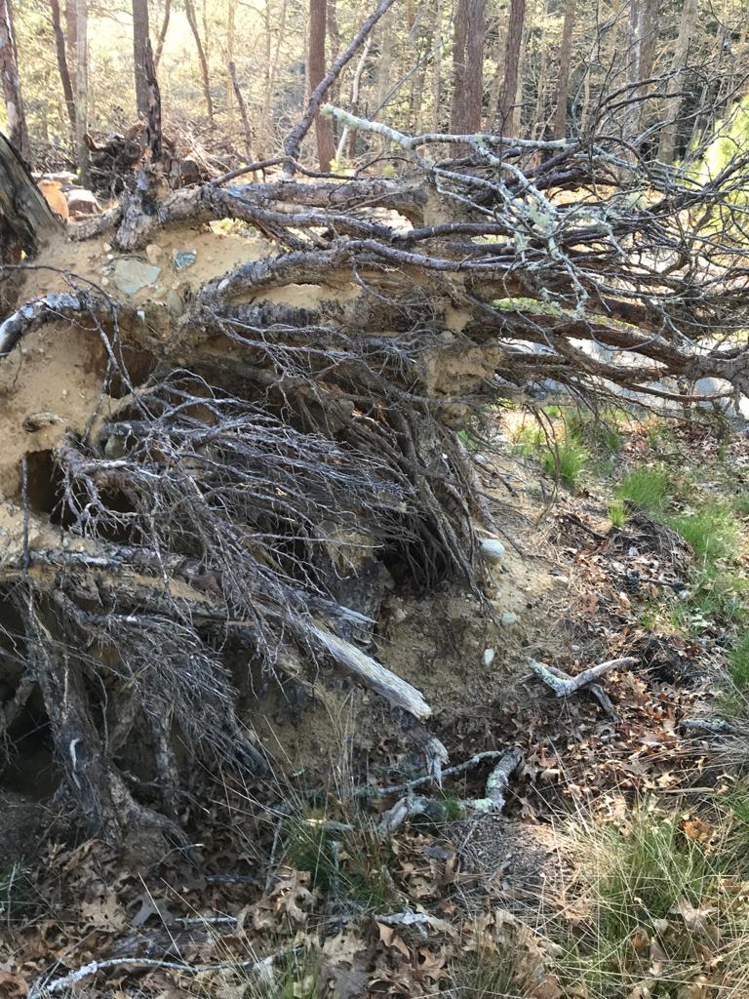
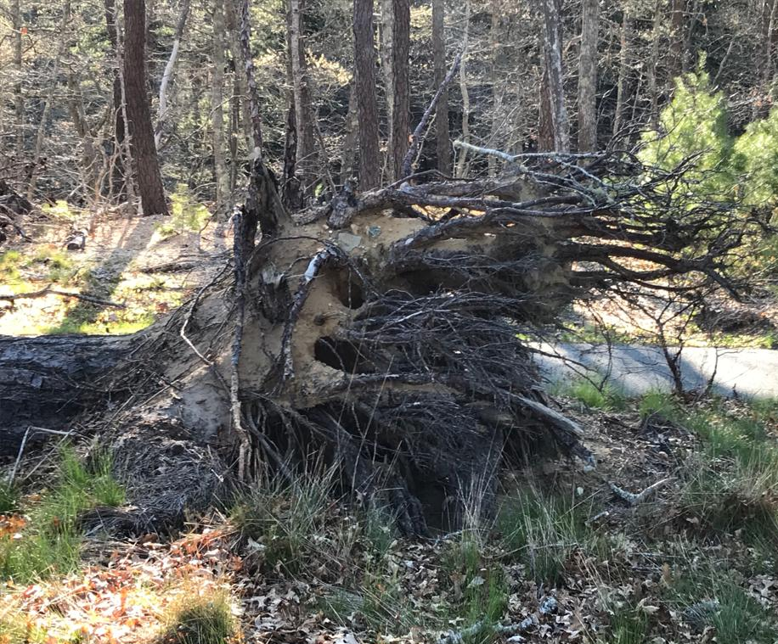

Slide 10
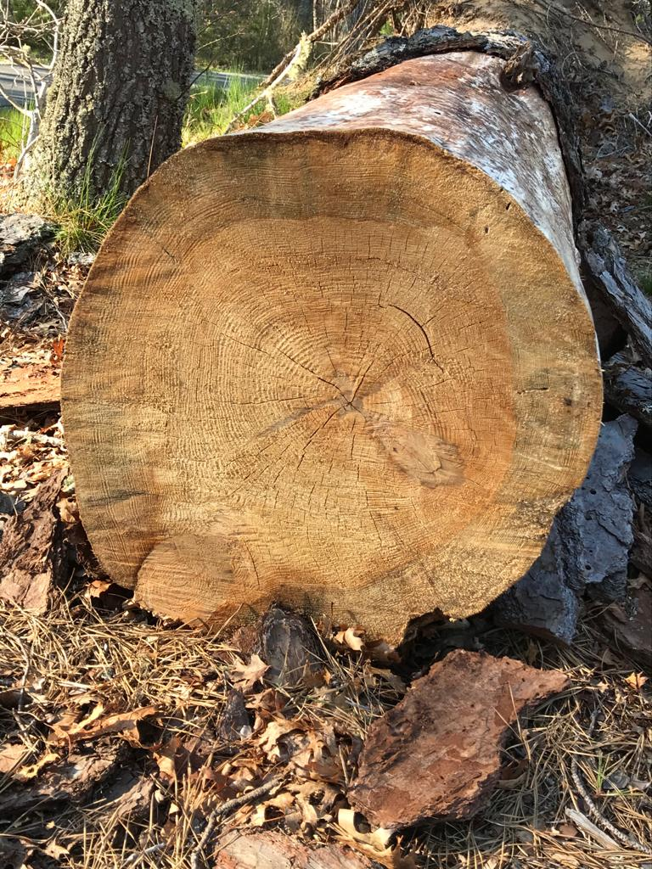
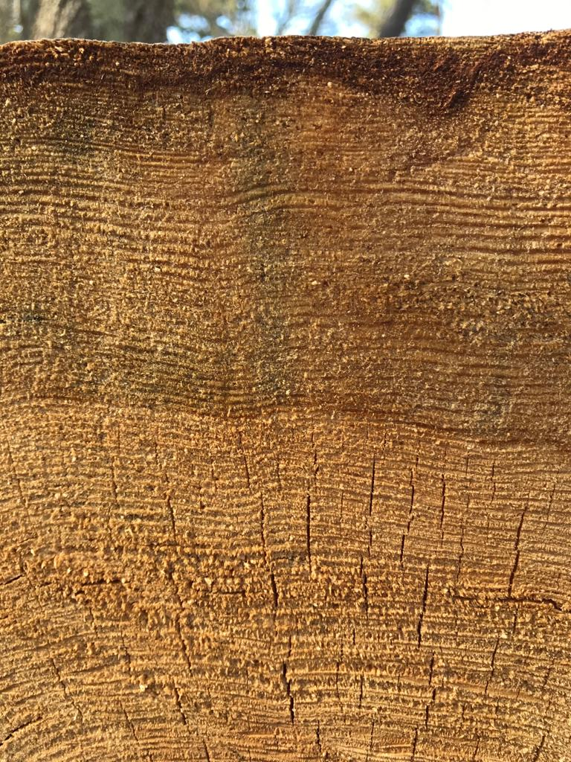
These annual rings hold a secret about this tree. Do you know what it is?

Slide 11
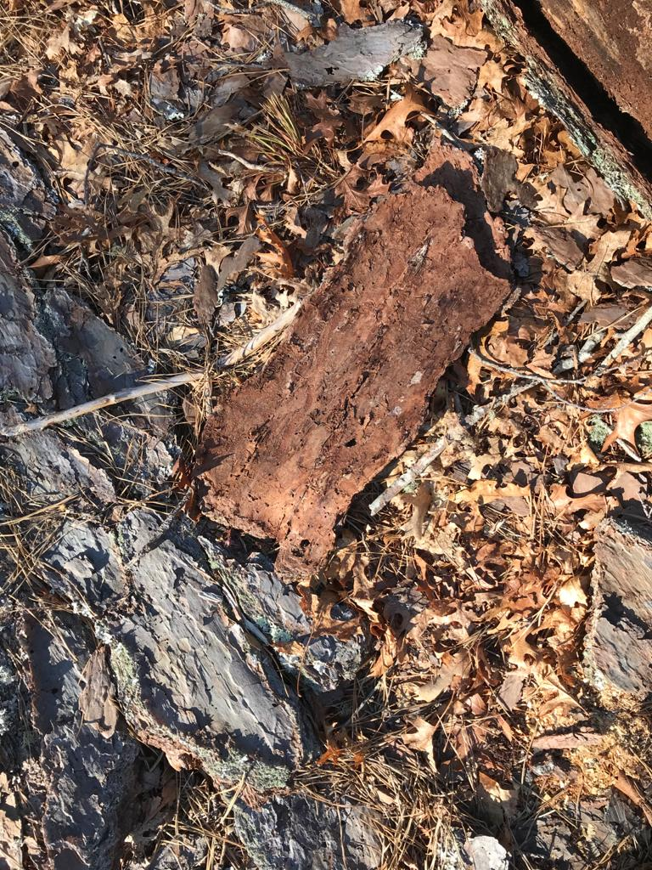
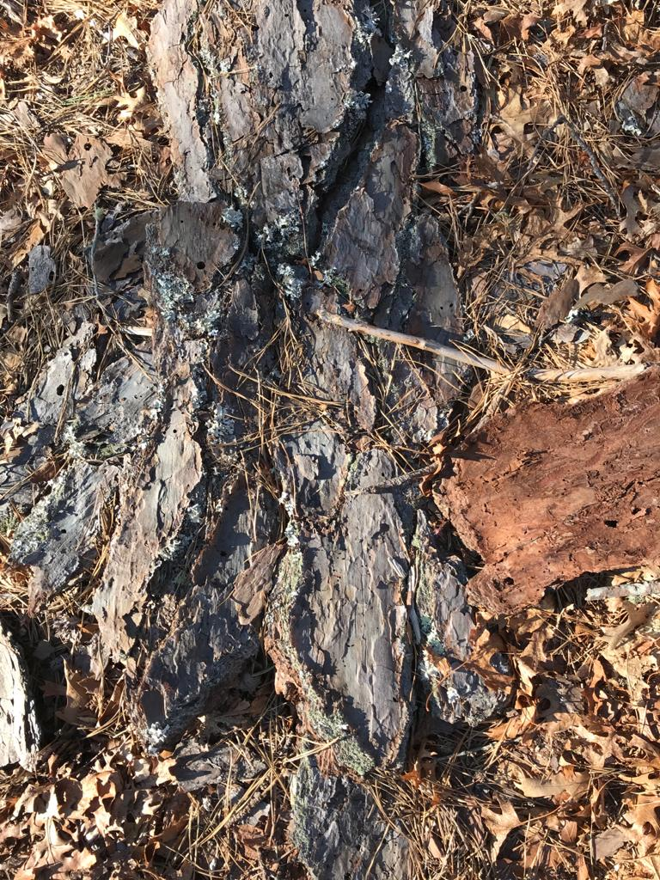
The inside of the bark.
The outside of the the bark.

