Slide 1
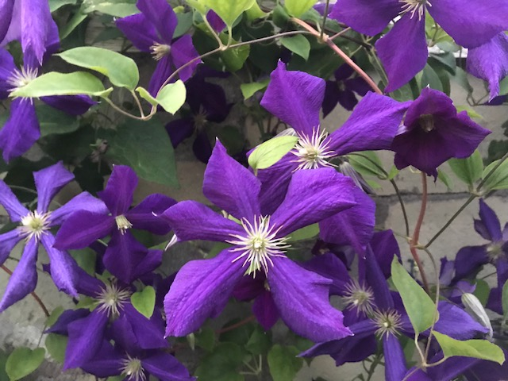
Art Easel
Unit 4, Week 7
Photo by Marina Boni

Slide 2
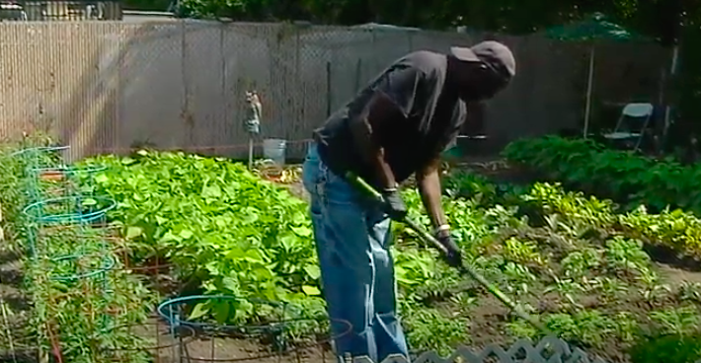
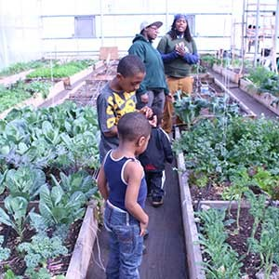
Community Gardens
https://www.wgbh.org/news/local-news/2020/07/09/in-a-time-of-uncertainty-bostonians-embrace-their-community-gardens
http://seedstock.com/2014/05/27/10-american-cities-lead-the-way-with-urban-agriculture-ordinances/

Slide 3
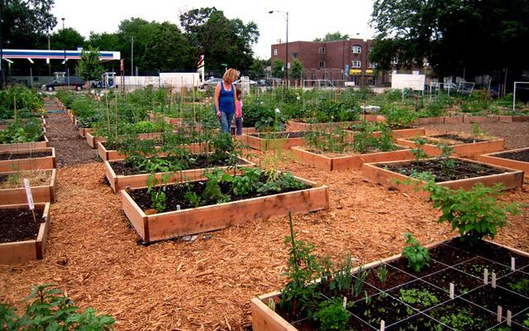
Community Garden
https://www.greenovateboston.org/join_or_start_a_community_garden/

Slide 4
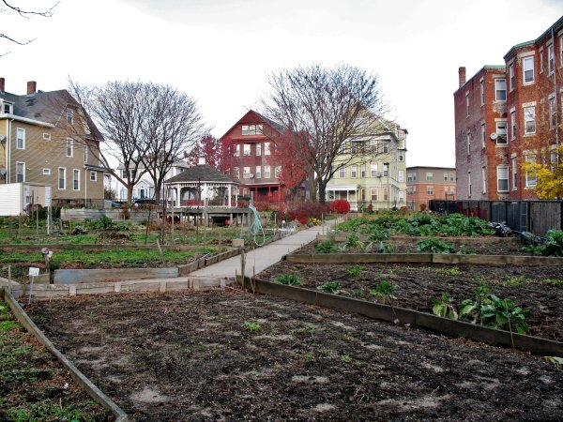
Community Garden
http://www.uphamscornernews.com/boston-natural-areas-network-bnan-role-in-the-growing-presence-of-community-gardens.html

Slide 5
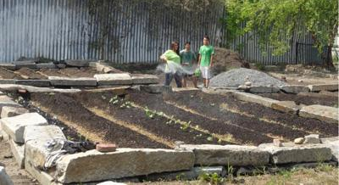
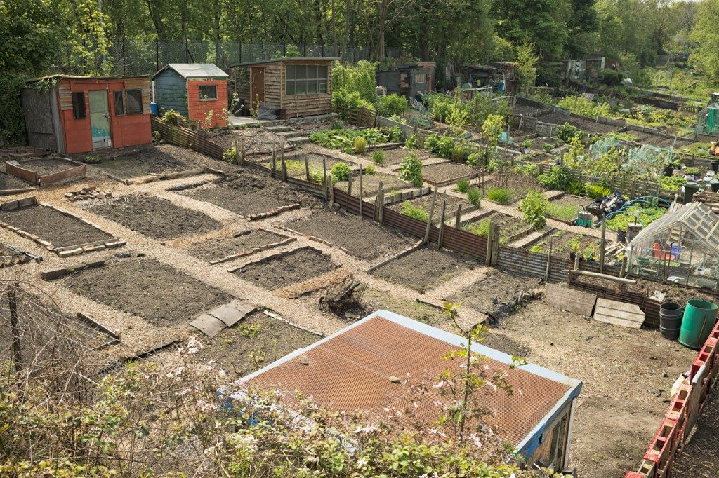
Community Gardens
https://www.gardeningknowhow.com/special/urban/vacant-lot-gardening.htm
https://thenaturalfarmer.org/article/south-street-farm/

Slide 6
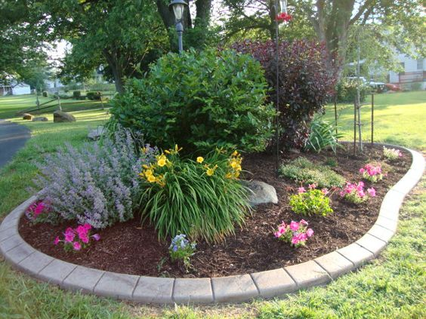
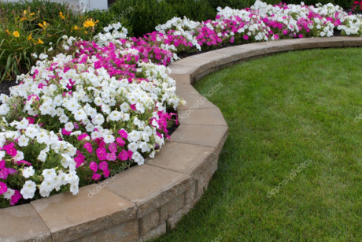
Garden Beds
https://www.architectureartdesigns.com/16-small-flower-gardens-will-beautify-outdoor-space/
http://dklandscaping.com/flowers/four-creative-flower-bed-ideas-to-get-you-going/

Slide 7
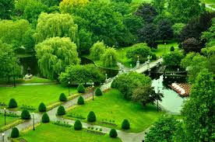
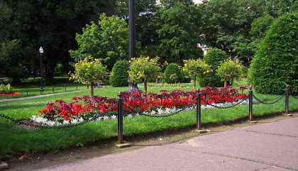
Boston Public Garden
http://www.celebrateboston.com/attractions/public-garden-photos.htm
https://www.thenewburyboston.com/journal/art-all-public-garden

Slide 8
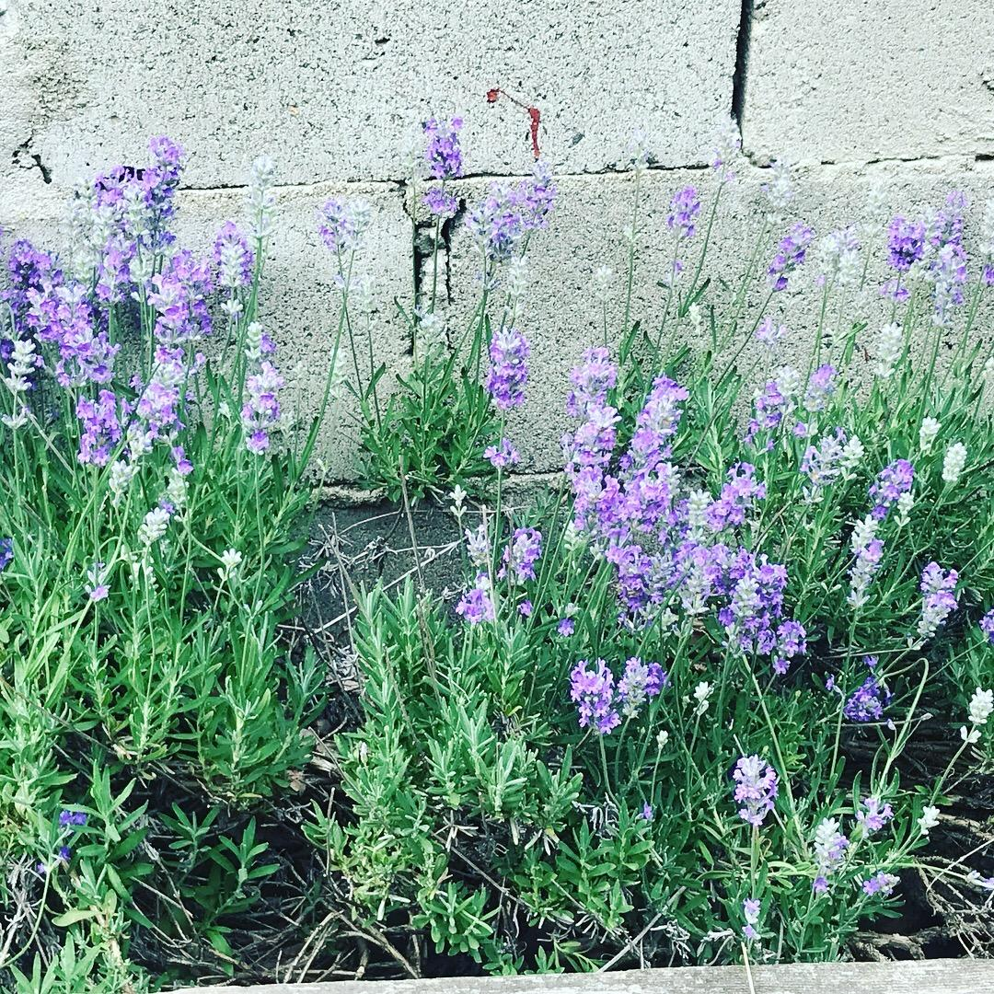
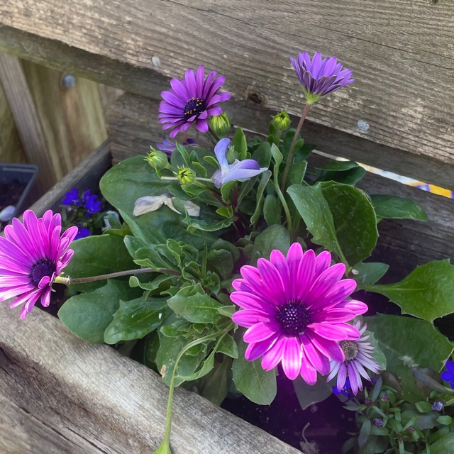
Flower Beds
Photos by Marina Boni

Slide 9
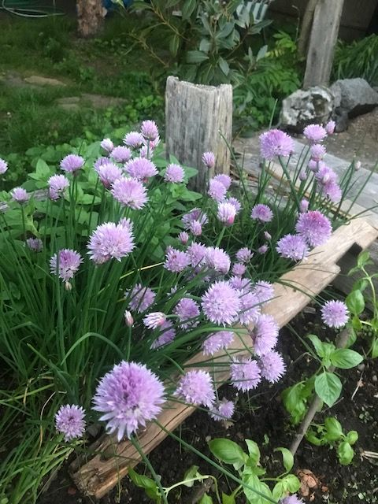
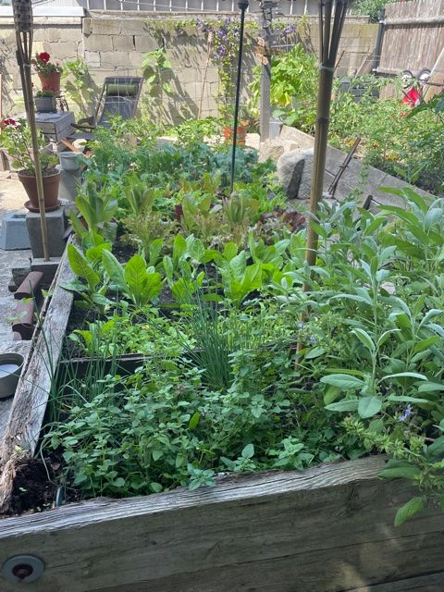
Garden Beds
Photos by Marina Boni

Slide 10
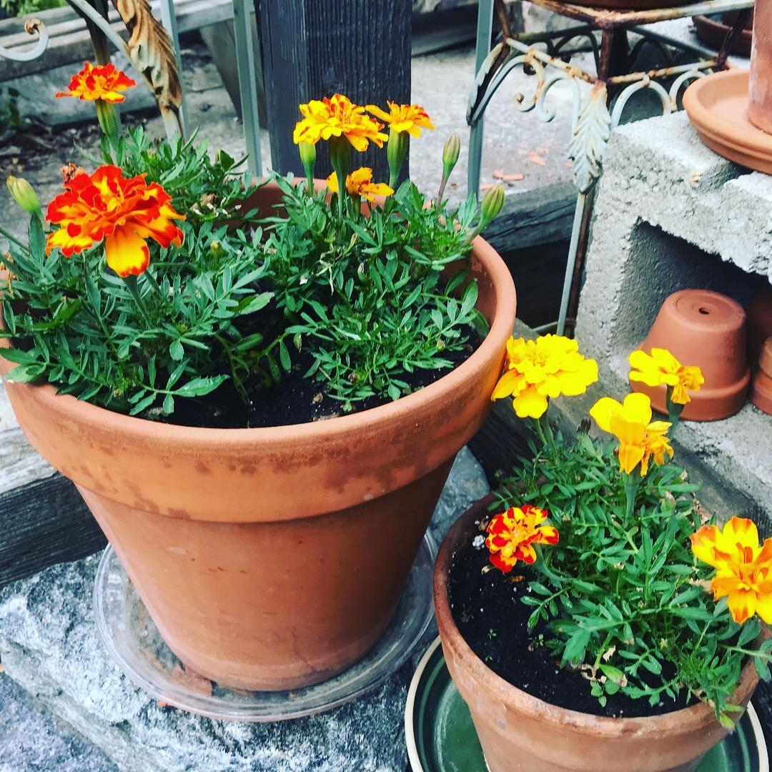
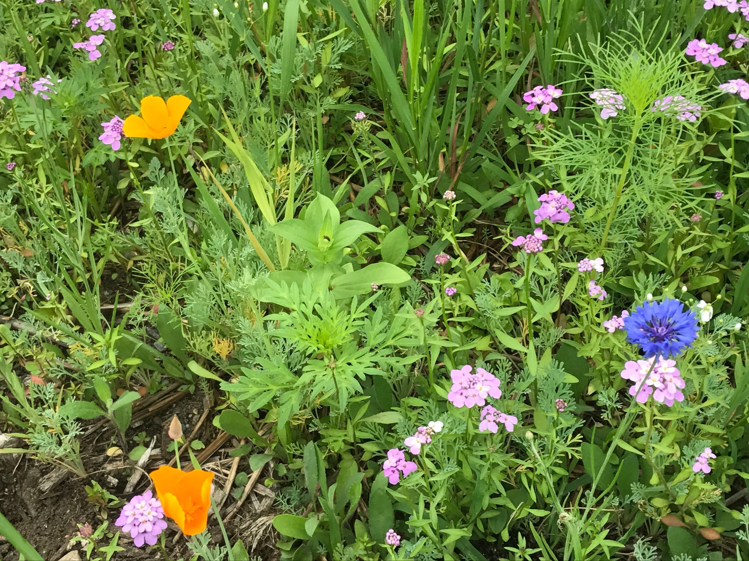
Flowers growing in pots and beds
Photos by Marina Boni

Slide 11
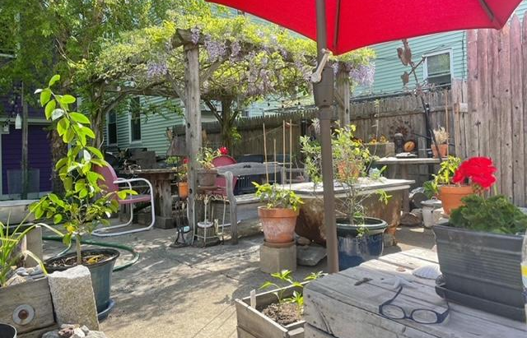
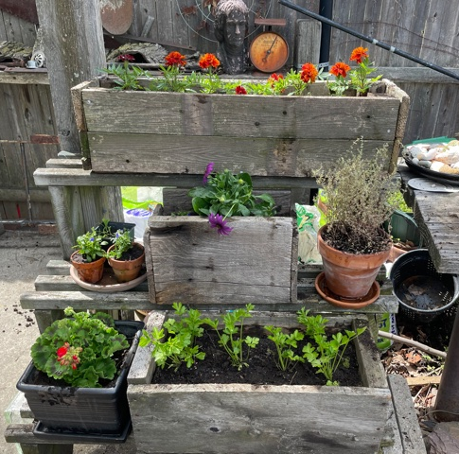
Backyard Garden
Photos by Marina Boni

Slide 12
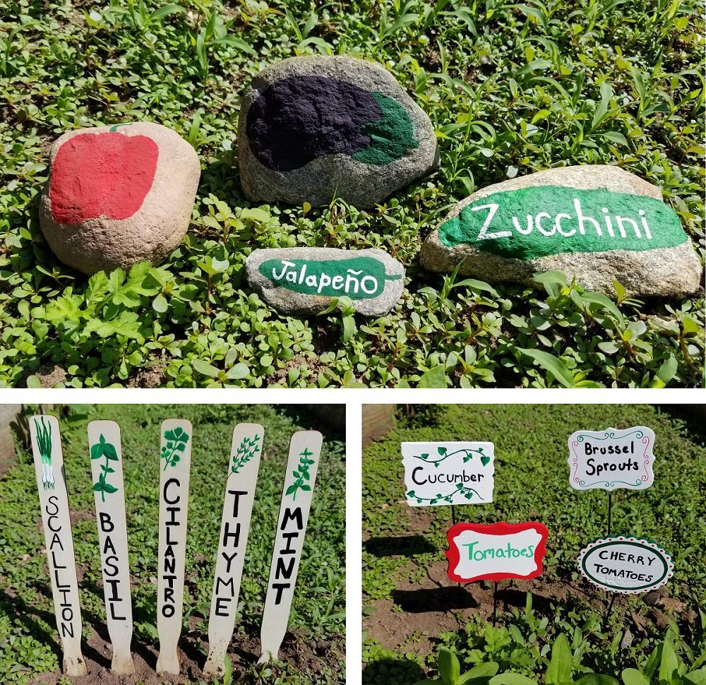
Gardens Signs
https://www.ssww.com/blog/3-crafty-ways-to-label-your-vegetable-garden/

Slide 13
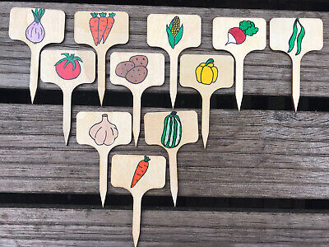
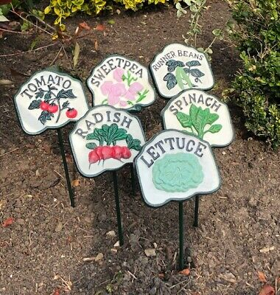
Gardens Signs
https://www.dealsan.uk/buy/vegetable-signs

Slide 14
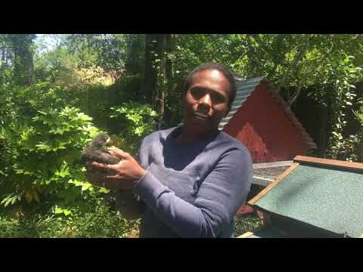
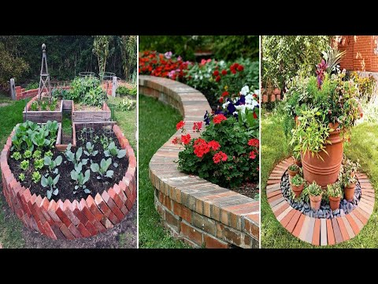
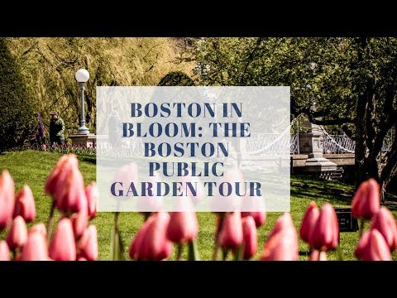
Video Resources

