Slide 1
Art Easel
Unit 4, Week 6

Slide 2
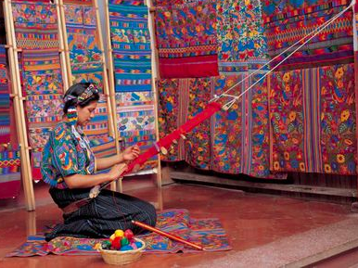
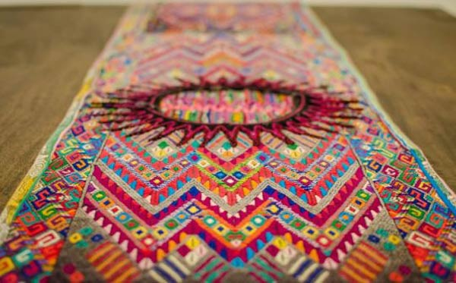
https://www.anywhere.com/guatemala/destinations/la-antigua/tours/cultural-textile-halfday
https://www.ancient-origins.net/ancient-places-americas/weaving-world-ancient-mayan-women-001976

Slide 3
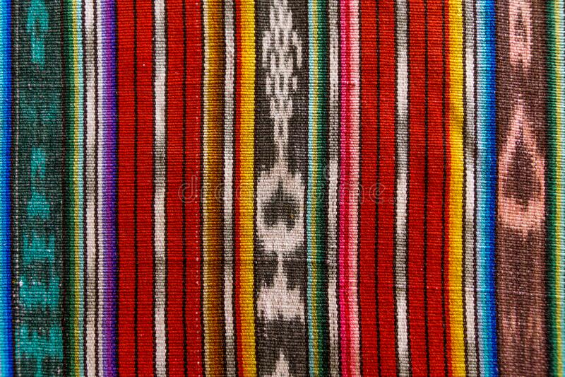
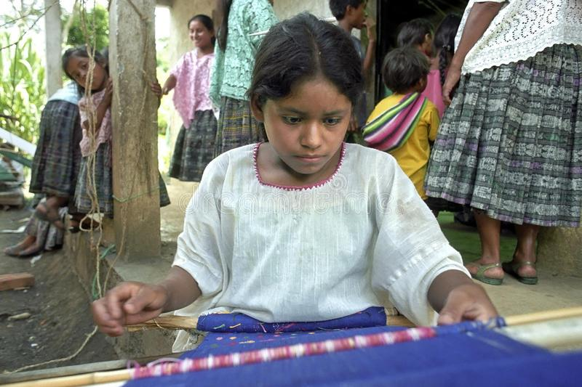
https://www.dreamstime.com/photos-images/traditional-guatemalan-weave.html

Slide 4
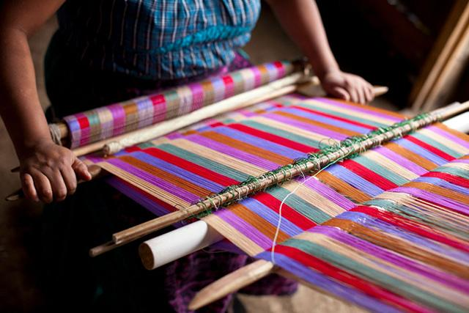
https://truthout.org/articles/two-headed-bird-lands-in-guatemala-s-political-arena-mayan-women-fight-to-protect-their-textile-heritage/

Slide 5
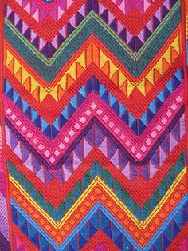
https://mayancalendar.net/weaving-the-thread-of-time-in-the-mayan-calendar/#.YNnIQulKgcg

Slide 6
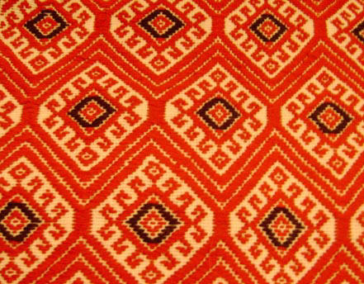
https://www.yachana.org/teaching/students/webpages/women08/patrickmaya.html

Slide 7
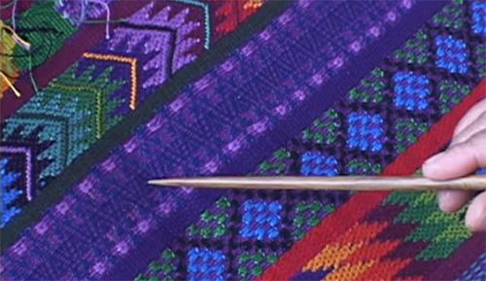
http://nationalclothing.org/america/82-guatemala/253-traditional-blouse-of-guatemala-maya-women-weave-their-folk-clothing-on-backstrap-loom.html

Slide 8
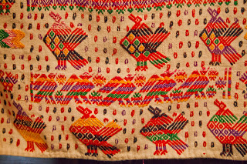
https://walkingarizona.blogspot.com/2012/08/mayan-textiles.html

Slide 9
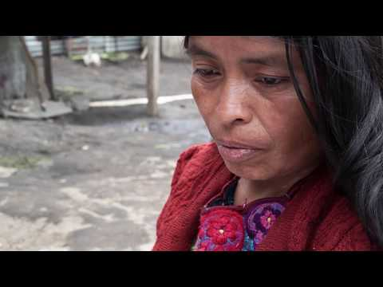
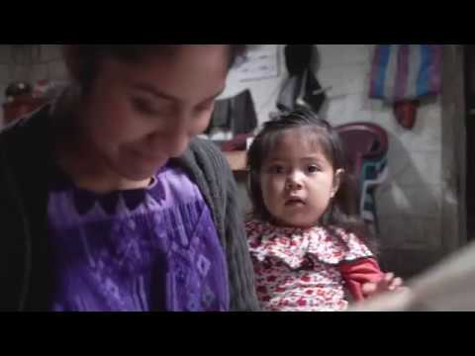
Video Resources

