Slide 1
Art Easel
Unit 4 Week 5

Slide 2
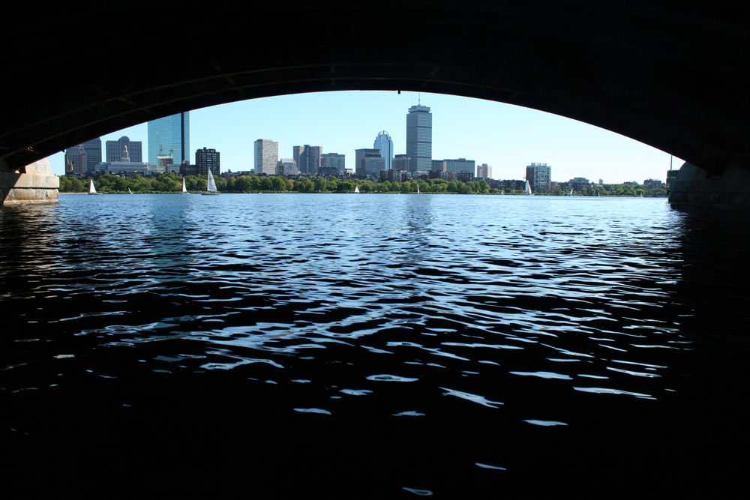
Charles River
http://www.francoissoulignac.com/blog/boston-charles-river-basin-by-kayak/

Slide 3
River Flowing

Slide 4
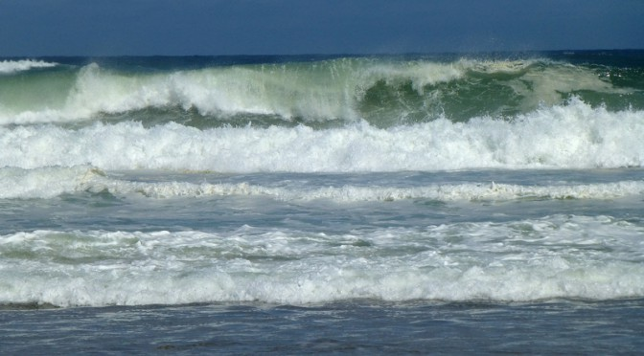
Waves on Cape Cod
https://www.mycapecodblog.com/?p=1315

Slide 5
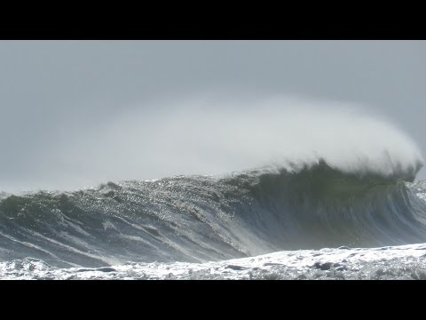
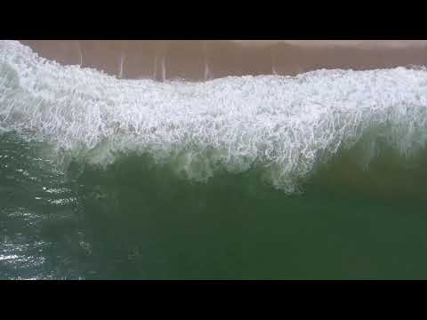
Ocean Waves on Cape Cod

Slide 6
Rain
https://www.myneworleans.com/rain-rain-go-away-2/

Slide 7
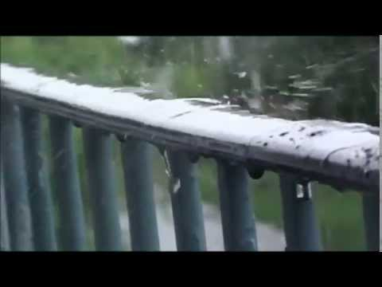
Rain

Slide 8
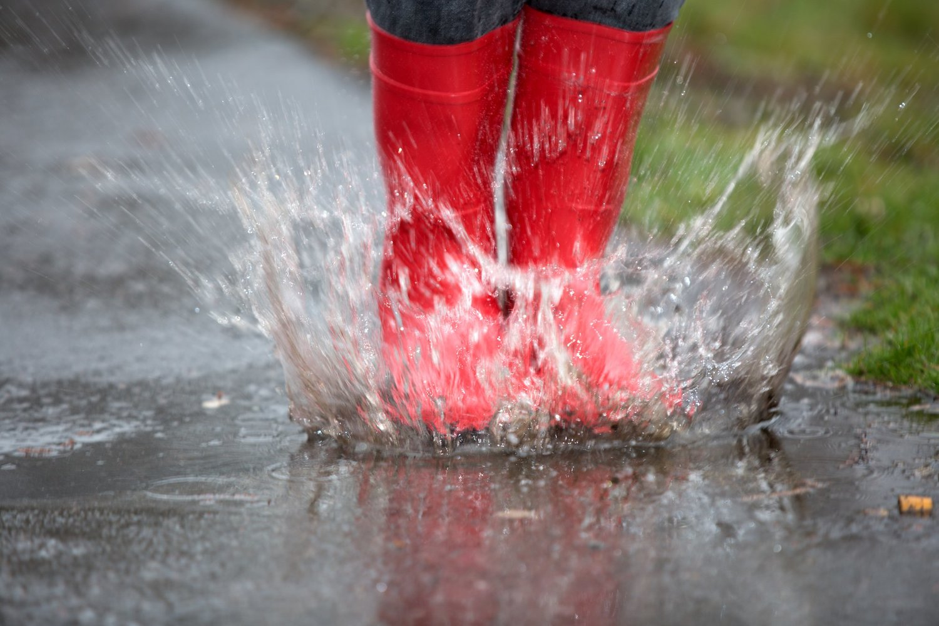
Puddle
https://www.dawnrigby.com/blog/2018/6/10/puddles

Slide 9
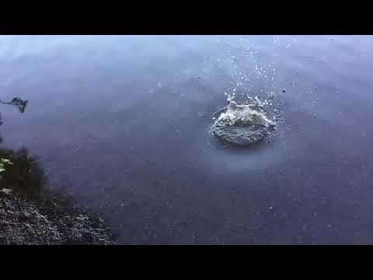
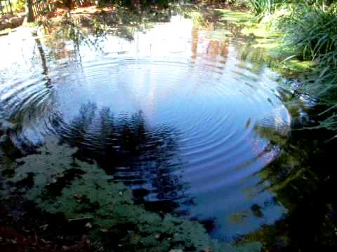
Ripples

