Slide 1
Art Easel
Unit 4, Week 1

Slide 2
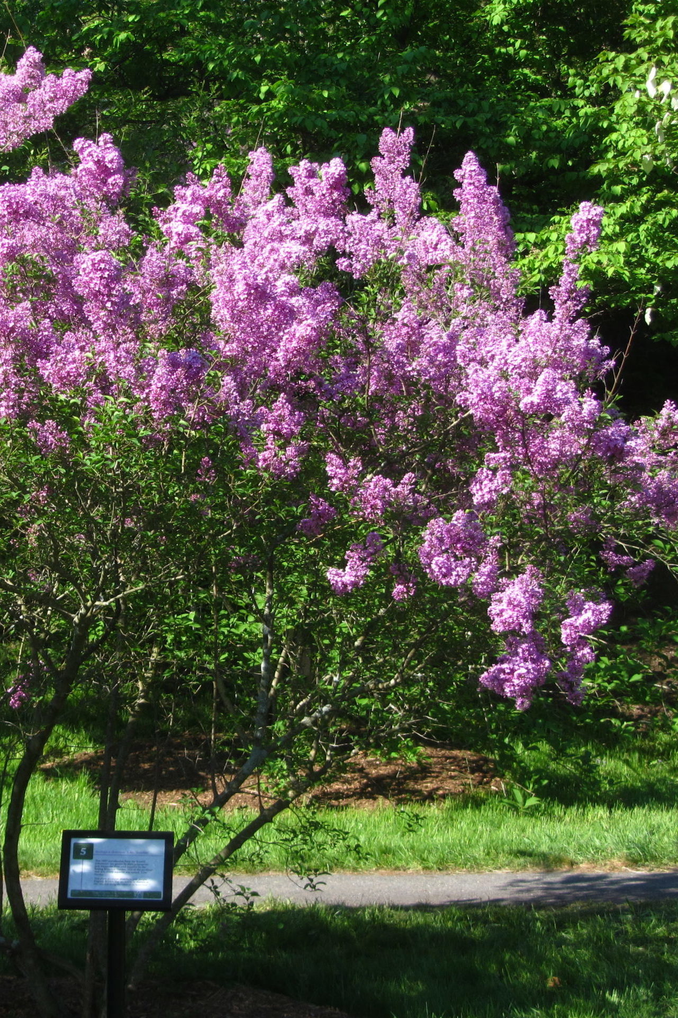
https://arboretum.harvard.edu/plant-bios/lilac-sunday/
Arnold Arboretum

Slide 3
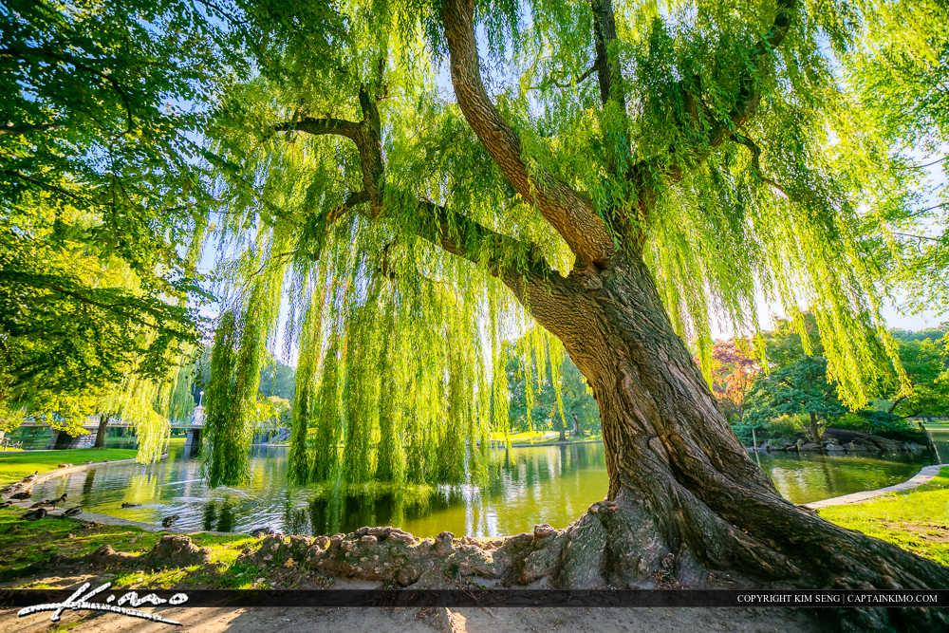
Boston Public Garden
https://royalstockphoto.com/gallery/wispering-willow-tree-boston-public-garden-2/

Slide 4
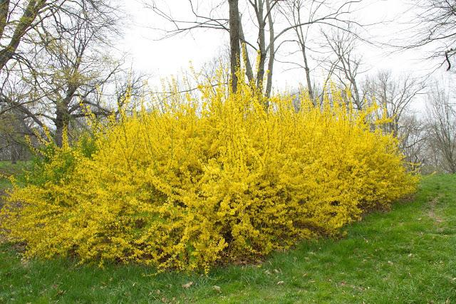
http://www.siteandinsight.com/springtime-in-boston-lets-hope-it-comes/
Arnold Arboretum

Slide 5
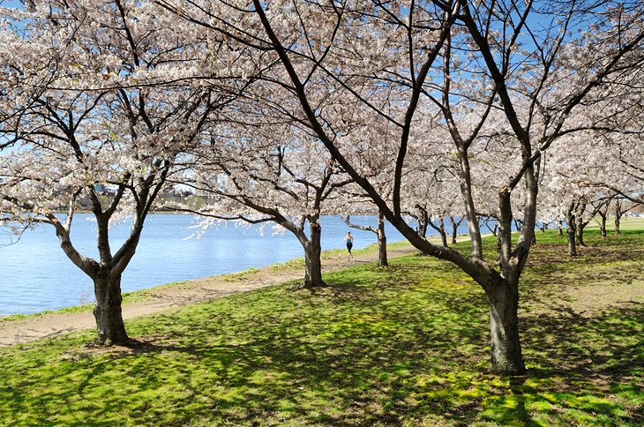
https://www.planetware.com/massachusetts/top-hiking-and-walking-trails-near-boston-us-ma-12.htm
Charles River

Slide 6
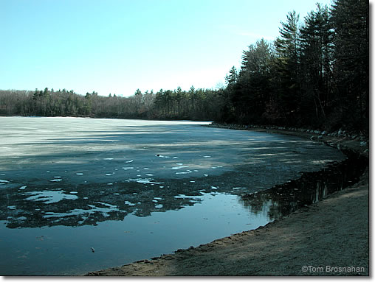
Walden Pond
https://newenglandtravelplanner.com/photo_gallery/walden_winter/photopages/014.html

Slide 7
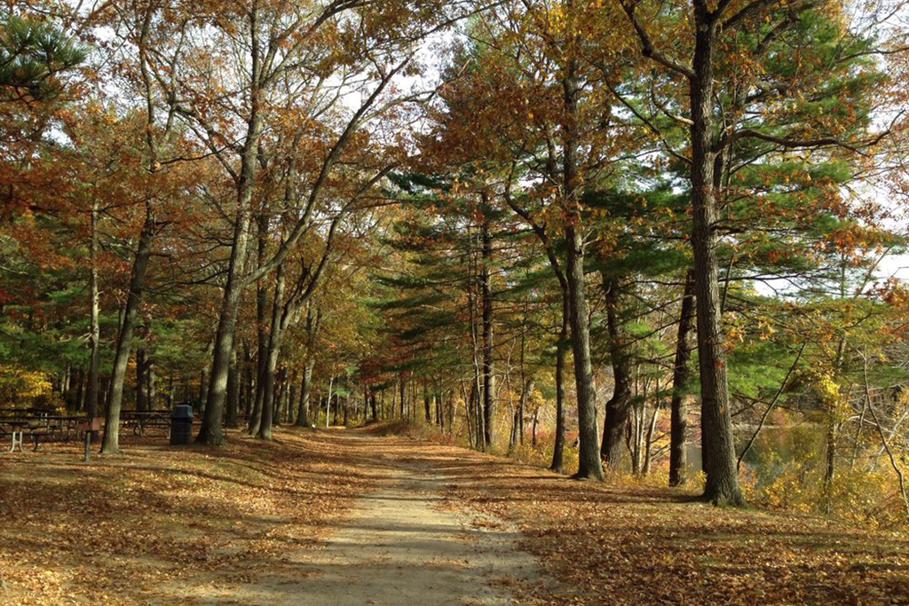
https://www.timeout.com/boston/things-to-do/best-camping-near-boston
Blue Hills Reservation

Slide 8
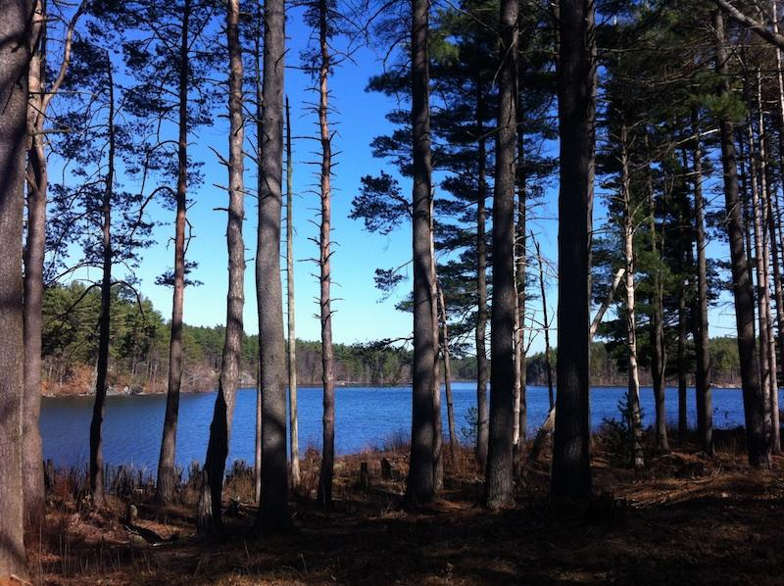
Middlesex Fells
http://somervillebeat.com/beyond/beyond-somervillea-walk-in-the-woods-at-the-middlesex-fells-reservation/

Slide 9
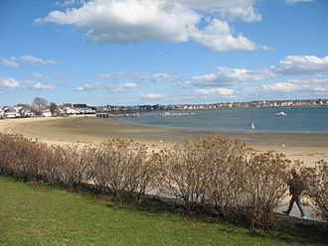
Constitution Beach East Boston
https://en.wikipedia.org/wiki/Constitution_Beach

Slide 10
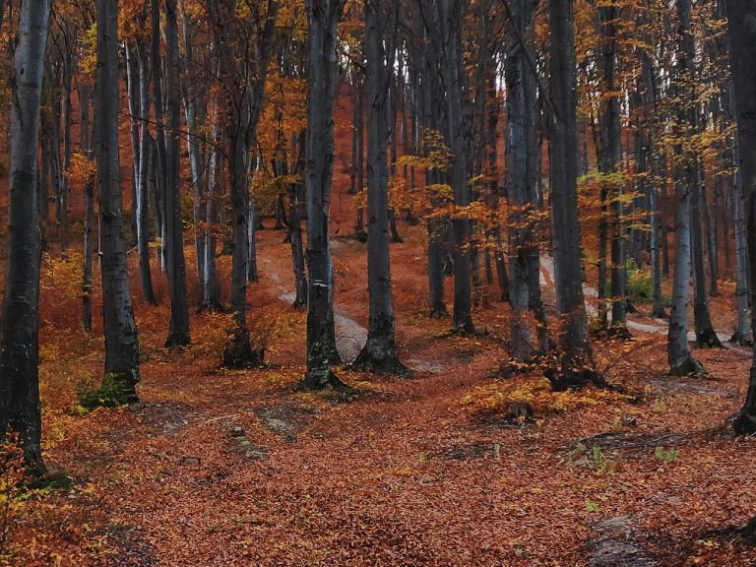
https://www.jackmaddenford.com/blogs/2928/is-the-blue-hills-reservation-free-10-essential-facts-for-visitors/
Blue Hills Reservation

Slide 11
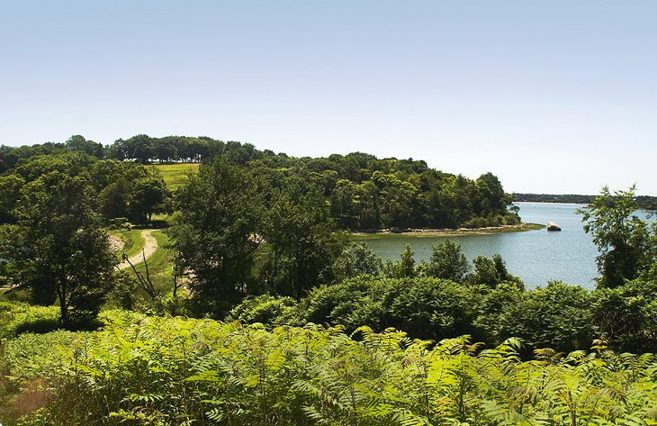
https://www.planetware.com/massachusetts/top-hiking-and-walking-trails-near-boston-us-ma-12.htm
World’s End
Hingham, MA

Slide 12
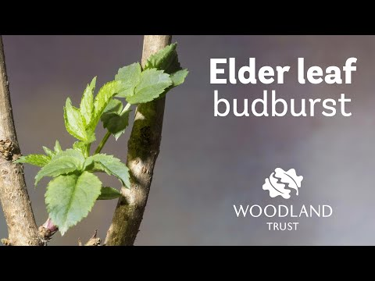
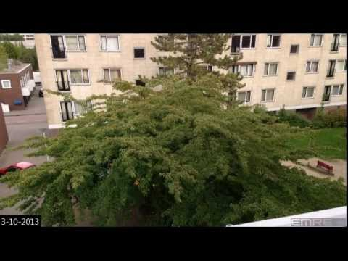
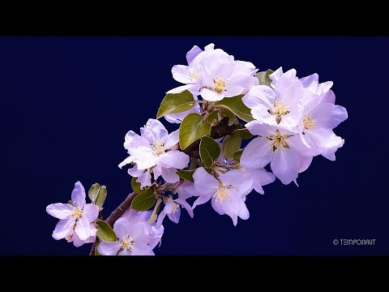
Watch one of these videos and see how it inspires you

