Slide 1
Art Table
Unit 4, Week 8

Slide 2
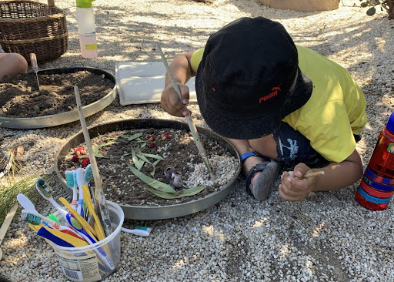
http://www.louisapenfold.com/soil-trays-land-art-for-kids/

Slide 3
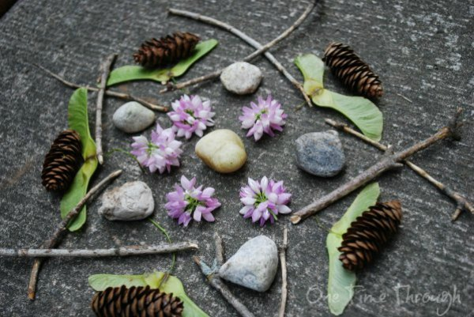
https://onetimethrough.com/open-ended-spring-art-projects-kids/

Slide 4
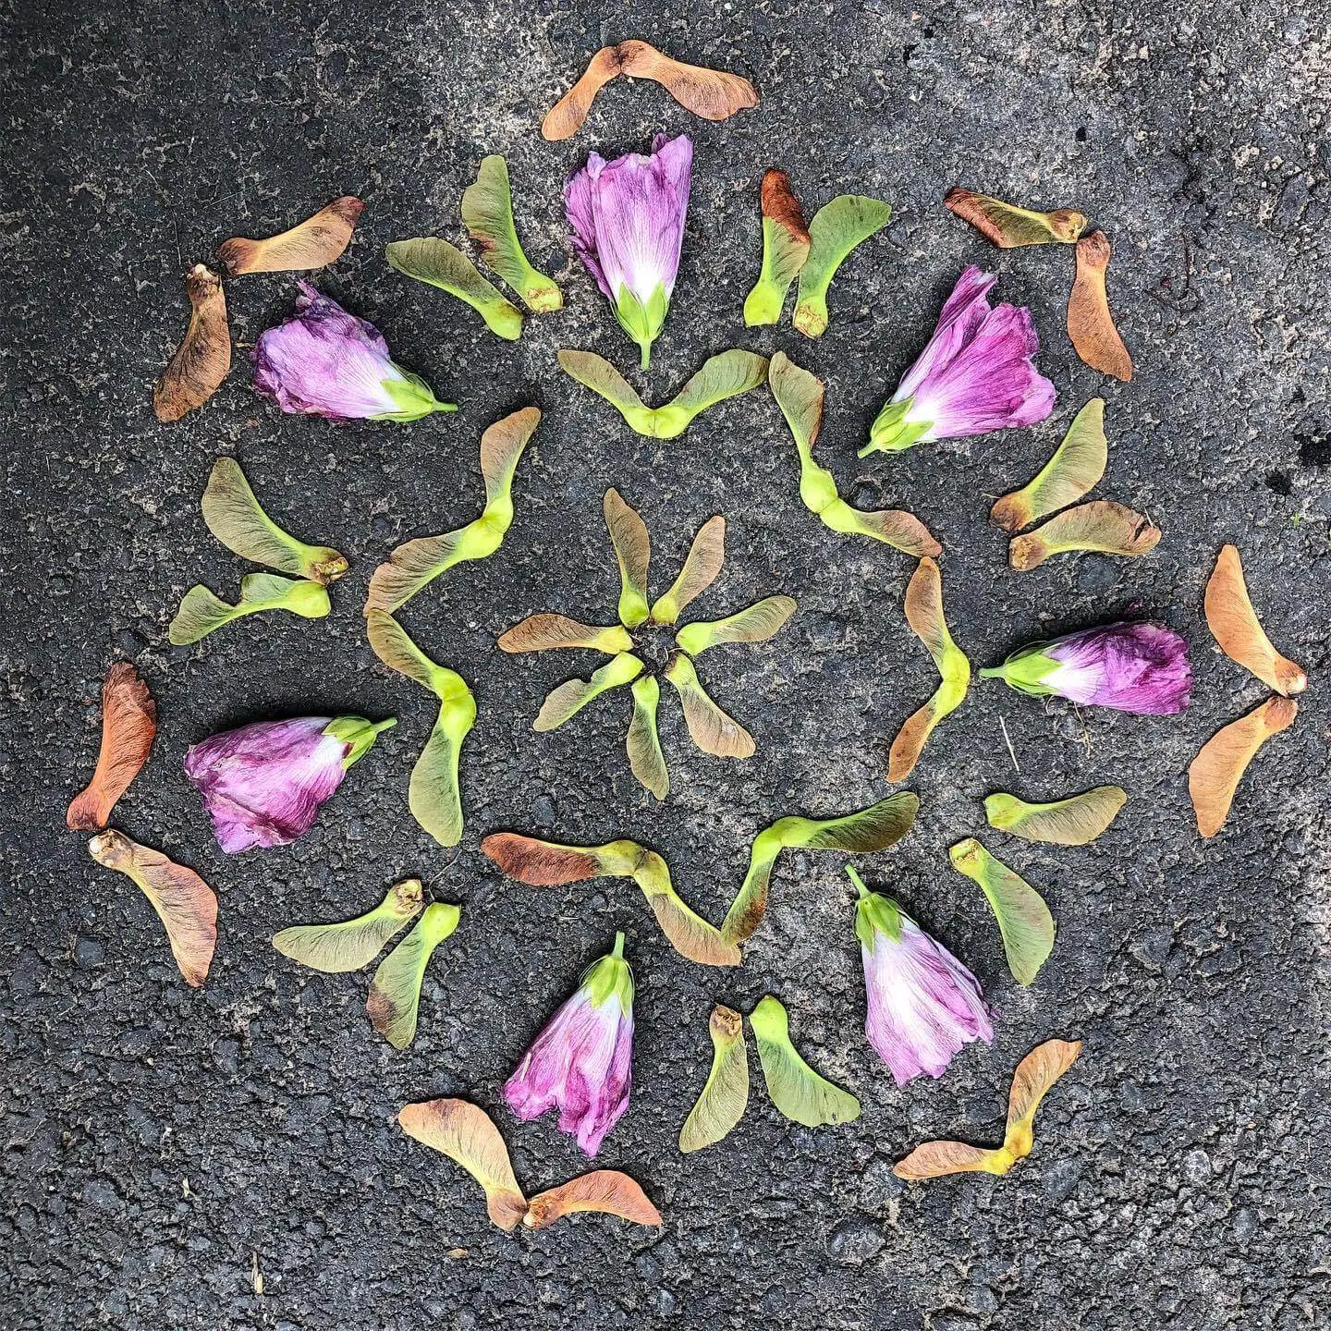
https://marymakesgood.com/2020/05/nature-mandalas.html

Slide 5
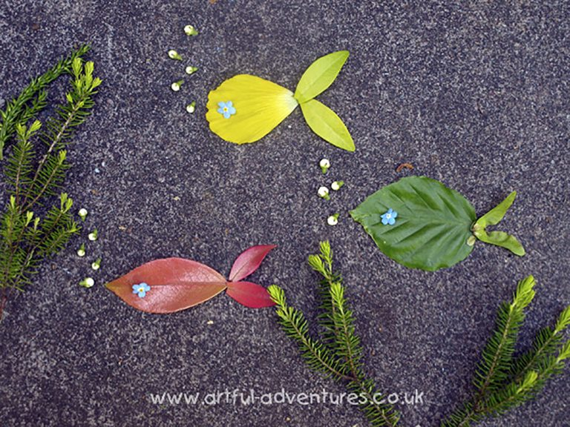
https://artful-kids.com/2011/05/04/land-art-in-the-spring/

Slide 6
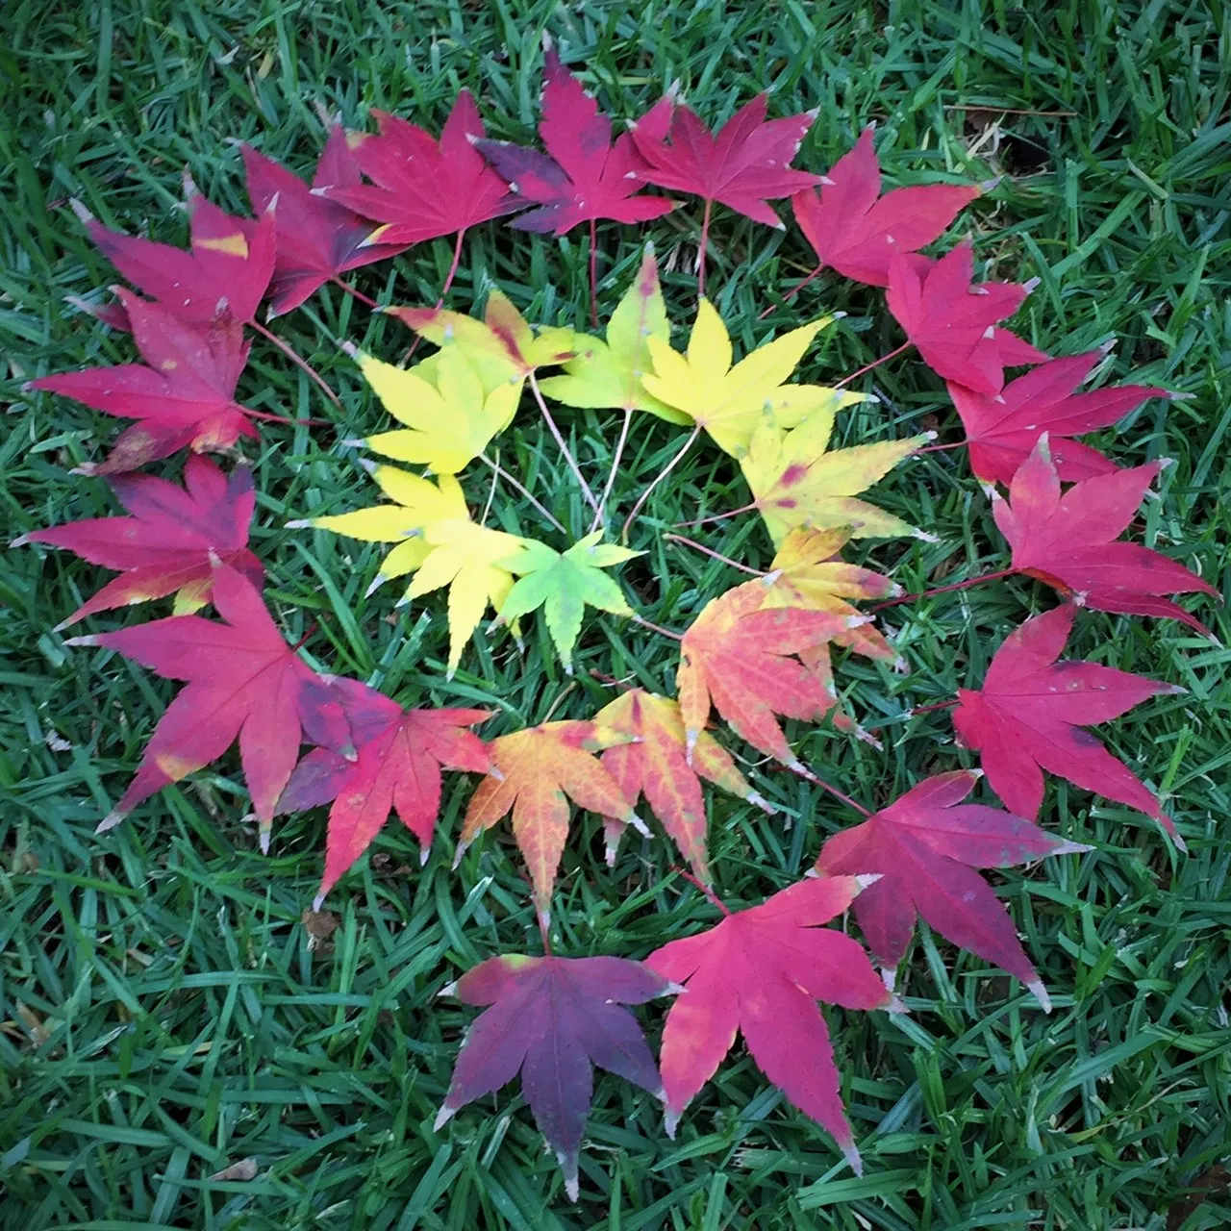
http://naturecraftsforkids.com/tag/land-art/

