Slide 1
Art Table
Unit 4, Week 7

Slide 2
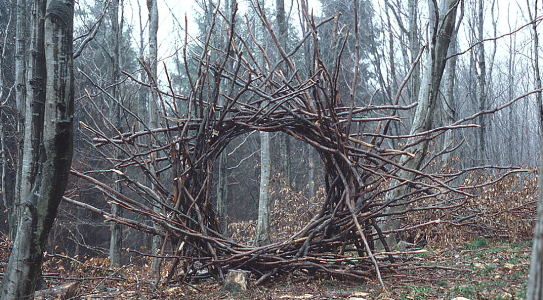
https://eldoradoexperience.org/journal/andy-goldsworthy-working-with-time/
Sculptor: Andy Goldsworthy

Slide 3
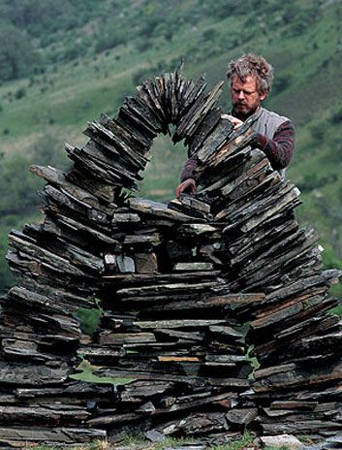
Sculptor: Andy Goldsworthy
https://www.smithsonianmag.com/arts-culture/35-who-made-a-difference-andy-goldsworthy-114067437/

Slide 4
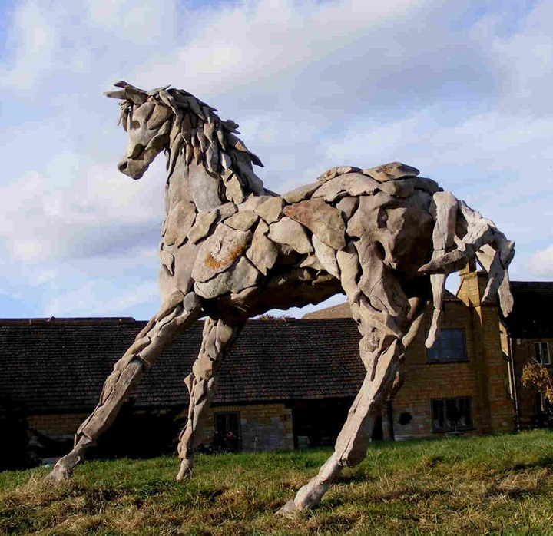
“Horse”
Sculptor: Duncan Elliot
https://positiveimagination.me/2017/03/02/charles-searles-african-american-visual-artists-achievements-series-38/

Slide 5
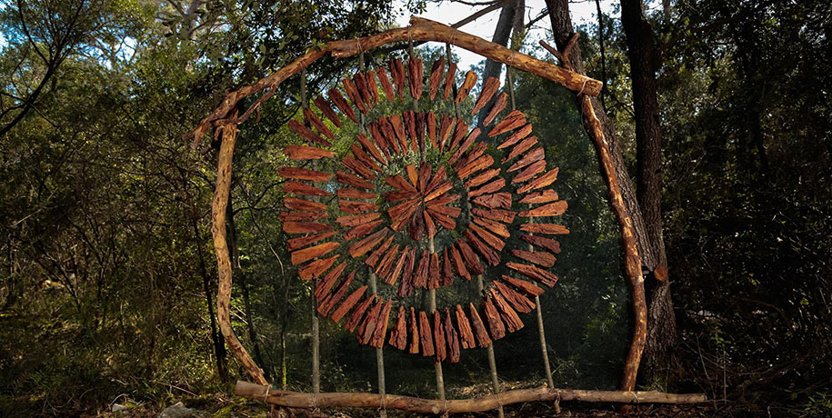
https://www.demilked.com/forest-land-art-nature-spencer-byles/
Sculptor: Spencer Byles
Recycled Bottle Caps collage painting

