Slide 1
Art Table
Unit 4, Week 4

Slide 2
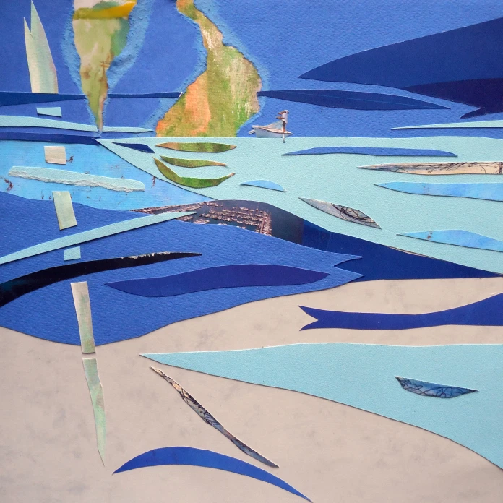
“Water Collages”
Artist: Deborah Semel Demirtaş
https://deborahsemeldemirtas.com/2015/07/04/water-collages/

Slide 3
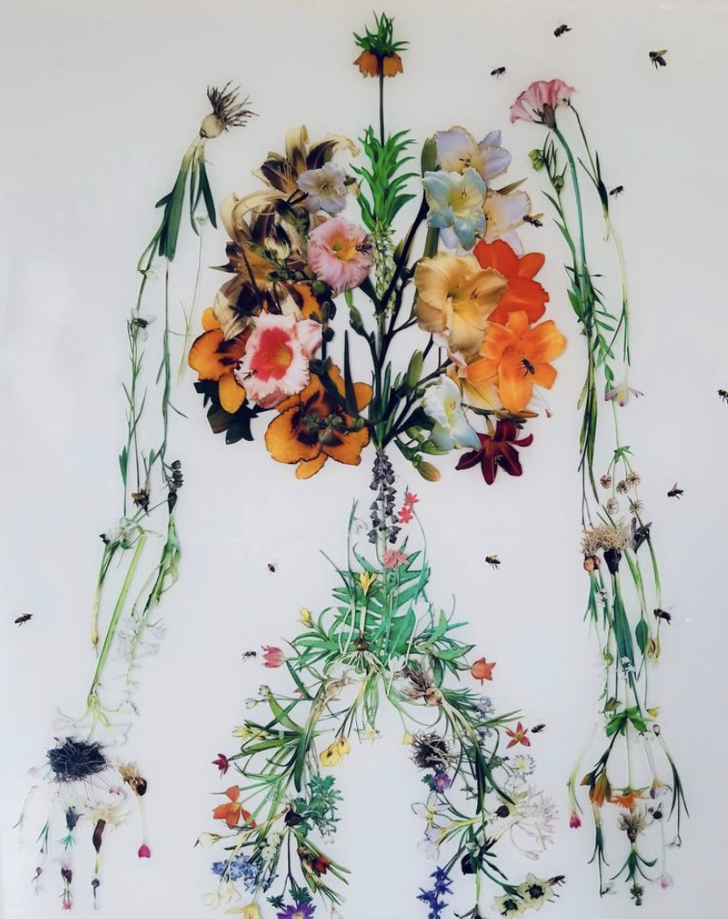
“Human Nature Collage”
Artist: Holly Hudson
https://www.saatchiart.com/art/Collage-Human-Nature/399948/6203079/view

Slide 4
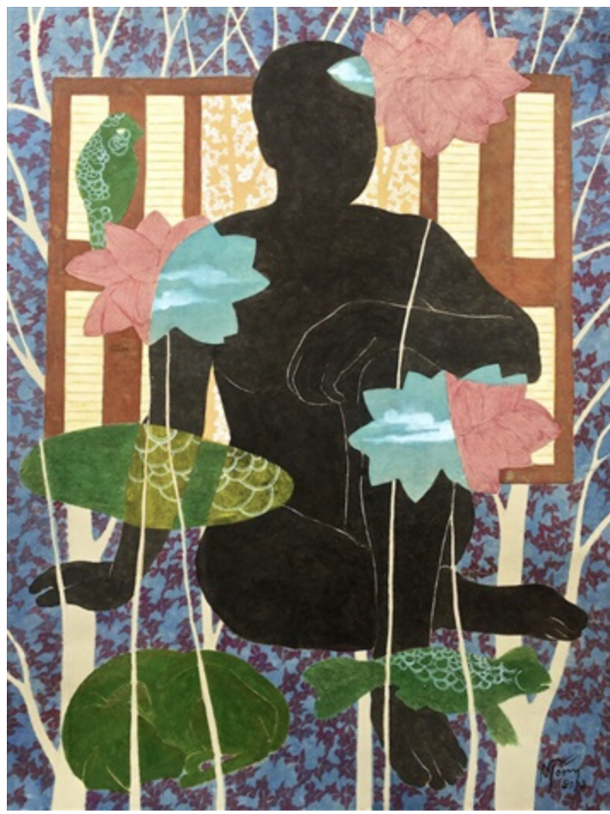
https://thepaperfair.com/exhibitors/exhibitor/vietnamese-contemporary-fine-art-art-on-paper-ny-2019
“Lotus Vision”
Artist: Dinh Thi Tham Poong

Slide 5
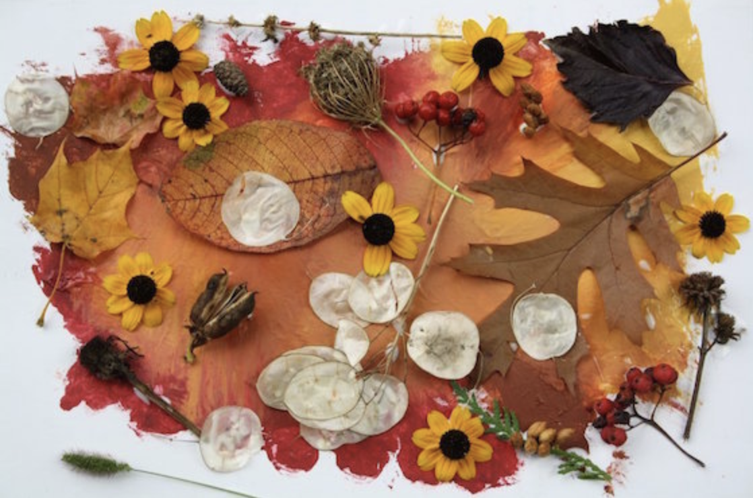
http://wildfreeandcrafty.com/2018/08/26/kids-crafts/

Slide 6
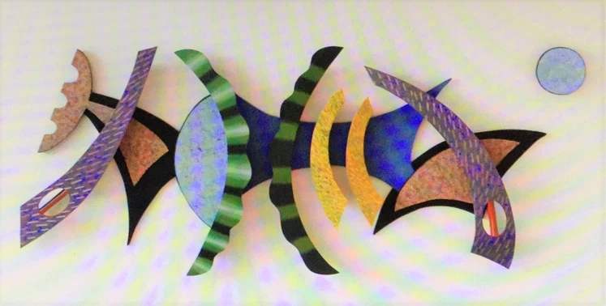
“Moondance”
Artist: Charles Searles
https://positiveimagination.me/2017/03/02/charles-searles-african-american-visual-artists-achievements-series-38/

Slide 7
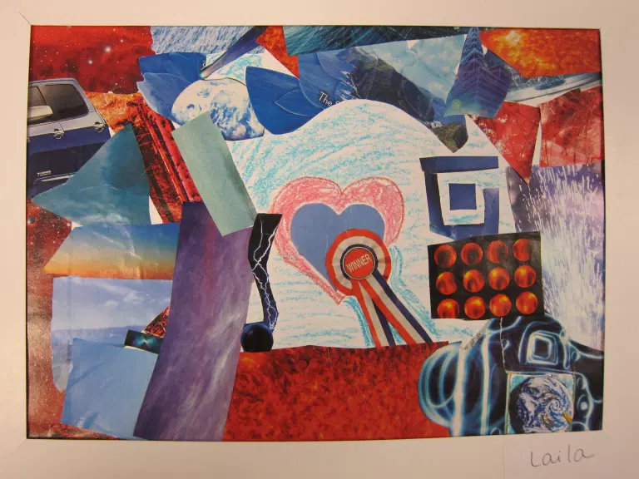
Artist: Marcia Beckett
https://www.artisbasic.com/2016/01/why-i-love-collage.html

