Slide 1
Our Earth: Saving Water
Peggy Hock
Scholastic News: Nonfiction Readers

Slide 2
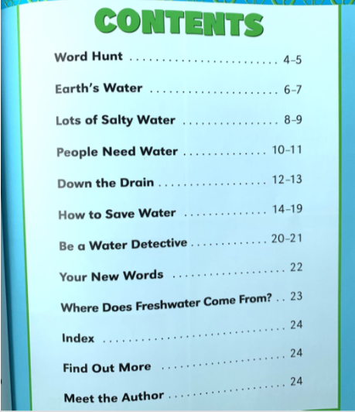

Slide 3
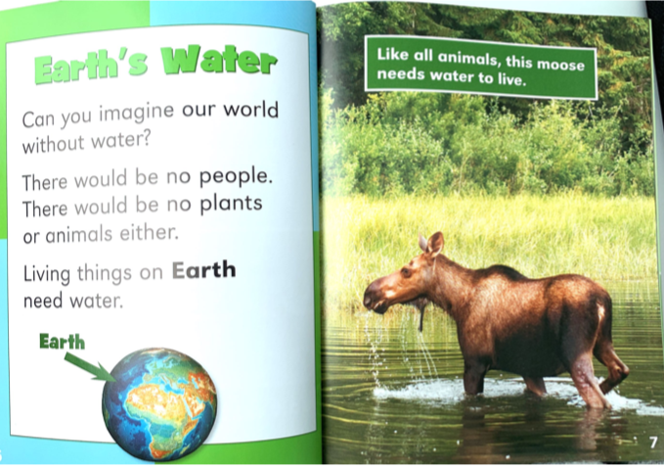

Slide 4
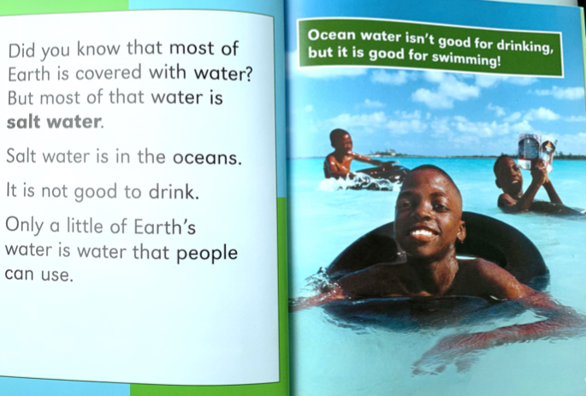

Slide 5
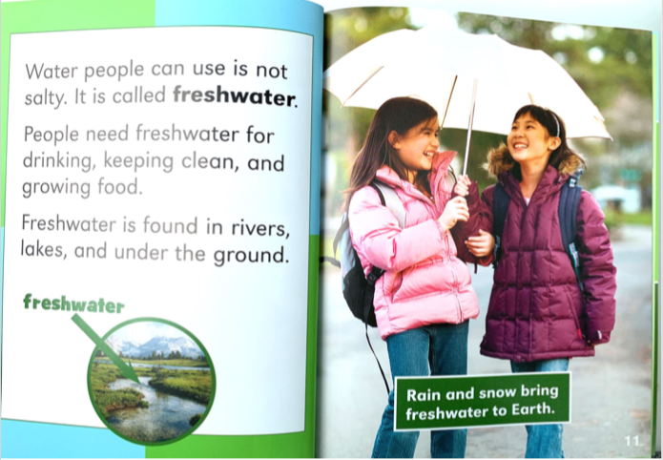

Slide 9
