Slide 1
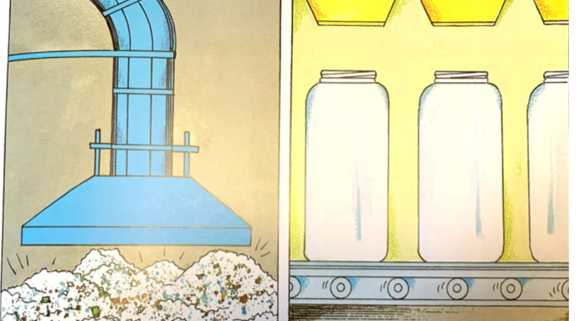
It takes much less energy and creates less pollution to make new glass from old glass. The glass is crushed and remelted. Next, recycled liquid glass is poured into formed machines and stamped into new glass products. The sad, lime, and soda ash don’t have to be dug again, which would waste natural resources and destroy forests and fields.

