Slide 1
Cristal Martinez: Caretaker of Our Earth
Focus on K2 Unit 4 Week 7

Slide 2
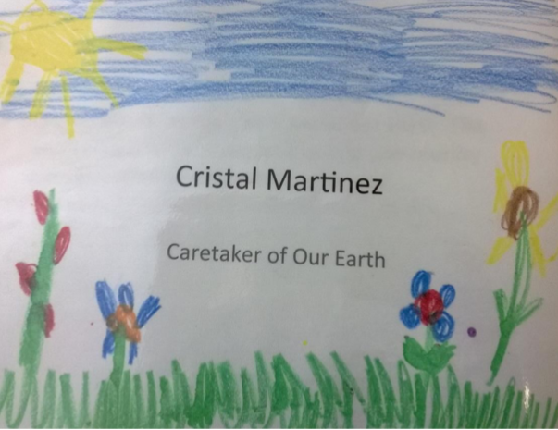

Slide 3
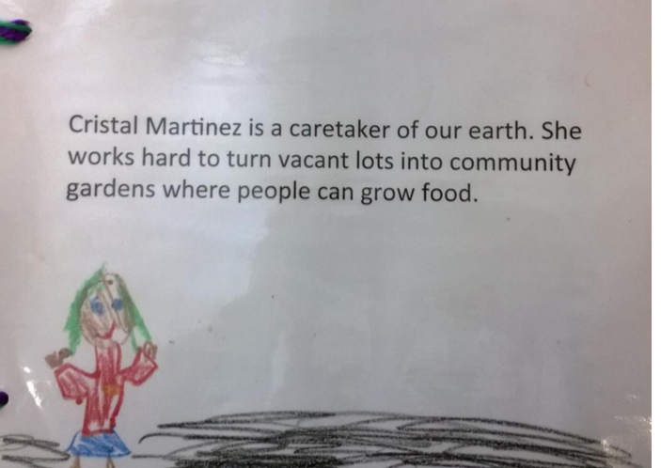

Slide 4
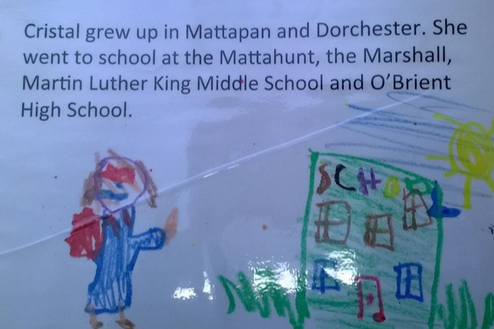

Slide 5
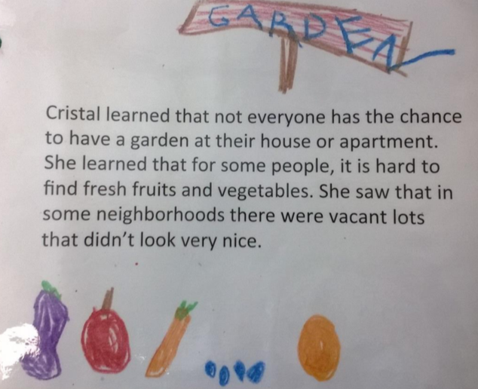

Slide 6
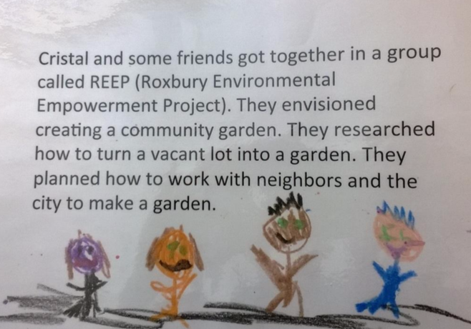

Slide 7
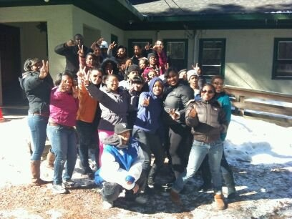
https://ace-ej.org/reep

Slide 8
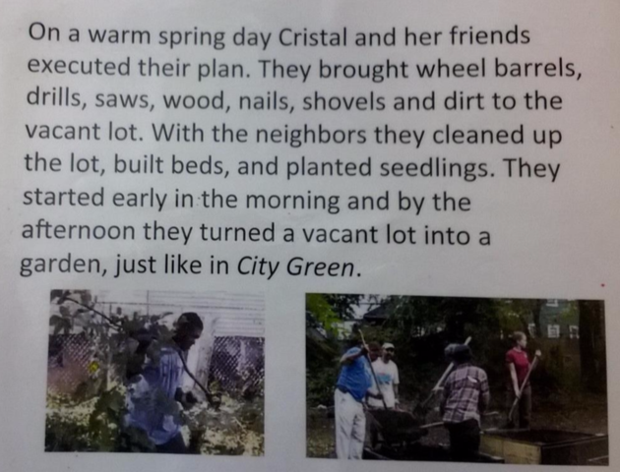

Slide 9
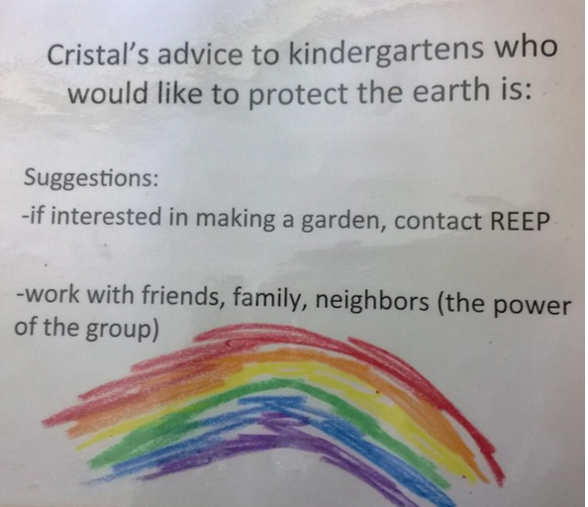

Slide 10
Watch a video of Cristal Martinez talking about how she’s a Caretaker of our Earth!
Notes:
Click on link to watch video.

Slide 11
