Slide 1
Communities as Caretakers of the Earth
Read Aloud Unit 4, Week 7 Day 5

Slide 2
How did the communities in these two texts work together to be caretakers of the earth?

Slide 4
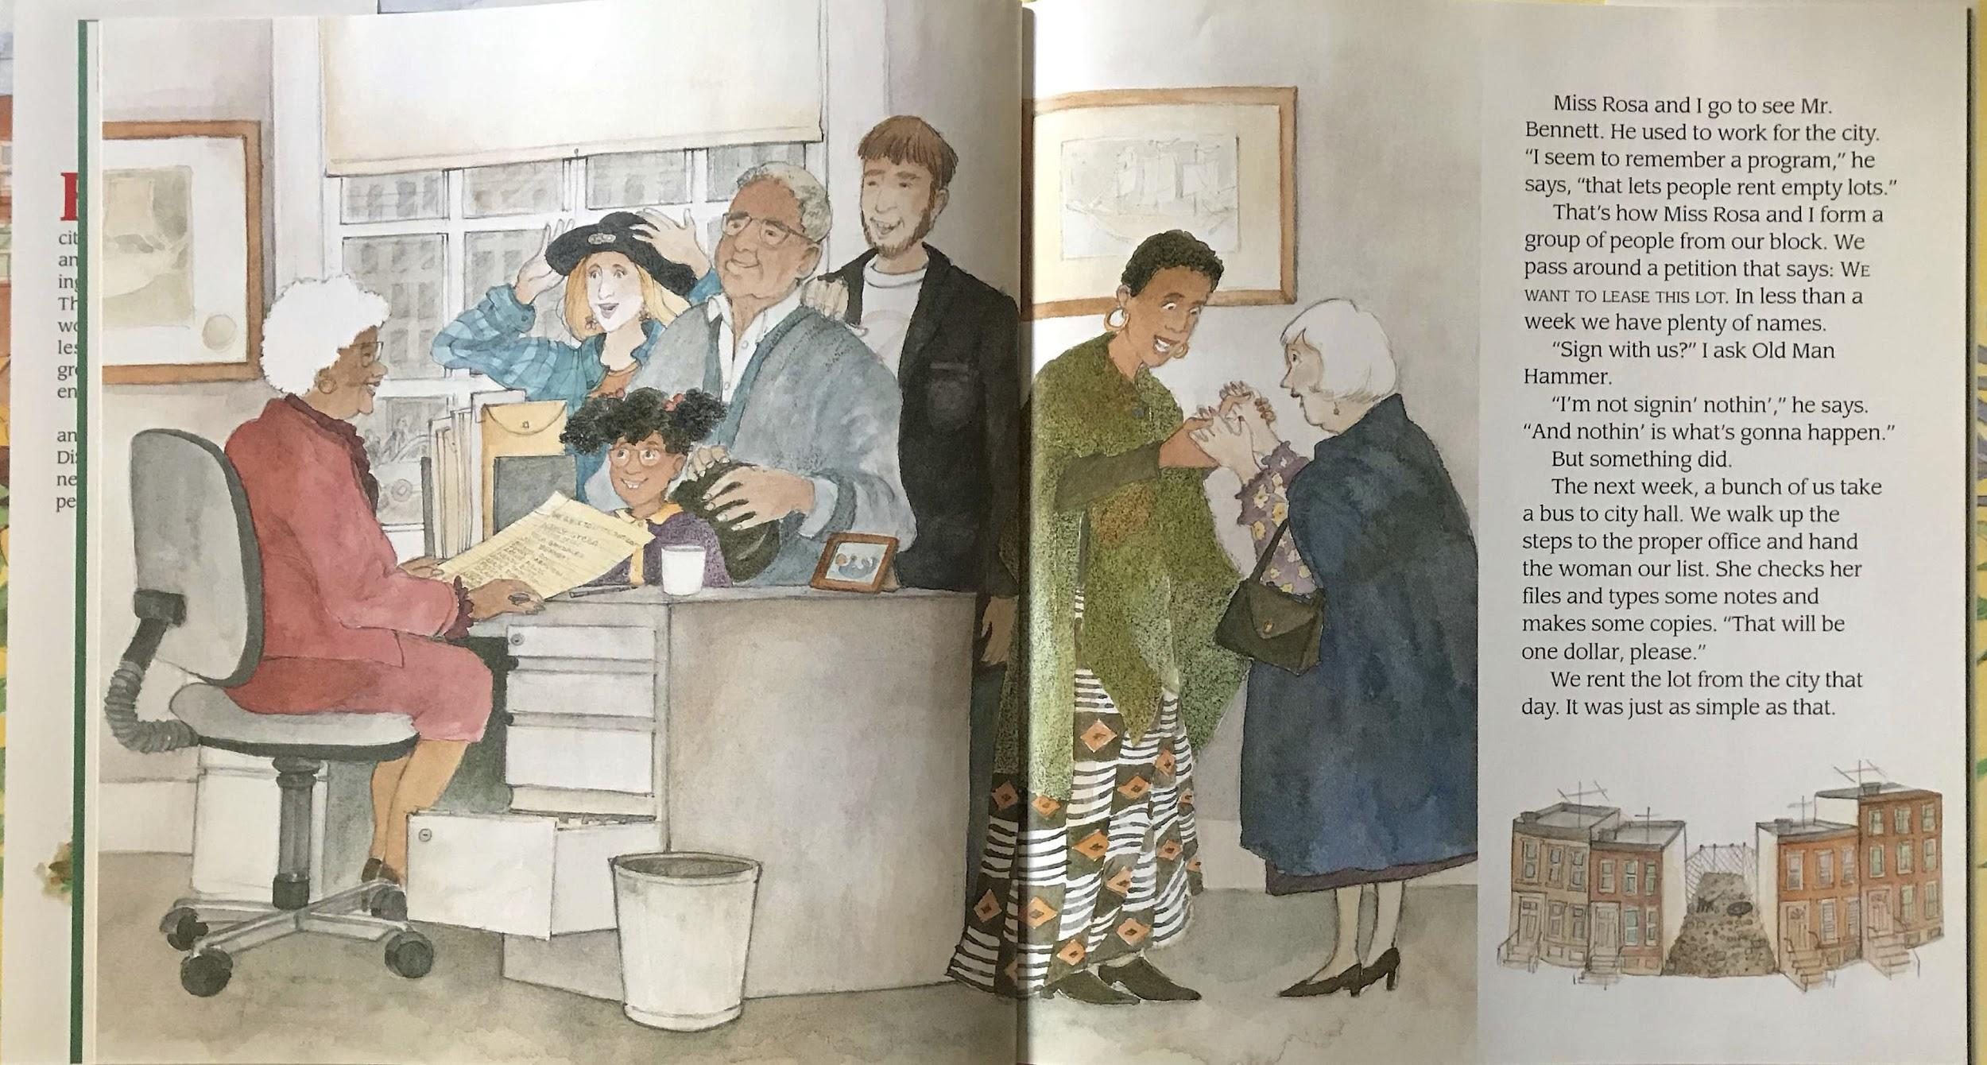

Slide 5
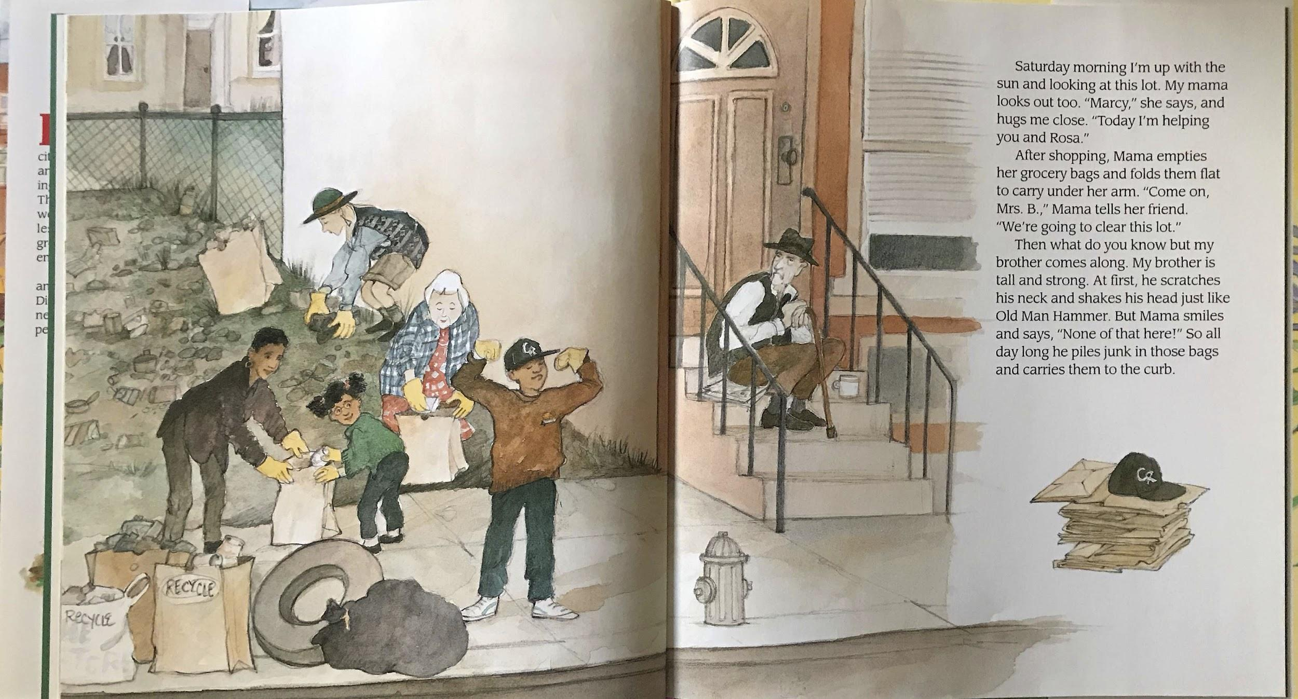

Slide 6
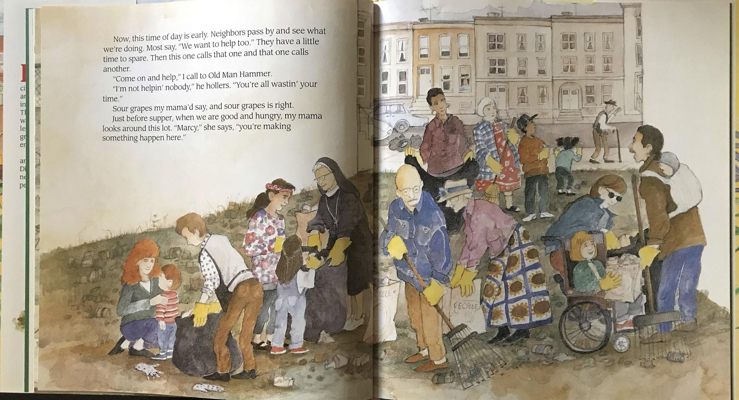

Slide 7
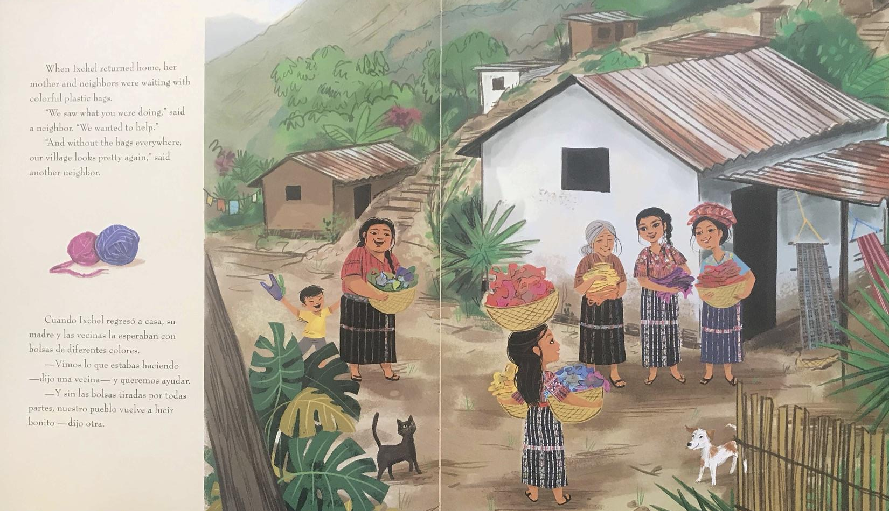

Slide 8
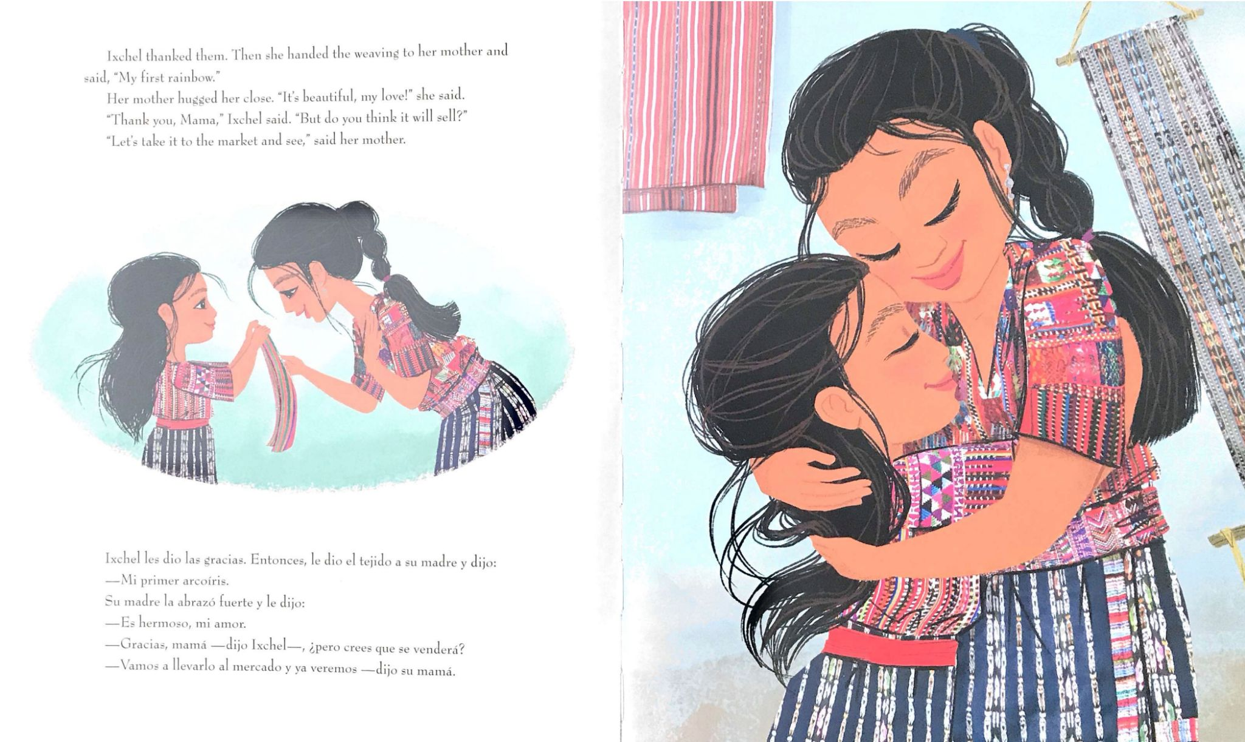

Slide 9
How can communities work together to be caretakers of the Earth?

