Slide 1
Text Comparison
Read Aloud Week 5 Day 5

Slide 2
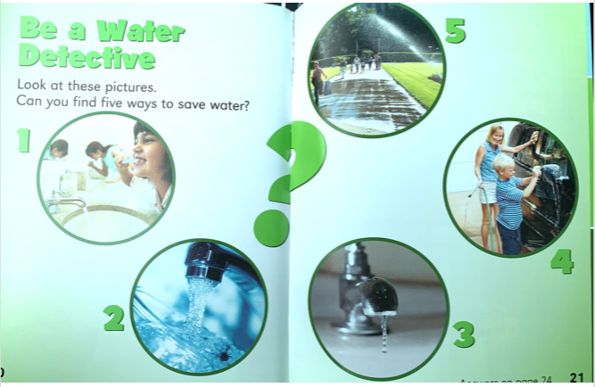

Slide 3
