Slide 1
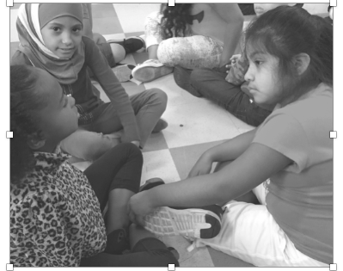
Think, Triad, Share
 | Face one another.
 | 2. Think about your ideas.
 | 3. The “Discussion Starter” shares ideas. 4. Discuss ideas. Every person participates.
 | 5. The “Reporter” shares out.

