Slide 1
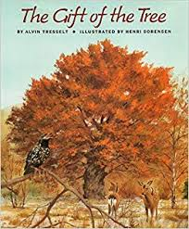
Notes:
spread: to stretch out, to extend
tunnel (v): to hollow out under or through something, to dig
weak: likely to break, not sturdy
nourishment: something needed to be alive and grow, food
return: to come back

Slide 2
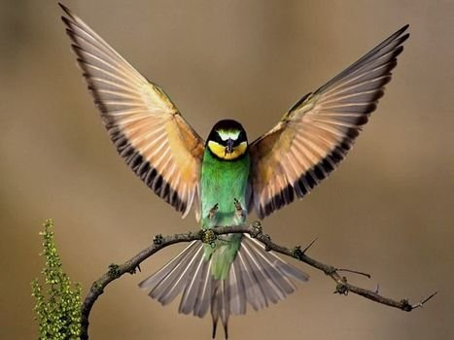
spread
https://pixy.org/1386270/
Notes:
A word in the story is spread.
In Spanish it is extender (ehks-tehn-dehr).
To spread is to stretch out, to extend. Let’s stand up and spread our arms to the ceiling like young shoots of a tree looking for light to grow.
Let’s say the word spread together. Ready?
”Spread.” When you say spread, I hear the /s/ sound at the beginning of the word.
Look, spread begins with the letter s.
Here is a picture that shows spread. The bird is spreading its wings. Look how much bigger he seems!

Slide 3
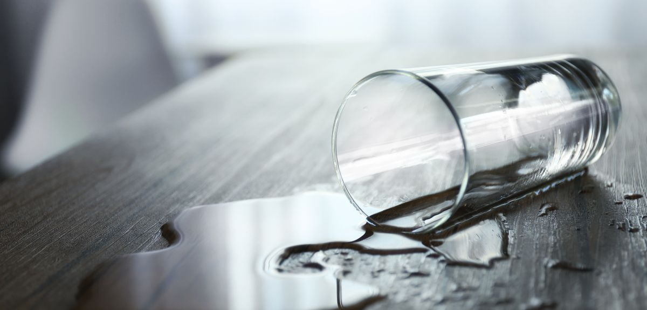
spread
https://www.ox.ac.uk/news/science-blog/why-does-liquid-stay-horizontally-turned-straw-not-glass
Notes:
Here is another picture of spread.
How does this picture show the meaning of spread? Turn and talk to your partner.
The glass fell on the table and the water spread all over the table.
How many syllables are in the word spread? Let’s find out by clapping. Ready?
“Spread.” 1 syllable.
Now, let’s say spread three times while clapping the syllables. Ready?
“Spread, spread, spread.”

Slide 4
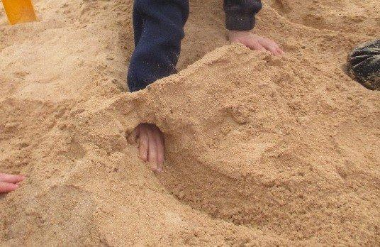
tunnel
https://steemit.com/steemiteducation/@evlachsblog/sand-tunnel
Notes:
Another word in the story is tunnel.
In Spanish it is cavar (kah-bahr).
Have you heard this word before? What do you know about it? [Gather a few ideas from the children.]
To tunnel in this text is an action that means to hollow out under or through something, to dig.
Let’s say the word tunnel together. Ready?
”Tunnel.” When you say tunnel, I hear the /t/ sound at the beginning of the word.
Look, tunnel begins with the letter t.
This picture shows tunnel. The person tunneled through the sand to make a castle surrounded by a ditch.

Slide 5
tunnel
https://www.chconstructionkc.com/termite-and-carpenter-ant-damage-prevention/
Notes:
Here is another picture of tunnel.
How does this picture show the meaning of tunnel? Turn and talk to your partner.
Carpenter ants and termites tunneled through this log. Look at all the tunnels they made by eating up rotten wood.
How many syllables are in the word tunnel? Let’s find out by clapping. Ready?
“Tun-nel.” 2 syllables.
Now, let’s say tunnel three times by clapping the syllables. Ready?
“Tun-nel, tun-nel, tun-nel.”

Slide 6
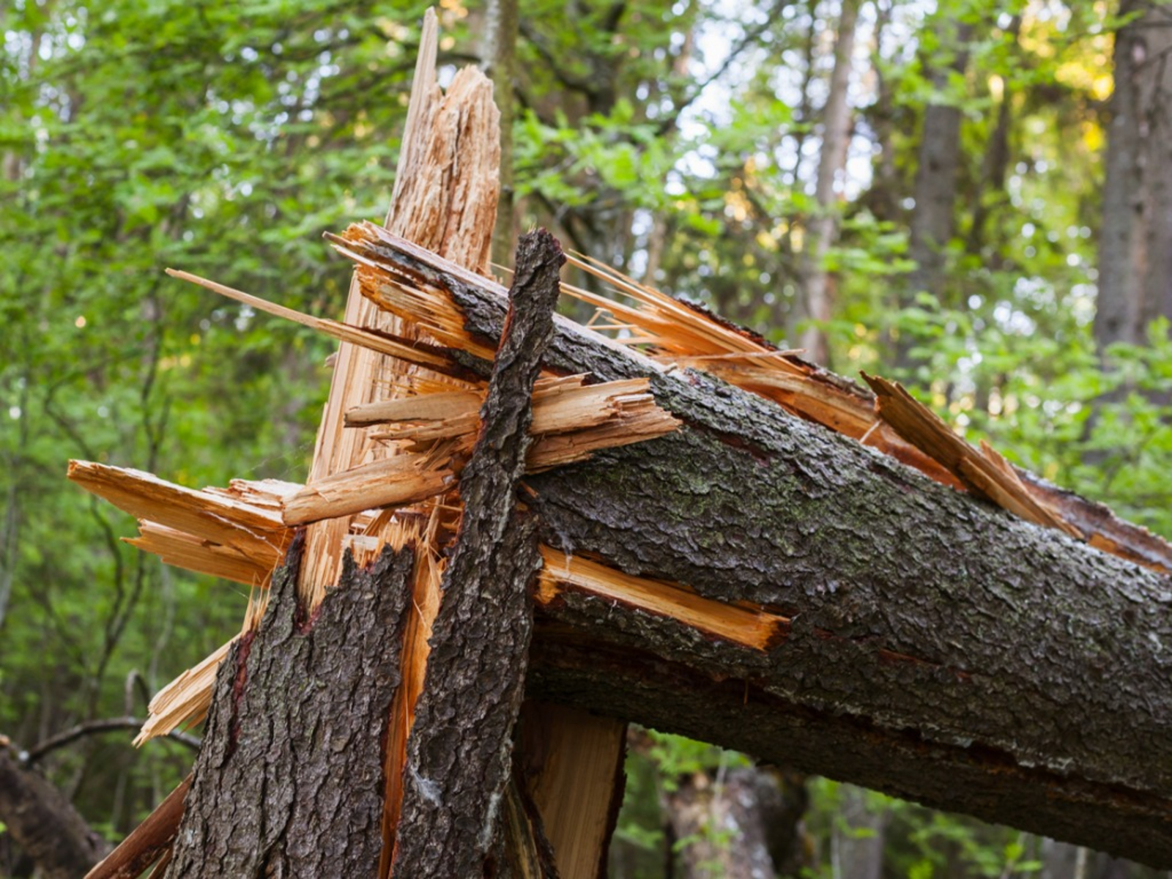
weak
https://www.gardeningknowhow.com/ornamental/trees/tgen/dry-brittle-tree-branches.htm
Notes:
A word in the story is weak.
In Spanish it is débil (deh-beel).
Weak describes something that is likely to break, not sturdy.
Let’s say the word weak together. Ready?
”Weak.” When you say weak, I hear the /w/ sound at the beginning of the word.
Look, weak begins with the letter w.
Here is a picture that shows weak. The trunk of the tree was weak, so it broke during a storm.

Slide 7
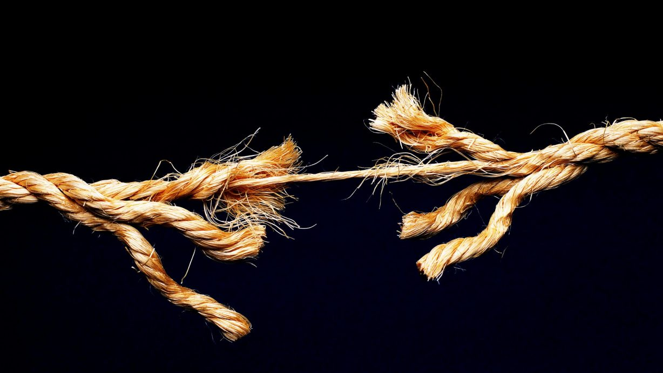
weak
https://sarahnollwilson.com/toleration-tension/
Notes:
Here is another picture of weak.
How does this picture show the meaning of weak? Turn and talk to your partner.
This picture shows a rope with weak threads. When someone pulled on the rope, it broke.
How many syllables are in the word weak? Let’s find out by clapping. Ready?
“Weak.” 1 syllable.
Now, let’s say weak three times by clapping the syllables. Ready?
“Weak, weak, weak.”

Slide 8
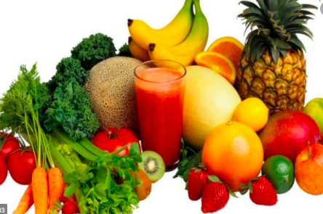
nourishment
https://www.lifehack.org/articles/lifestyle/20-incredible-facts-about-eating-fruits-and-vegetables-that-you-probably-didnt-know.html
Notes:
A word in the story is nourishment.
In Spanish it is nutrición (noo-tree-syohn).
Nourishment is something that is needed for a plant or animal to be alive and grow; it’s food.
Let’s say the word nourishment together. Ready?
”Nourishment.” When you say nourishment, I hear the /n/ sound at the beginning of the word.
Look, nourishment begins with the letter n.
Here is a picture that shows nourishment. Fruits and vegetables are nourishment for us; they give us nutrition we need to be healthy and to grow.

Slide 9
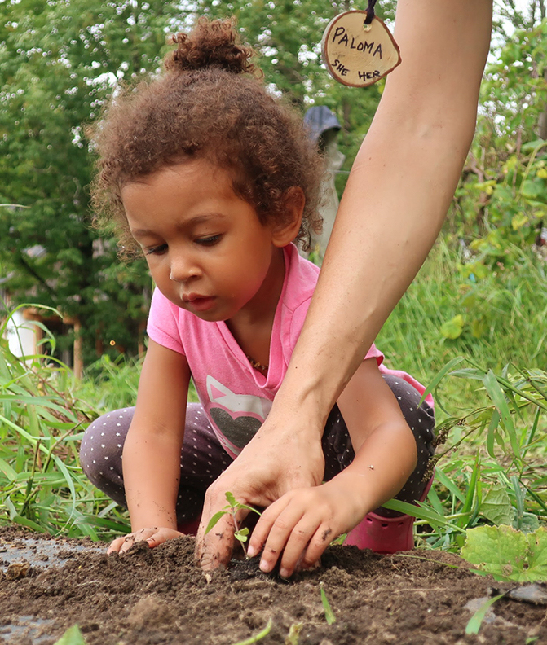
nourishment
https://civileats.com/2019/02/18/by-reconnecting-with-soil-we-heal-the-planet-and-ourselves/
Notes:
Here is another picture of nourishment.
How does this picture show the meaning of nourishment? Turn and talk to your partner.
The soil is nourishment for the new shoot.
How many syllables are in the word nourishment? Let’s find out by clapping. Ready?
“Nour-ish-ment” 3 syllables.
Now, let’s say nourishment three times by clapping the syllables. Ready?
“Nour-ish-ment, nour-ish-ment, nour-ish-ment”

Slide 10
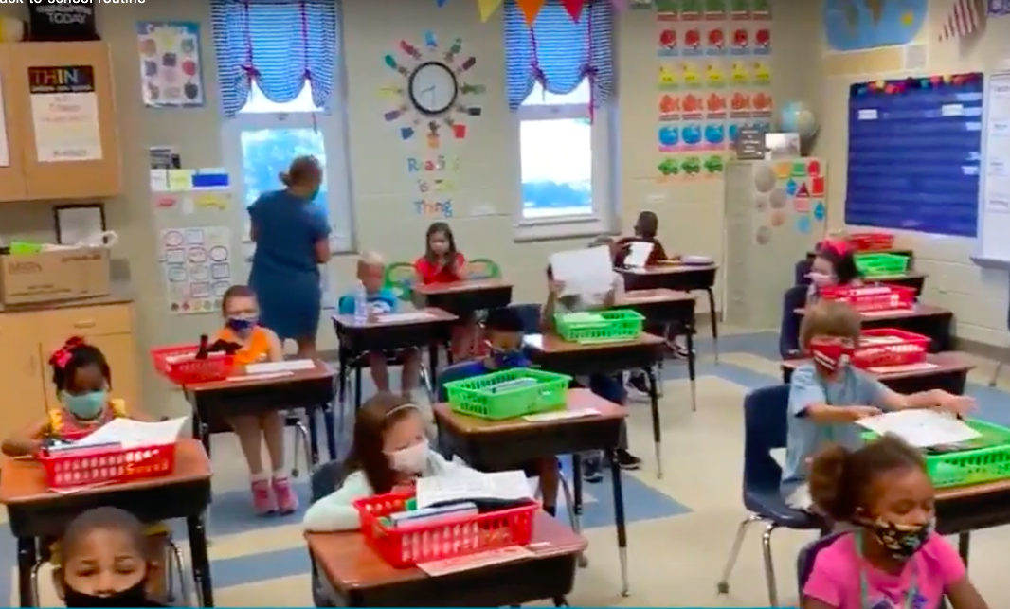
return
https://globalnews.ca/news/7288714/coronavirus-back-to-school-prep/
Notes:
A word in the story is return.
In Spanish it is volver (bohl-behr).
To return is to come back.
Let’s say the word return together. Ready?
”Return” When you say return, I hear the /r/ sound at the beginning of the word.
Look, return begins with the letter r.
Here is a picture that shows return. These children returned to school after learning for many months remotely.

Slide 11
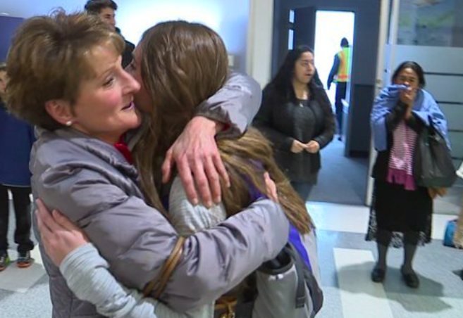
return
https://fox8.com/news/local-students-return-home-after-school-trip-to-ft-lauderdale/
Notes:
Here is another picture of return.
How does this picture show the meaning of return? Turn and talk to your partner.
The mother and daughter hug each other when the daughter returns from visiting her family in Colombia.
How many syllables are in the word return? Let’s find out by clapping. Ready?
“Return.” 2 syllables.
Now, let’s say return three times by clapping the syllables. Ready?
“Re-turn, re-turn, re-turn.”

