Slide 1
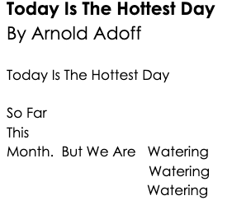

Slide 2
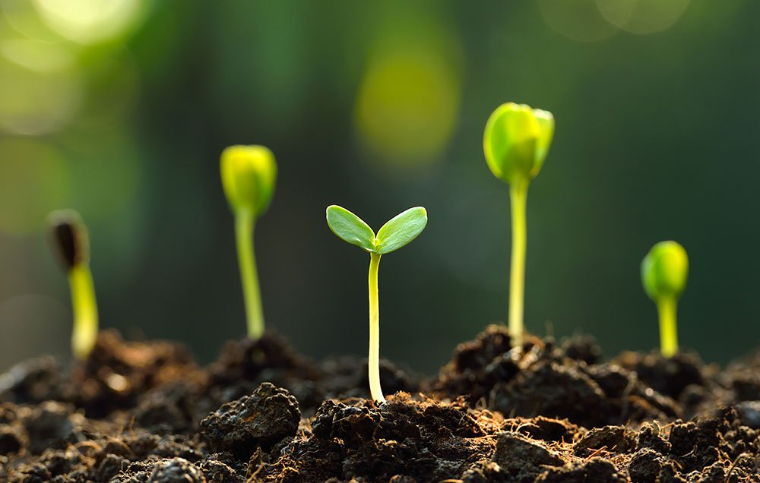
shoot
https://twitter.com/darrigonewyork
Notes:
A word in the poem is shoot.
In Spanish it is brote (broh-teh).
A shoot in the poem is a little piece of new growth. The word shoot has many different meanings. What are other meanings you know for this word?
Let’s say the word shoot together. Ready?
”Shoot.” When you say shoot, I hear the /sh/ sound at the beginning of the word.
Look, shoot begins with the letters sh, together they make the /sh/ sound. We call it a digraph..
Here is a picture that shows several shoots. The seeds underground sprouted and the new shoots are coming out looking for the light to grow.

Slide 3
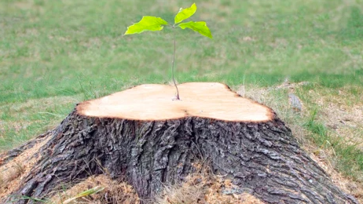
shoot
https://treasuredupandpondered.blog/2018/06/29/a-shoot-from-a-stump/
Notes:
Here is another picture of shoot.
How does this picture show the meaning of shoot? Turn and talk to your partner.
The image shows a shoot coming out of a stump of a tree. The tree was cut down and a seed fell inside a crack in the stump. It allowed the seed to sprout and a shoot grew out of it.
How many syllables are in the word shoot? Let’s find out by clapping. Ready?
“Shoot.” 1 syllable.
Now, let’s say shoot three times while clapping the syllables. Ready?
“Shoot, shoot, shoot.”

