Slide 1
Notes:
contain: to have or hold within something
nutrition: food to make us grow strong and healthy
protect: to make sure something or someone is safe and not hurt
scatter: to throw things all around in lots of different places
care: to keep something or someone safe

Slide 2
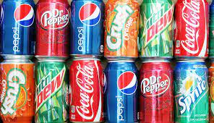
contain
https://www.eater.com/2016/2/15/10976654/breakfast-soda-drinking-trend
Notes:
A word in the story is contain.
In Spanish it is contener (kohn-teh-nehr).
Contain means to have or to hold within something.
Let’s say the word contain together. Ready?
”Contain.” When you say contain, I hear the /k/ sound at the beginning of the word.
Look, contain begins with the letter c.
Here is a picture that shows contain. The cans contain soda. Sodas contain a lot of sugar. We can’t see the sugar because it is mixed in the beverage; when we look at the label, we read that sugar is one of the ingredients—it’s inside the soda. When we drink the soda, we can taste it, as well!

Slide 3
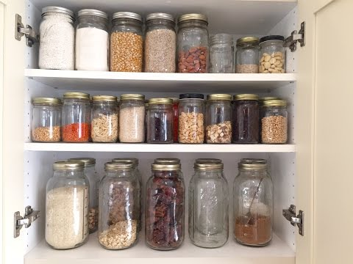
contain
https://dir.indiamart.com/impcat/mason-jars.html?biz=30
Notes:
Here is another picture of contain.
How does this picture show the meaning of contain? Turn and talk to your partner.
The image shows a lot of jars that contain food. They contain spices, beans, rice, lentils, and flour.
How many syllables are in the word contain? Let’s find out by clapping. Ready?
“Con-tain.” 2 syllables.
Now, let’s say contain three times while clapping the syllables. Ready?
“Con-tain, con-tain, con-tain.”

Slide 4
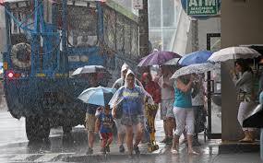
protect
https://www.bostonherald.com/2014/07/05/hurricane-gets-public-popping-into-boston-museums/
Notes:
A word in the story is protect.
In Spanish it is proteger (proh-teh-hehr).
Protect is to make sure something or someone is safe and not hurt.
Let’s say the word protect together. Ready?
”Protect.” When you say protect, I hear the /p/ sound at the beginning of the word.
Look, protect begins with the letter p.
Here is a picture that shows protect. Umbrellas and raincoats help protect people from getting soaking wet in the rain.

Slide 5
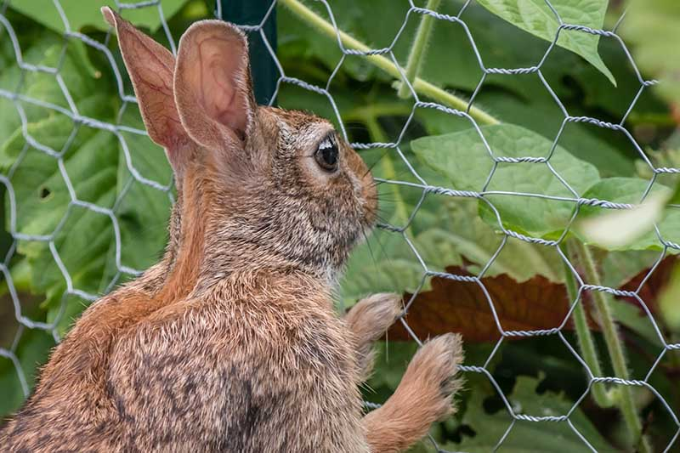
protect
https://gardenerspath.com/how-to/animals-and-wildlife/rabbits-cute-easter-can-wreck-havoc-garden/
Notes:
Here is another picture of protect.
How does this picture show the meaning of protect? Turn and talk to your partner.
The wire fence protects the lettuce from the rabbit who wants to eat the vegetables. The fence keeps the plants safe so people can grow and harvest them.
How many syllables are in the word protect? Let’s find out by clapping. Ready?
“Pro-tect.” 2 syllables.
Now, let’s say protect three times by clapping the syllables. Ready?
“Pro-tect, pro-tect, pro-tect.”

Slide 6
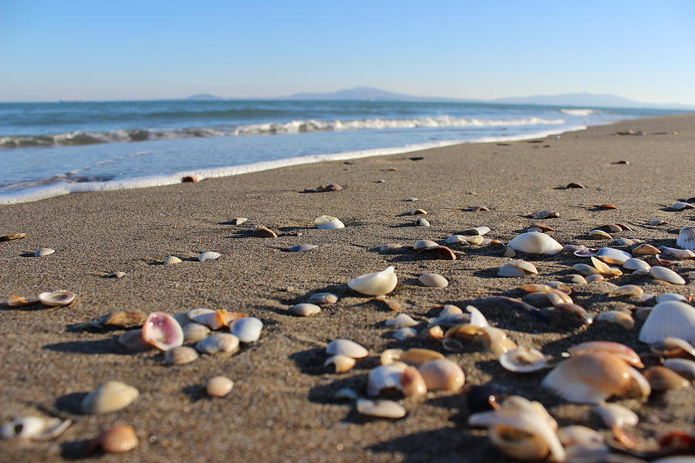
scatter
https://pixels.com/featured/shells-on-the-beach-natalia-luchinina.html
Notes:
A word in the story is scatter.
In Spanish it is esparcir (ehs-pahr-seer).
Scatter is to throw things all around in different places.
Let’s say the word scatter together. Ready?
”Scatter.” When you say scatter, I hear the /s/ sound at the beginning of the word.
Look, scatter begins with the letter s.
Here is a picture that shows scatter. The waves scattered the seashells all over the sandy beach.

Slide 7
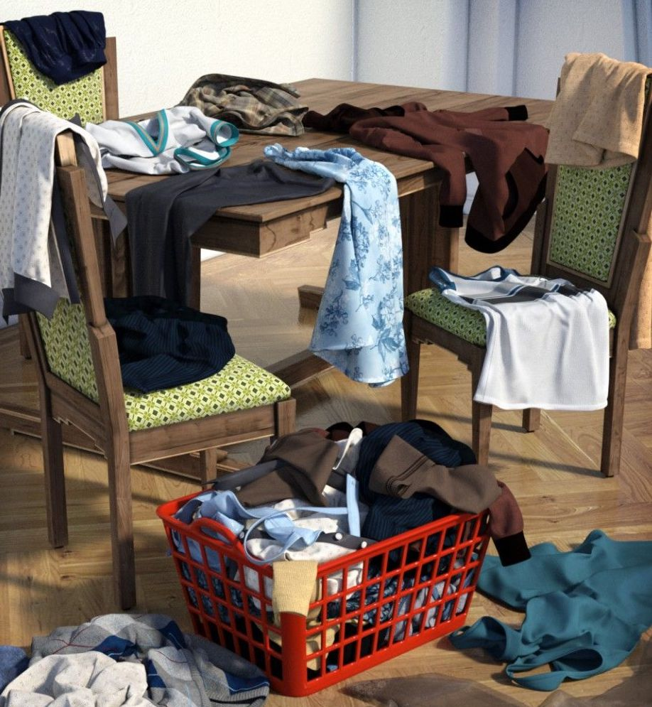
scatter
https://www.pinterest.com/pin/468444798725523956/
Notes:
Here is another picture of scatter.
How does this picture show the meaning of scatter? Turn and talk to your partner.
Someone scattered the laundry all over the dining room: they threw the clothes on the chairs, on the table, and on the floor!
How many syllables are in the word scatter? Let’s find out by clapping. Ready?
“Scat-ter.” 2 syllables.
Now, let’s say scatter three times by clapping the syllables. Ready?
“Scat-ter, scat-ter, scat-ter.”

Slide 8
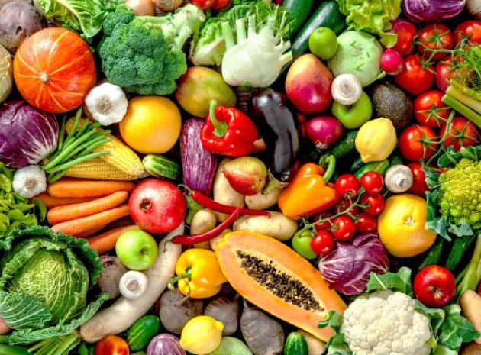
nutrition
https://www.teachearlyyears.com/a-unique-child/view/learning-about-fruit-and-vegetables-in-the-early-years
Notes:
Another word in the story is nutrition.
In Spanish it is nutrición (noo-tree-syohn).
Nutrition is food that helps us grow strong and healthy.
Let’s say the word nutrition together. Ready?
”Nutrition.” When you say nutrition, I hear the /n/ sound at the beginning of the word.
Look, nutrition begins with the letter n.
This picture shows nutrition. Fruits and vegetables are good sources of nutrition for us. These are some foods that help us grow strong and healthy.

Slide 9
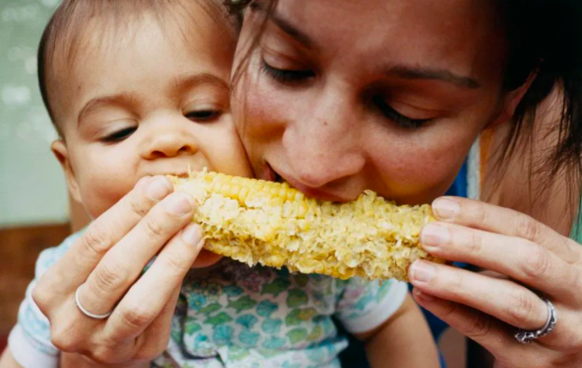
nutrition
https://www.medicalnewstoday.com/articles/160774#macronutrients
Notes:
Here is another picture of nutrition.
How does this picture show the meaning of nutrition? Turn and talk to your partner.
Corn is good nutrition for babies and their mothers. Corn on the cob is good nutrition for all!
How many syllables are in the word nutrition? Let’s find out by clapping. Ready?
“Nu-tri-tion.” 3 syllables.
Now, let’s say nutrition three times by clapping the syllables. Ready?
“Nu-tri-tion, nu-tri-tion, nu-tri-tion.”

Slide 10
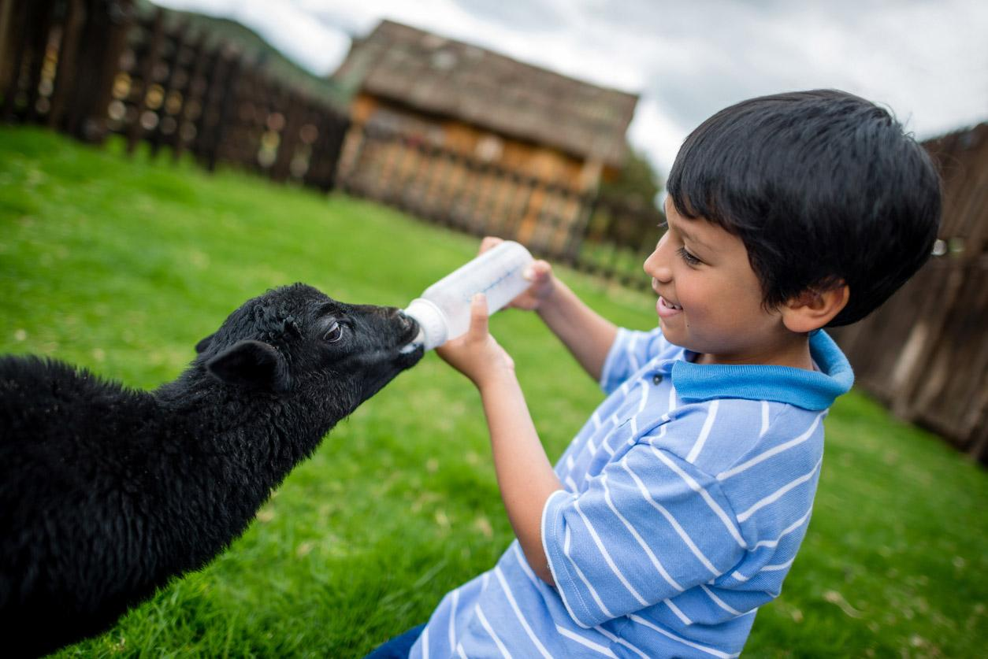
care
https://pjlibrary.org/beyond-books/pjblog/june-2018/11-books-about-caring-for-animals
Notes:
A word in the story is care.
In Spanish it is cuidar (kwee-dahr).
Care is to keep something or someone safe.
Let’s say the word care together. Ready?
”Care.” When you say care, I hear the /k/ sound at the beginning of the word.
Look, care begins with the letter c.
Here is a picture that shows care. The child cares for the newborn lamb by feeding it with a bottle—giving it nutrition so it can grow healthy and be safe.

Slide 11
care
https://www.hgtv.com/outdoors/landscaping-and-hardscaping/how-to-care-for-your-plants
Notes:
Here is another picture of care.
How does this picture show the meaning of care? Turn and talk to your partner.
The woman cares for her plants. She waters them so they can grow.
How many syllables are in the word care? Let’s find out by clapping. Ready?
“Care.” 1 syllable.
Now, let’s say care three times by clapping the syllables. Ready?
“Care, care, care.”

