Slide 1
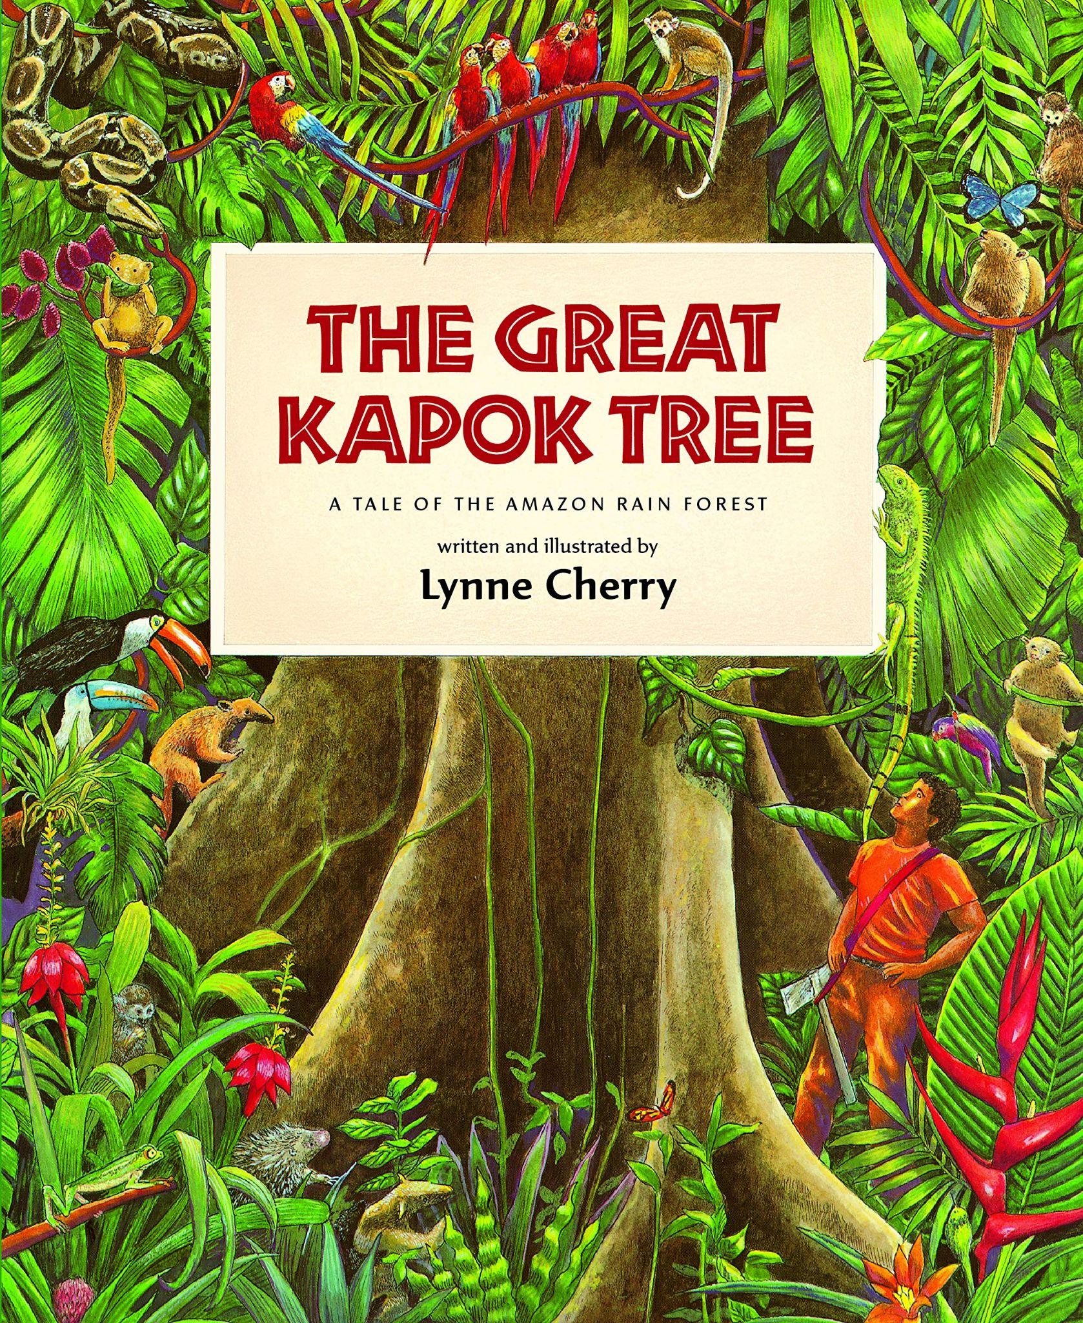
Notes:
depend: to strongly need and receive help from somebody or something in order to live and be well.
ancestor: an older member of a family who lived a long time ago
destroy: to ruin; to hurt or break
ruin: to destroy; to hurt or break
future: the time that has not yet happened
rare: unusual,not often found or seen

Slide 2
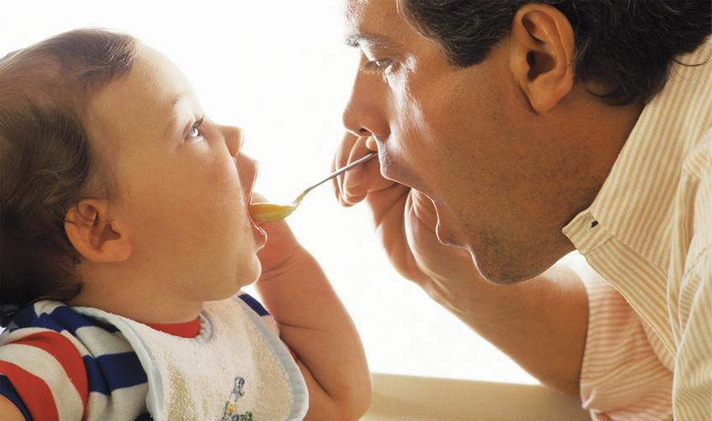
depend
https://www.firstthingsfirst.org/parent-kit/starting-solid-food-solids/
Notes:
A word in the story is depend.
In Spanish it is depender (deh-pehn-dehr).
Depend means to need and receive help from somebody or something in order to live and be well.
Let’s say the word depend together. Ready?
”Depend.” When you say depend, I hear the /d/ sound at the beginning of the word.
Look, depend begins with the letter d.
Here is a picture that shows depend. The toddler depends on grown up to eat. The toddler doesn’t yet know how to cook or even feed himself!

Slide 3
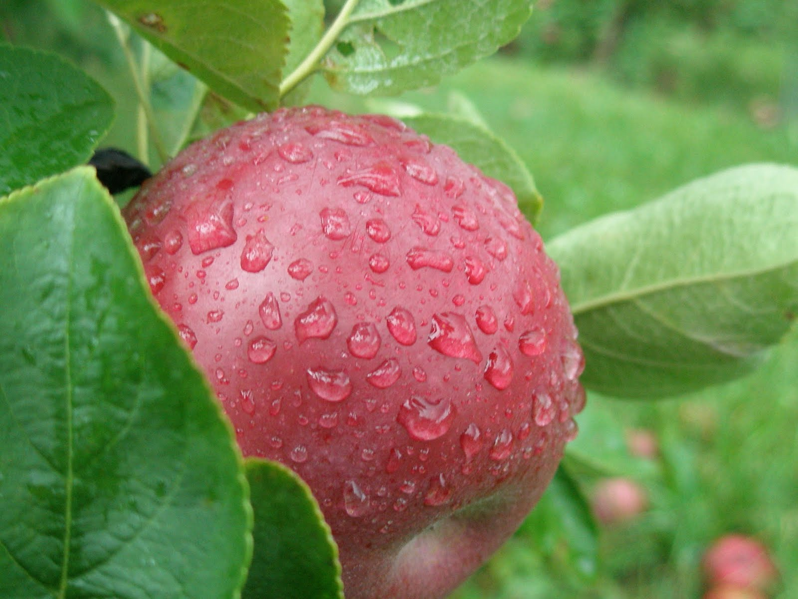
depend
http://appleharvester.blogspot.com/2010/09/apple-picking-day-9-rainy-mornings-and.html
Notes:
Here is another picture of depend.
How does this picture show the meaning of depend? Turn and talk to your partner.
Apples need rain to grow and turn into mature fruits. Apples depend on water to grow.
How many syllables are in the word depend? Let’s find out by clapping. Ready?
“De-pend.” 2 syllables.
Now, let’s say depend three times while clapping the syllables. Ready?
“De-pend, de-pend, de-pend.”

Slide 4
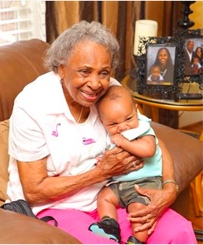
ancestor
https://www.today.com/parents/cutest-photo-gallery-babies-meet-their-great-grandparents-t47596
Notes:
Another word in the story is ancestor.
In Spanish it is el antepasado, la antepasada (ahn-teh-pah-sah-doh/ dah).
An ancestor is an older member of a family or someone who lived a long time ago.
Let’s say the word ancestor together. Ready?
”Ancestor.” When you say ancestor, I hear the /a/ sound at the beginning of the word.
Look, ancestor begins with the letter a.
This picture shows ancestor. The baby is in the arms of his great-grandmother. She is his ancestor. She is the grandmother of his mother and was born a long time ago!

Slide 5
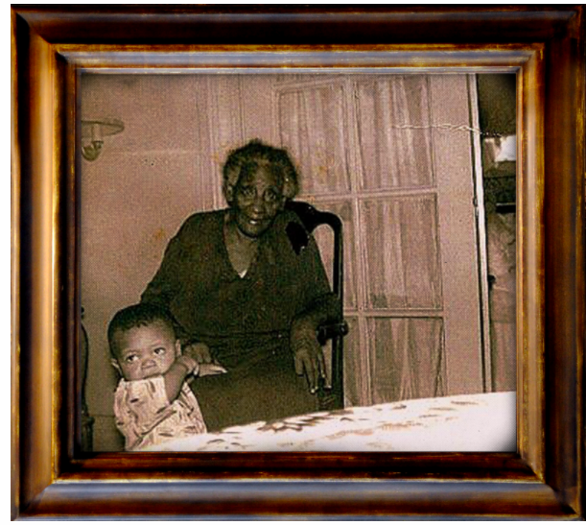
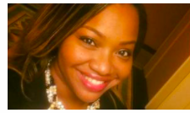
ancestor
https://www.cnn.com/2018/05/04/us/my-immigrant-ancestors-built-america-trnd/index.html
Notes:
Here is another picture of ancestor.
How does this picture show the meaning of ancestor? Turn and talk to your partner.
The young woman has a picture of her ancestors at home. These people were her grandfather and great-great-grandmother, who are no longer living.
How many syllables are in the word ancestor? Let’s find out by clapping. Ready?
“An-ces-tor.” 3 syllables.
Now, let’s say ancestor three times by clapping the syllables. Ready?
“An-ces-tor, an-ces-tor, an-ces-tor.”

Slide 6
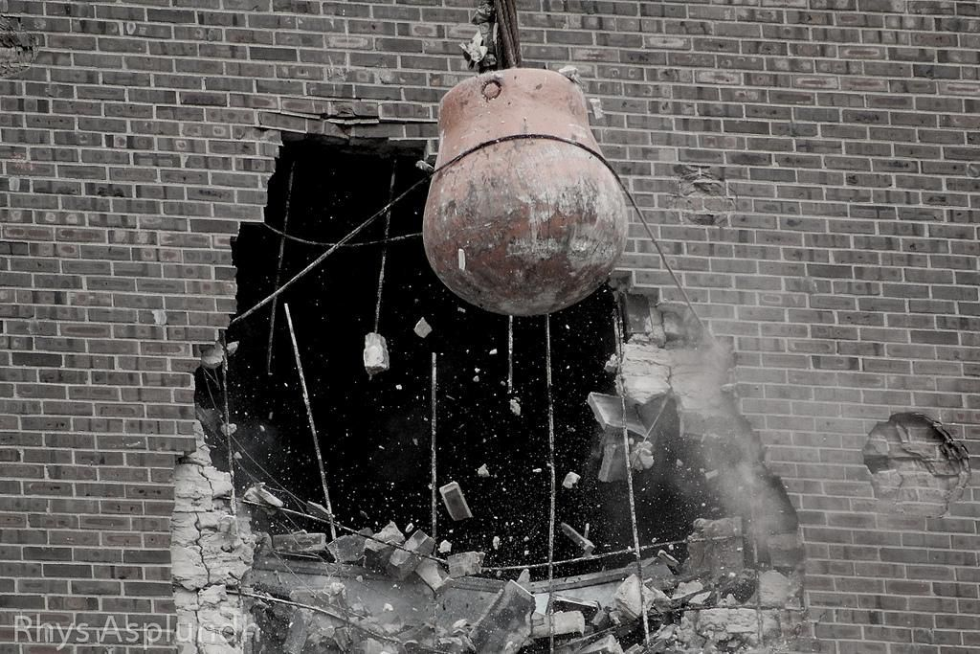
destroy - ruin
https://www.smithsonianmag.com/smart-news/rise-and-fall-wrecking-ball-180957752/
Notes:
A word in the story is destroy. Another word is ruin.
In Spanish they are destruir (dehs-trweer) and arruinar (ah-rrwee-nahr).
Destroy and ruin mean the same thing; they are synonyms. They mean to break.
Let’s say the word destroy together. Ready?
”Destroy.” When you say destroy, I hear the /d/ sound at the beginning of the word.
Look, destroy begins with the letter d.
Now let’s say the word ruin together. Ready?
”Ruin.” When you say ruin, I hear the /r/ sound at the beginning of the word.
Look, ruin begins with the letter r.
Here is a picture that shows destroy and ruin. The machine is destroying the building. It is ruining the building. People will no longer be able to live there.

Slide 7
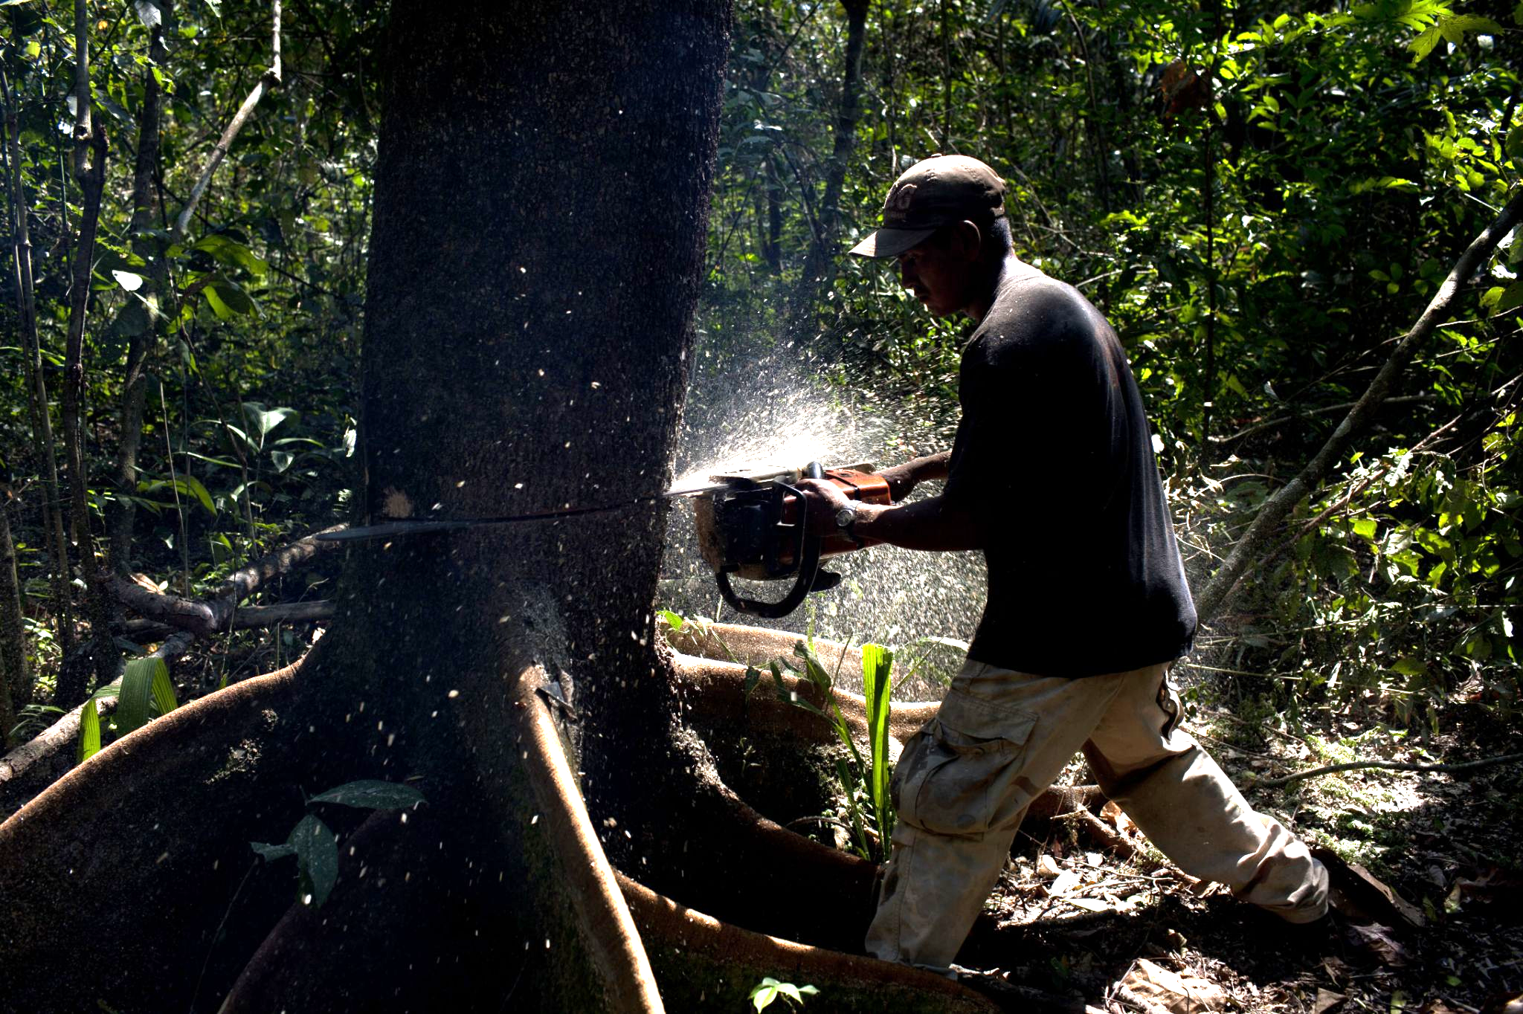
destroy - ruin
https://www.npr.org/2012/09/06/160171565/guess-whos-chopping-down-the-amazon-now
Notes:
Here is another picture of destroy and ruin.
How does this picture show the meaning of destroy and ruin? Turn and talk to your partner.
In this picture a man is sawing a tree. He is destroying a tree and ruining the habitat of the animals who depend on the tree.
How many syllables are in the word destroy? Let’s find out by clapping. Ready?
“Des-troy.” 2 syllables.
Now, let’s say destroy three times by clapping the syllables. Ready?
“Des-troy, des-troy, des-troy.”
And how many syllables are in the word ruin? Let’s find out by clapping. Ready?
“Ru-in.” 2 syllables.
Now, let’s say ruin three times by clapping the syllables. Ready?
“Ru-in, ru-in, ru-in.”

Slide 8
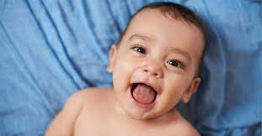
future
today
in 10 years
https://www.bellybelly.com.au/baby/when-do-babies-start-talking/, https://en.m.wikipedia.org/wiki/File:Blue_question_mark_icon.svg
Notes:
A word in the story is future.
In Spanish it is futuro (foo-too-roh).
Future is the time that has not yet happened.
Let’s say the word future together. Ready?
”Future.” When you say future, I hear the /f/ sound at the beginning of the word.
Look, future begins with the letter f.
Here is a picture that shows future. We see a smiling baby now. We don’t know how this baby will be like as a child, in 10 years. We don’t know how this person will change in the future.

Slide 9
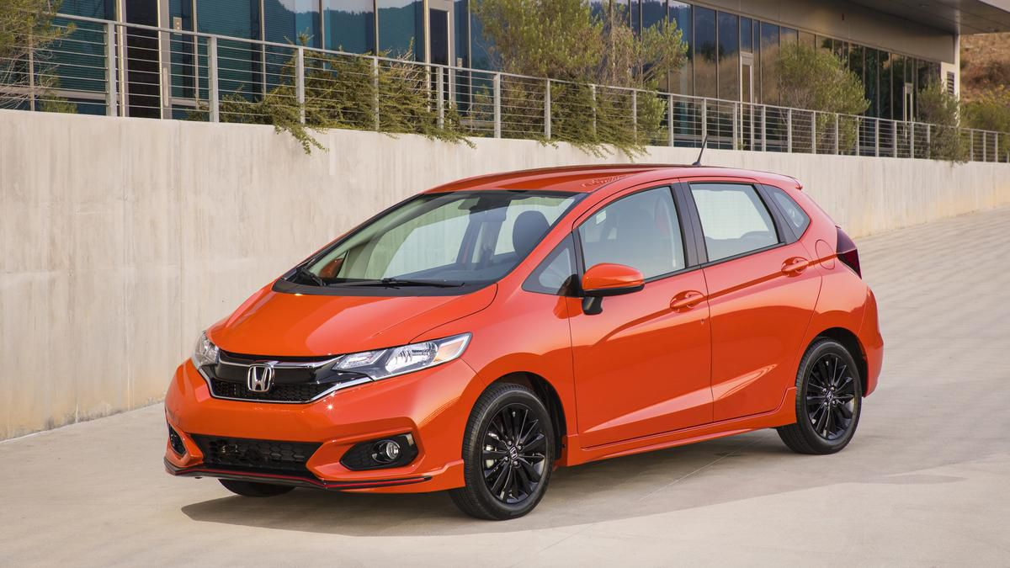
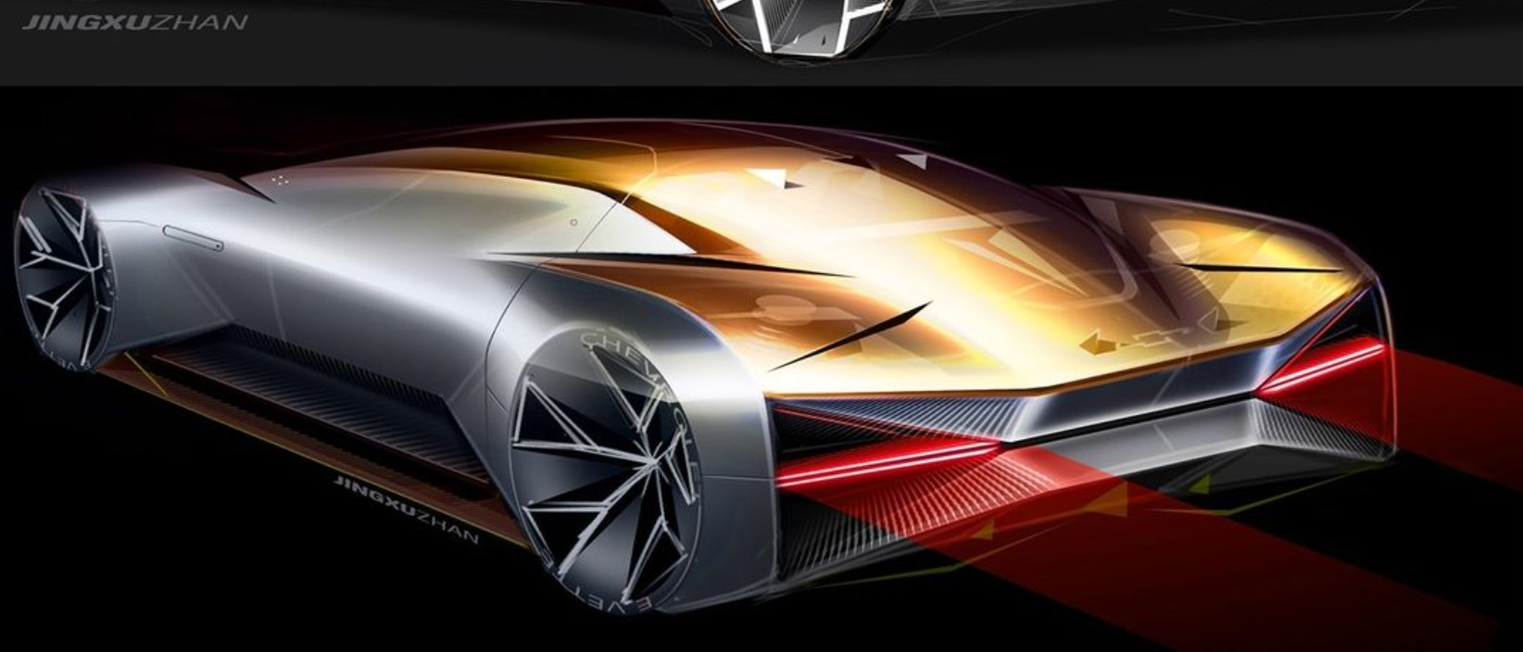
future
present
future
Notes:
Here is another picture of future.
How does this picture show the meaning of future? Turn and talk to your partner.
The picture shows a type of car we have now and a car of the future.
How many syllables are in the word future? Let’s find out by clapping. Ready?
“Fu-ture.” 2 syllables.
Now, let’s say future three times by clapping the syllables. Ready?
“Fu-ture, fu-ture,fu-ture.”

Slide 10
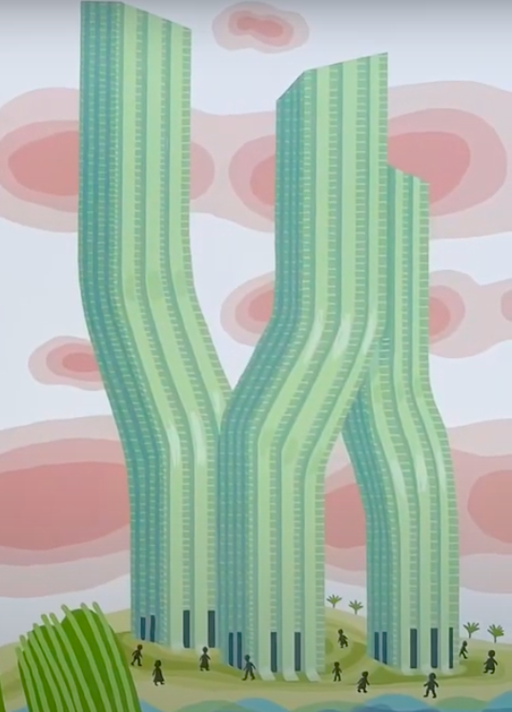
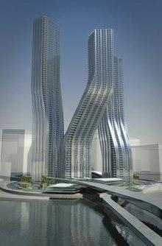
rare
https://www.youtube.com/watch?v=B-WlMMl0g4k, https://en.wikipedia.org/wiki/Signature_Towers
Notes:
A word in the story is rare.
In Spanish it is poco común (poh-koh koh-moon).
Rare is unusual, not often found or seen.
Let’s say the word rare together. Ready?
”Rare.” When you say rare, I hear the /r/ sound at the beginning of the word.
Look, rare begins with the letter r.
Here is a picture that shows rare. These are images from the book The World is Not a Rectangle—do you remember it? We learned that the buildings Zaha Hadid designed were rare or unusual. We don’t find many buildings like this in our city or around the world.

Slide 11
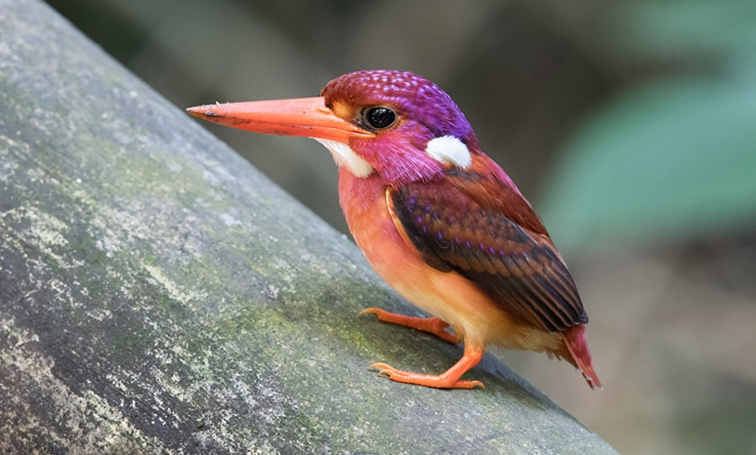
rare
https://happymag.tv/this-super-rare-bird-has-been-photographed-for-the-first-time/
Notes:
Here is another picture of rare.
How does this picture show the meaning of rare? Turn and talk to your partner.
This is a rare bird. We have none like this in Boston or even in Massachusetts. Scientists found it in the Philippines after many years of looking for one! It’s called a South Philippine Dwarf Kingfisher.
How many syllables are in the word rare? Let’s find out by clapping. Ready?
“Rare.” 1 syllable.
Now, let’s say rare three times by clapping the syllables. Ready?
“Rare, rare, rare.”

