Slide 1
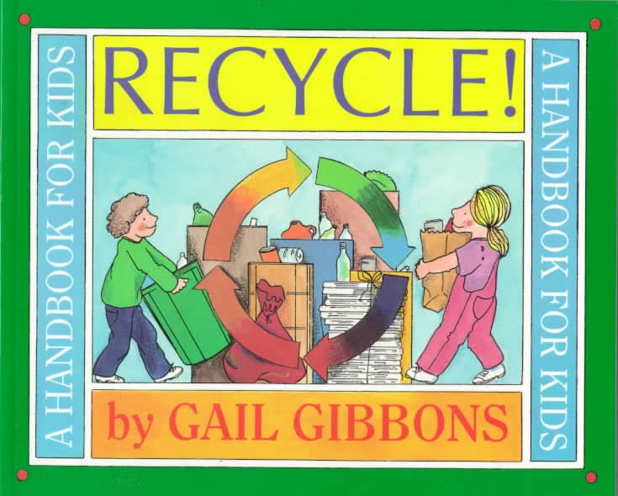
Notes:
waste: to use in a careless way. The opposite is save.
energy: the amount of power needed to make something
liquid: a form of matter that flows easily and is neither a solid nor a gas. Liquid can take on the shape of any container it is poured into.
pollution: is what people create when they dirty the air, water, and land and turn it unhealthy
resource: a thing we use or need to make something

Slide 2
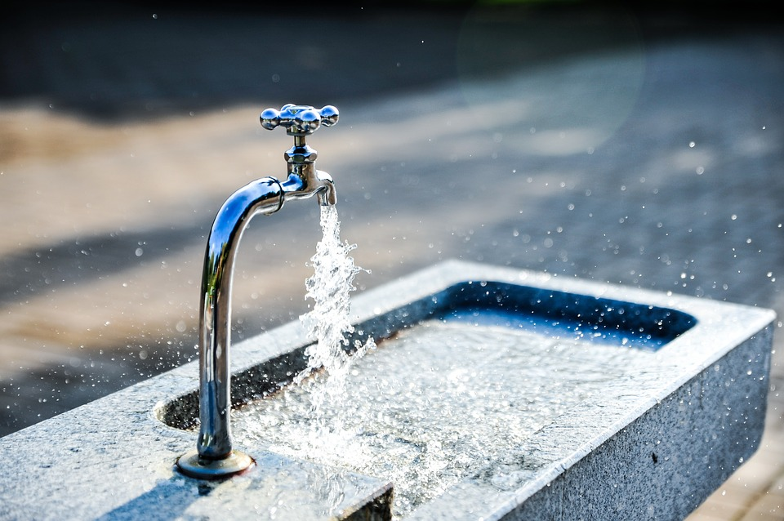
waste
https://www.chesterpaul.com/blog/3-effective-ways-companies-can-combat-water-waste/
Notes:
A word in the book is waste.
In Spanish it is malgastar (mahl-gahs-tahr).
Waste is something we do when we use more of something than we need. The opposite is save.
Let’s say the word waste together. Ready?
”Waste.” When you say waste, I hear the /w/ sound at the beginning of the word.
Look, waste begins with the letter w.
Here is a picture that shows waste. When we leave the faucet open and let the water run when we are not using it, we are wasting water. We are using water when we don’t need it.

Slide 3
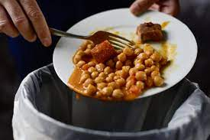
waste
https://www.newfoodmagazine.com/article/107809/waste-not-want-not/
Notes:
Here is another picture of waste.
How does this picture show the meaning of waste? Turn and talk to your partner.
This person has too much food. They cannot eat it all, and now they throw it in the trash. This person is wasting food that someone else could have eaten.
How many syllables are in the word waste? Let’s find out by clapping. Ready?
“Waste.” 1 syllable.
Now, let’s say waste three times while clapping the syllables. Ready?
“Waste, waste, waste.”

Slide 4
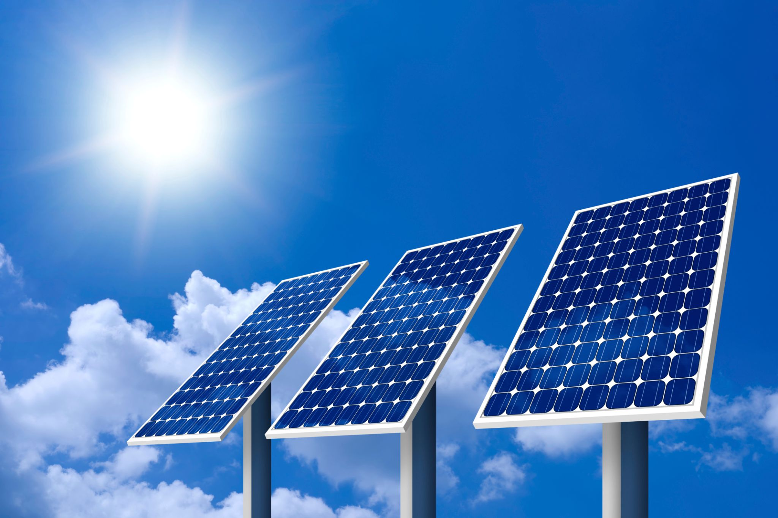
energy
https://uptothepoint.com/solar-panels-cheapest-renewable-source-energy/
Notes:
Another word in the book is energy.
In Spanish it is energía (eh-nehr-hee-ah).
Energy is the amount of power needed to make or do something.
Let’s say the word energy together. Ready?
”Energy.” When you say energy, I hear the /e/ sound at the beginning of the word.
Look, energy begins with the letter e.
This picture shows energy. The sun is a good source of energy, or power. These panels absorb sunlight and turn it into electricity. We use electric energy to charge our phones and computers, to have light when it is dark, to make refrigerators work, and much more.

Slide 5
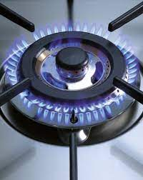
energy
https://www.ilveusa.com/brass-burners.html
Notes:
Here is another picture of energy.
How does this picture show the meaning of energy? Turn and talk to your partner.
The fire in this stove burner produces energy to cook a meal.
How many syllables are in the word energy? Let’s find out by clapping. Ready?
“E-ner-gy.” 3 syllables.
Now, let’s say energy three times by clapping the syllables. Ready?
“E-ner-gy, e-ner-gy, e-ner-gy.”

Slide 6
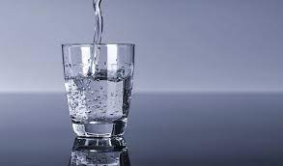
liquid
https://www.verywellhealth.com/medical-diets-and-ibd-1942698
Notes:
A word in the book is liquid.
In Spanish it is líquido (lee-kee-doh).
Liquid is a form of matter that flows easily and is neither a solid nor a gas. Liquid can take on the shape of any container it is poured into.
Let’s say the word liquid together. Ready?
”Liquid.” When you say liquid , I hear the /l/ sound at the beginning of the word.
Look, liquid begins with the letter l.
Here is a picture that shows liquid. The water we drink is a liquid. It always takes the shape of the container we pour it into: a glass, a bottle, a saucepan, a bucket.

Slide 7
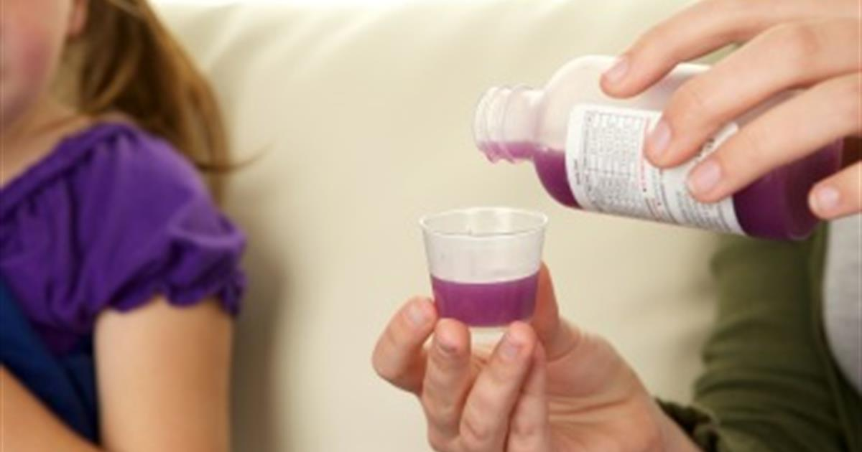
liquid
https://www.healthychildren.org/English/safety-prevention/at-home/medication-safety/Pages/Using-Liquid-Medicines.aspx
Notes:
Here is another picture of liquid.
How does this picture show the meaning of liquid? Turn and talk to your partner.
The child is getting a liquid medicine. For some children a liquid is easier to swallow than a pill.
How many syllables are in the word liquid? Let’s find out by clapping. Ready?
“Li-quid.” 2 syllables.
Now, let’s say liquid three times by clapping the syllables. Ready?
“Li-quid, li-quid, li-quid.”

Slide 8
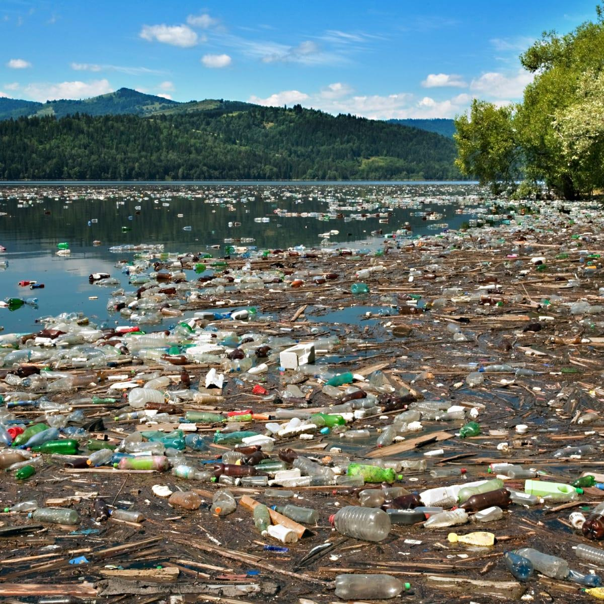
pollution
https://www.history.com/topics/natural-disasters-and-environment/water-and-air-pollution
Notes:
A word in the book is pollution.
In Spanish it is polución (poh-loo-syohn).
Pollution is what people create when we dirty the air, water, or land, making it unhealthy.
Let’s say the word pollution together. Ready?
”Pollution.” When you say pollution, I hear the /p/ sound at the beginning of the word.
Look, pollution begins with the letter p.
Here is a picture that shows pollution. The trash creates pollution—it makes the place dirty and unhealthy for animals to live in and for people to enjoy.

Slide 9
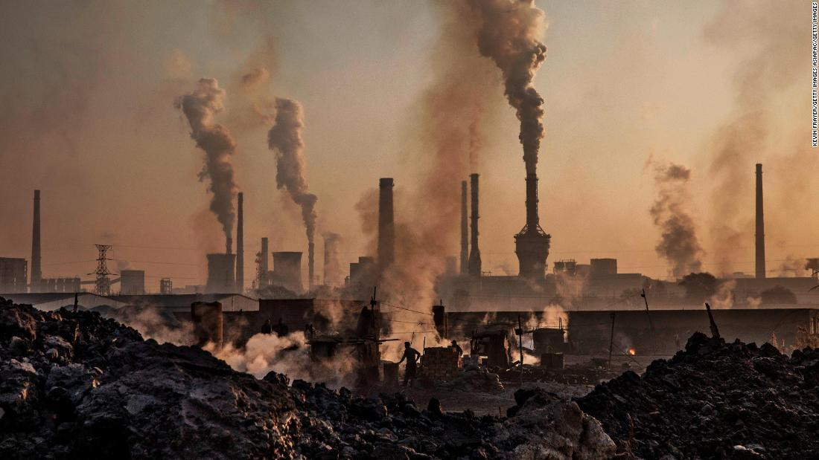
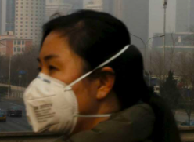
pollution
https://www.cnn.com/2019/07/10/asia/china-wuhan-pollution-problems-intl-hnk/index.html , https://www.dnaindia.com/world/report-china-winning-the-battle-against-smog-life-expectancy-could-rise-by-2-years-us-study-2593472
Notes:
Here is another picture of pollution.
How does this picture show the meaning of pollution? Turn and talk to your partner.
When there is pollution in the air, people wear masks to protect themselves. The air is unhealthy to breathe.
How many syllables are in the word pollution? Let’s find out by clapping. Ready?
“Pol-lu-tion.” 3 syllables.
Now, let’s say pollution three times by clapping the syllables. Ready?
“Pol-lu-tion, pol-lu-tion, pol-lu-tion.”

Slide 10
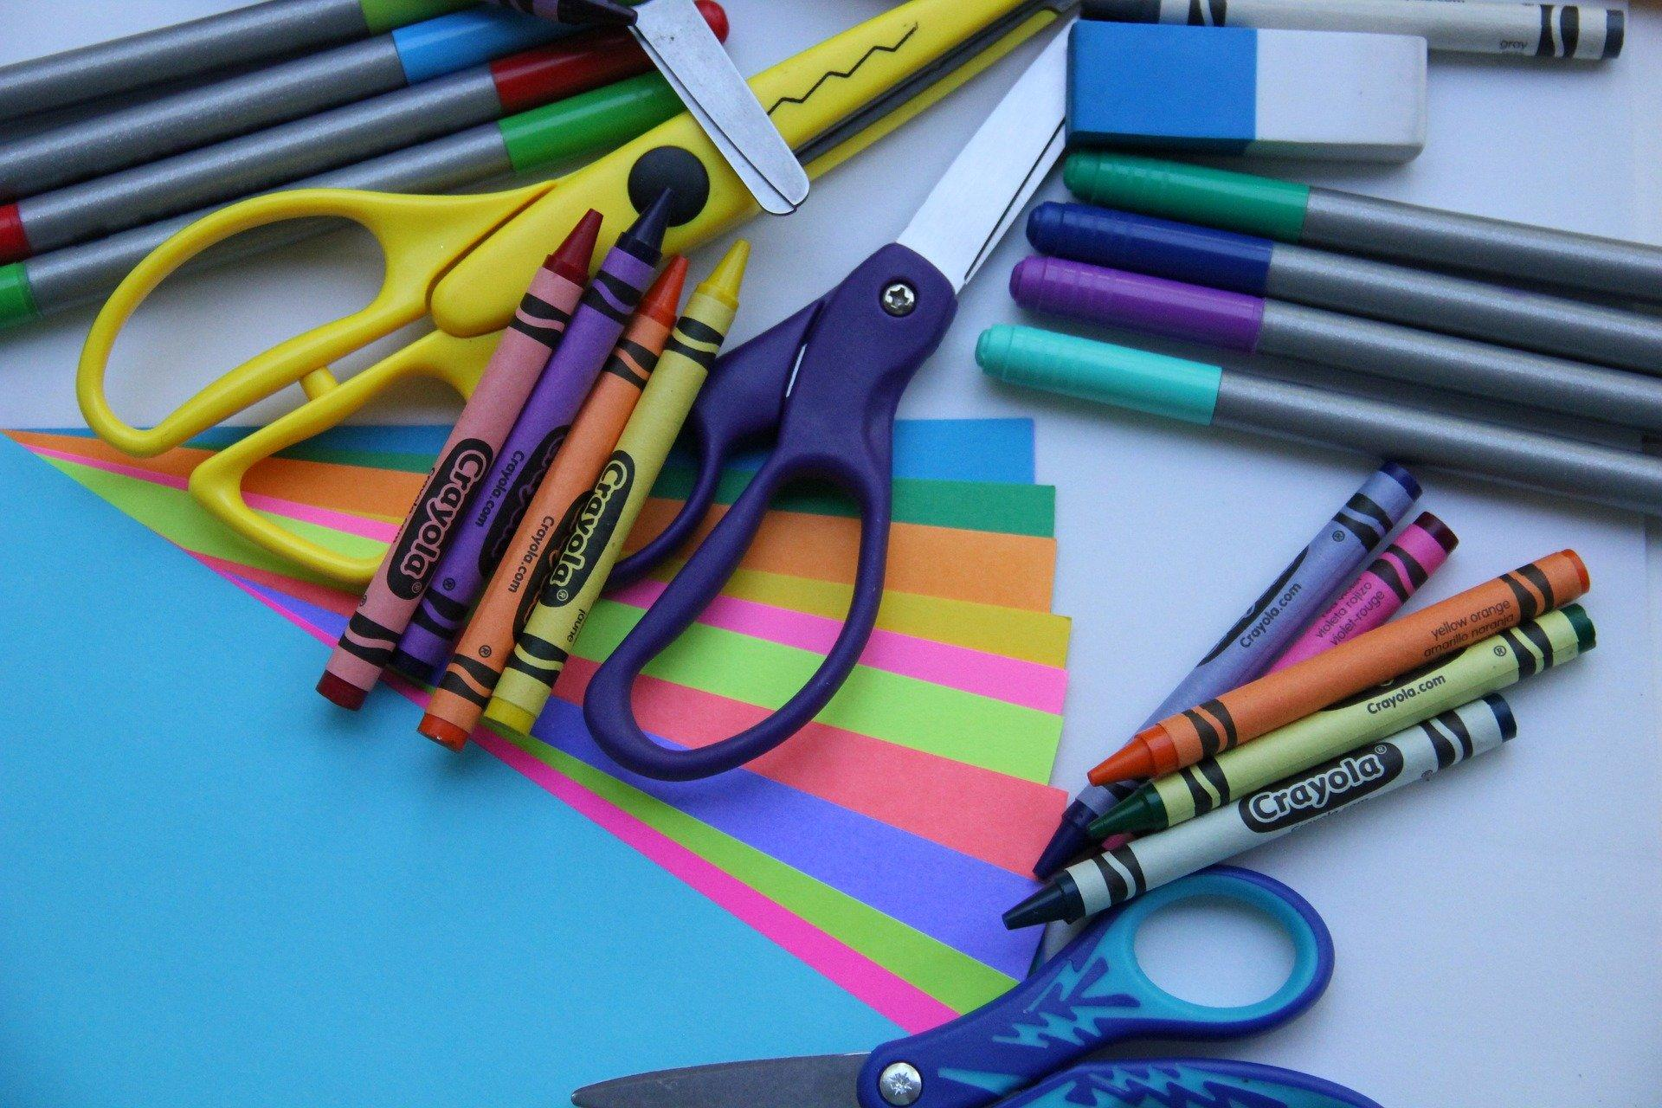
resource
https://www.superprof.co.uk/blog/help-support-a-deaf-child-with-this-handy-set-of-tips/
Notes:
A word in the book is resource.
In Spanish it is recurso (rreh-koor-soh).
A resource is a thing we use or need to make something.
Let’s say the word resource together. Ready?
”Resource.” When you say resource, I hear the /r/ sound at the beginning of the word.
Look, resource begins with the letter r.
Here is a picture that shows resource. These are school resources. You use scissors, crayons, paper, and colored pens to create projects.

Slide 11
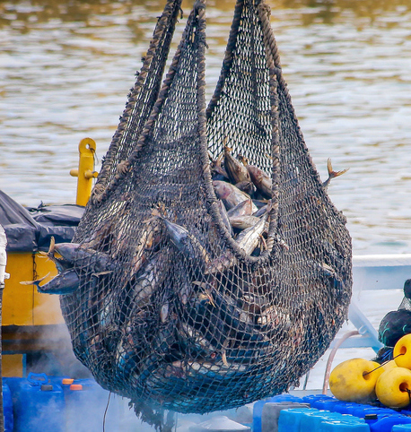
resource
https://www.veganfoodandliving.com/why-vegan/animal-impact/fishing-nets-make-up-almost-half-of-ocean-plastic-pollution/
Notes:
Here is another picture of resource.
How does this picture show the meaning of resource? Turn and talk to your partner.
Fish are a natural resource. We catch them to eat, and provide a healthy source of food.
How many syllables are in the word resource? Let’s find out by clapping. Ready?
“Re-source.” 2 syllables.
Now, let’s say resource three times by clapping the syllables. Ready?
“Re-source, re-source, re-source.”

