Slide 1
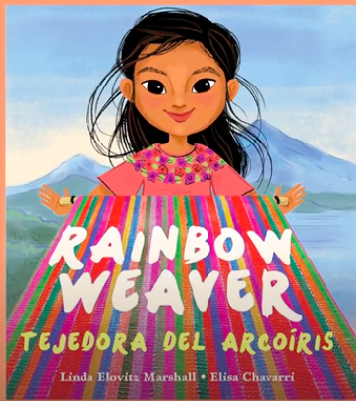
Notes:
weave: to make (fabric) by passing threads or strips over and under each other
thread: a fine cord used in sewing and weaving
loom: a machine for weaving cloth
litter (v): to make messy by scattering trash or other objects
dull: not interesting

Slide 2
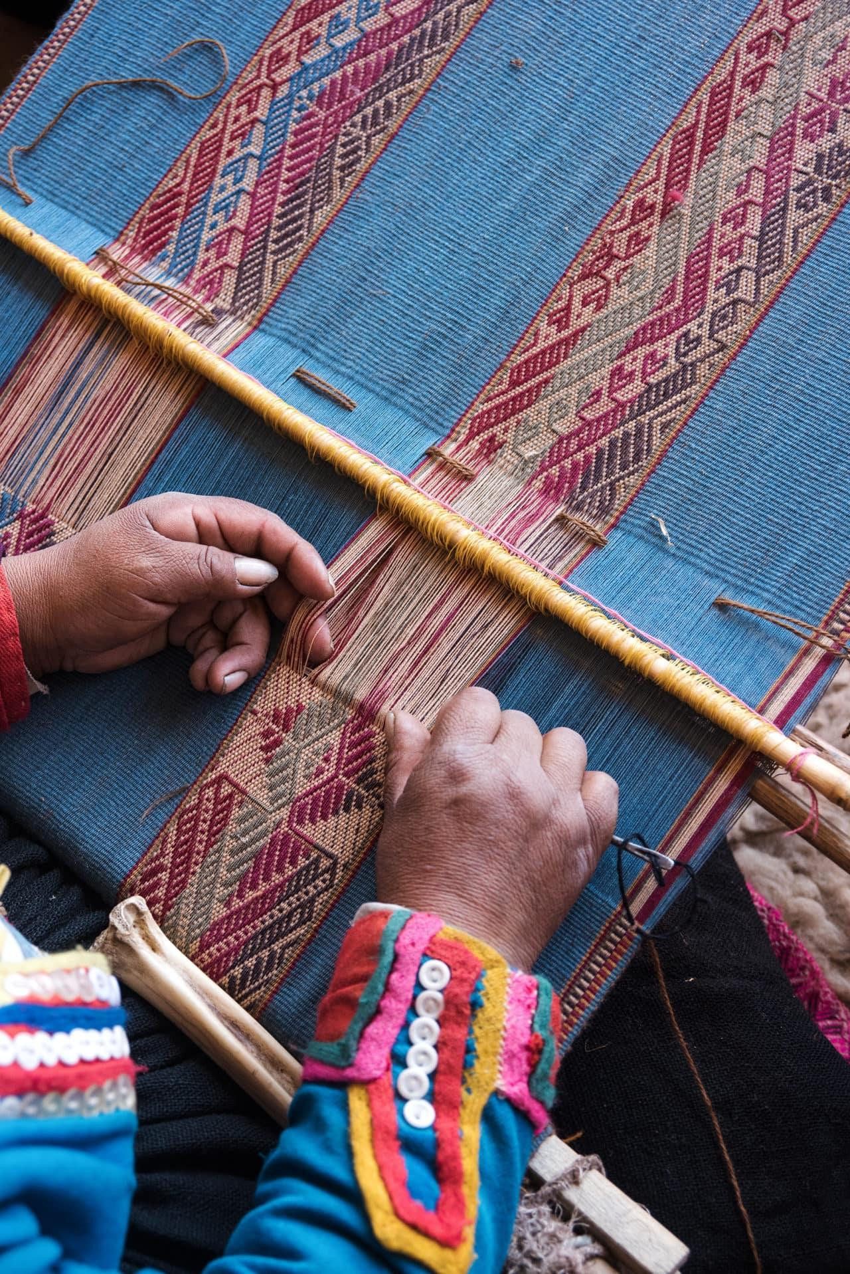
weave
https://thekindcraft.com/cusco-peru-textiles-cttc/
Notes:
A word in the story is weave.
In Spanish it is tejer (teh-hehr).
To weave is to make something such as fabric by passing threads or strips over and under each other.
Let’s say the word weave together. Ready?
”Weave.” When you say weave, I hear the /w/ sound at the beginning of the word.
Look, weave begins with the letter w.
Here is a picture that shows weave. Someone weaves a piece of cloth. This person is passing threads over and under, over and under in a pattern to create the design and make a strong piece of cloth.

Slide 3
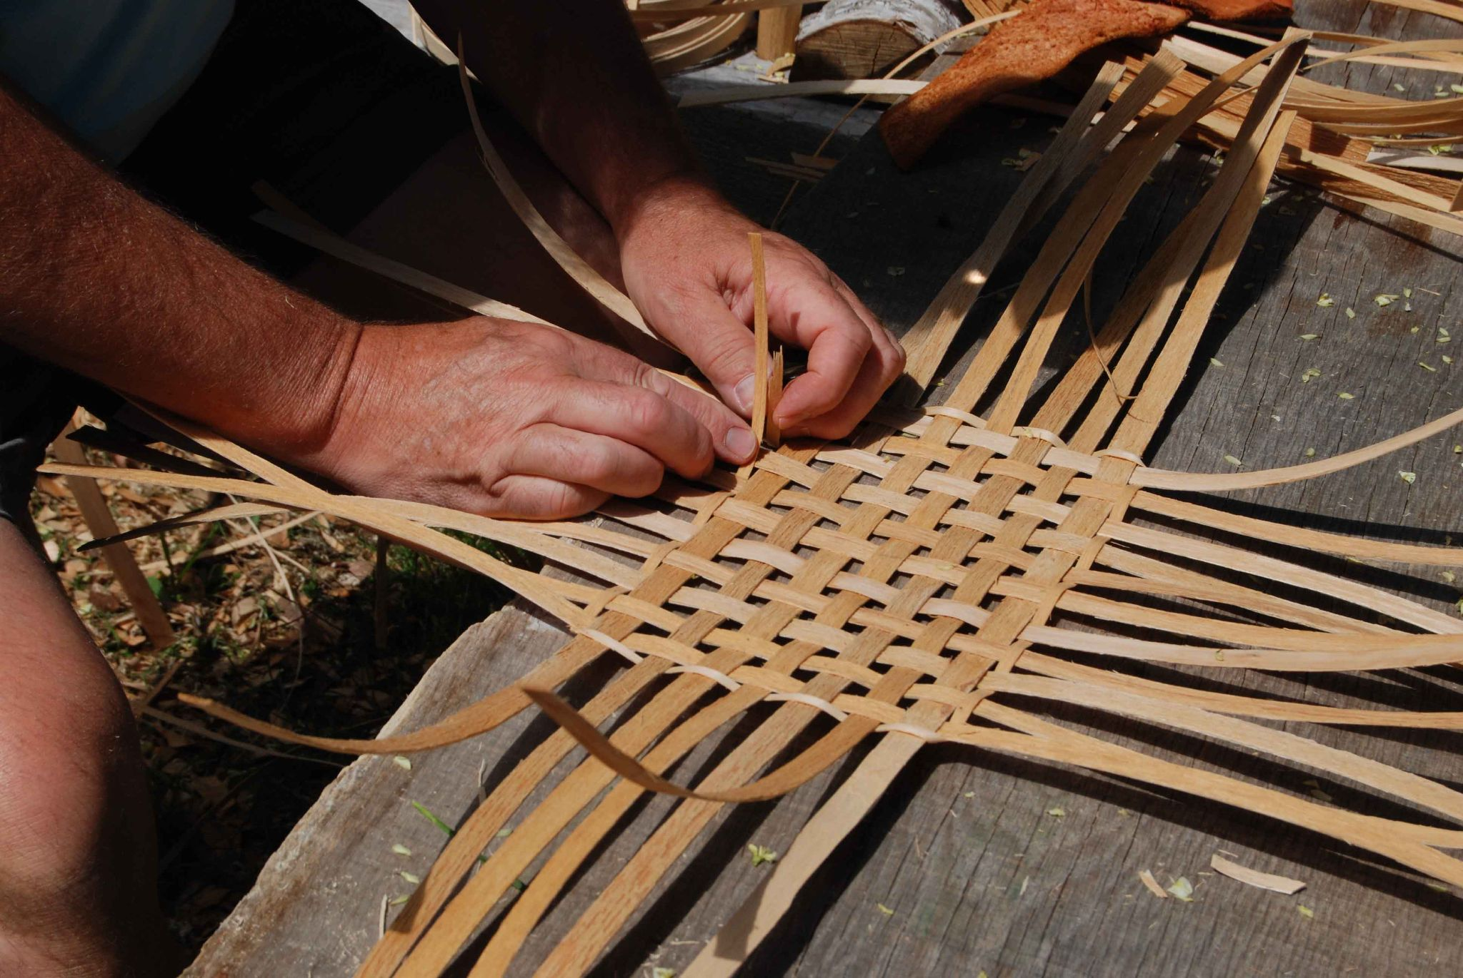
weave
https://pfollansbee.wordpress.com/tag/basket-weaving/
Notes:
Here is another picture of weave.
How does this picture show the meaning of weave? Turn and talk to your partner.
This person is weaving a basket using fibers from some kind of plant.
How many syllables are in the word weave? Let’s find out by clapping. Ready?
“Weave.” 1 syllable.
Now, let’s say weave three times while clapping the syllables. Ready?
“Weave, weave, weave.”

Slide 4
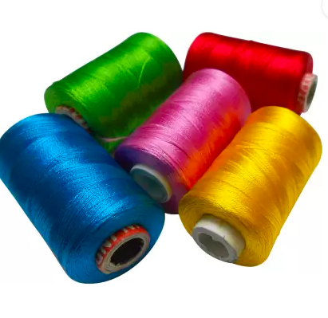
thread
https://www.flipkart.com/goelx-shiny-silk-thread-5-spools-wrapping/p/itmendcj35yuywcm
Notes:
Another word in the story is thread.
In Spanish it is hilo (ee-loh).
Thread is a fine cord, or string, used in sewing and weaving.
Let’s say the word thread together. Ready?
”Thread.” When you say thread, I hear the /th/ sound at the beginning of the word.
Look, thread begins with the digraph th.
This picture shows spools of thread. Thread is dyed many different colors. When some people sew buttons on a shirt they like to match the color of the thread with that of the button. Some prefer a contrasting, or different, color thread.

Slide 5
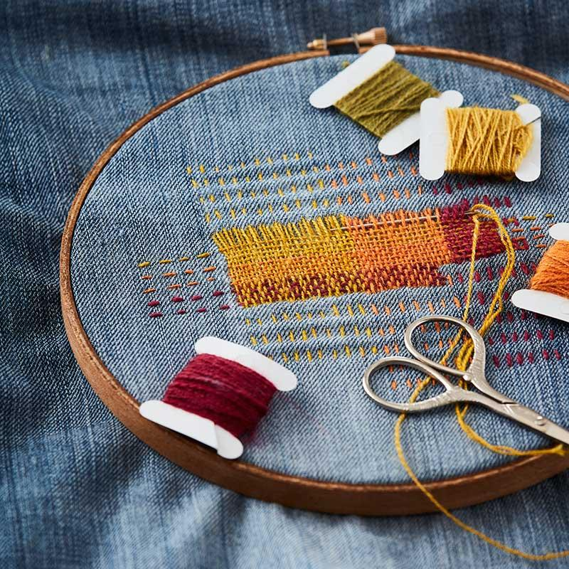
thread
https://spinoffmagazine.com/visible-mending-7-tricks-know-sew/
Notes:
Here is another picture of thread.
How does this picture show the meaning of thread? Turn and talk to your partner.
There are four different colored threads in this work: green, yellow, orange, and red.
How many syllables are in the word thread? Let’s find out by clapping. Ready?
“Thread.” 1 syllable.
Now, let’s say thread three times by clapping the syllables. Ready?
“Thread, thread, thread.”

Slide 6
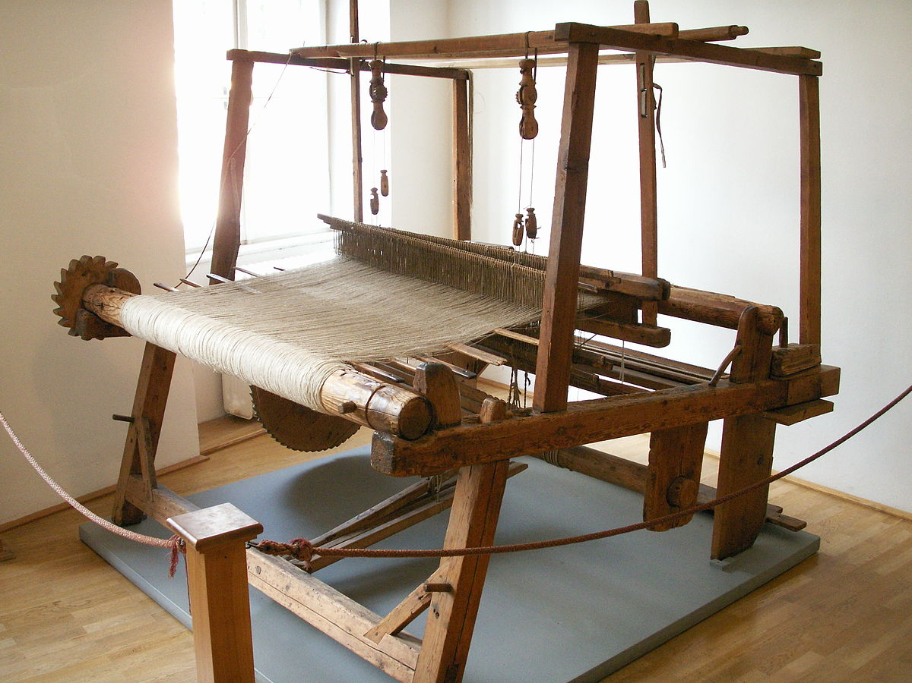
loom
https://en.wiktionary.org/wiki/loom
Notes:
A word in the story is loom.
In Spanish it is telar (teh-lahr).
A loom is a machine for weaving cloth. Looms can be powered by people or by electricity.
Let’s say the word loom together. Ready?
”Loom.” When you say loom, I hear the /l/ sound at the beginning of the word.
Look, loom begins with the letter l.
Here is a picture that shows loom. This is a wooden floor loom. People use these looms to weave cloth and to make rugs, towels, scarves, and other things by hand.

Slide 7
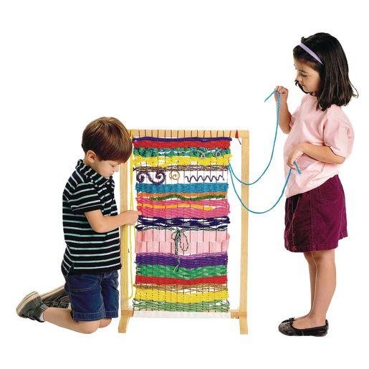
loom
https://www.discountschoolsupply.com/arts-crafts/arts-crafts-supplies/fabric-felt-yarn/the-classroom-loom/p/26658
Notes:
Here is another picture of loom.
How does this picture show the meaning of loom? Turn and talk to your partner.
The children are using a standing loom. They are weaving threads under and over and helping each other make a piece of cloth.
How many syllables are in the word loom? Let’s find out by clapping. Ready?
“Loom.” 1 syllable.
Now, let’s say loom three times by clapping the syllables. Ready?
“Loom, loom, loom.”

Slide 8
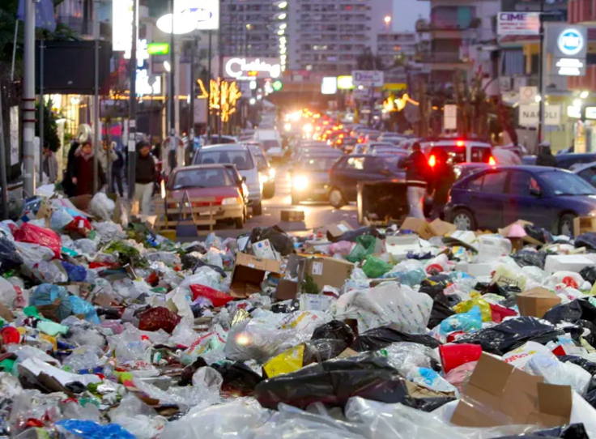
litter
https://www.theguardian.com/cities/2016/oct/27/which-is-the-worlds-most-wasteful-city
Notes:
A word in the story is litter.
In Spanish it is tirar basura (tee-rahr bah-soo-rah).
To litter is to make a place messy by scattering trash or other objects.
Let’s say the word litter together. Ready?
”Litter.” When you say litter, I hear the /l/ sound at the beginning of the word.
Look, litter begins with the letter l.
Here is a picture that shows litter. People littered the streets in the city.

Slide 9
litter
https://www.dreamstime.com/photos-images/litter-garbage.html
Notes:
Here is another picture of litter.
How does this picture show the meaning of litter? Turn and talk to your partner.
All sorts of objects litter the beach. The two young women collect them to clean up the beach.
How many syllables are in the word litter? Let’s find out by clapping. Ready?
“Lit-ter.” 2 syllables.
Now, let’s say litter three times by clapping the syllables. Ready?
“Lit-ter, lit-ter, lit-ter.”

Slide 10
dull
https://www.marvictextiles.co.uk/curtain-fabrics/serafina-beige,
Notes:
A word in the story is dull.
In Spanish it is aburrido (ah-boo-rree-doh).
Dull is not interesting.
Let’s say the word dull together. Ready?
”Dull.” When you say dull, I hear the /d/ sound at the beginning of the word.
Look, dull begins with the letter d.
Here is a picture that shows dull. The beige cloth is dull, doesn’t have much interest.

Slide 11
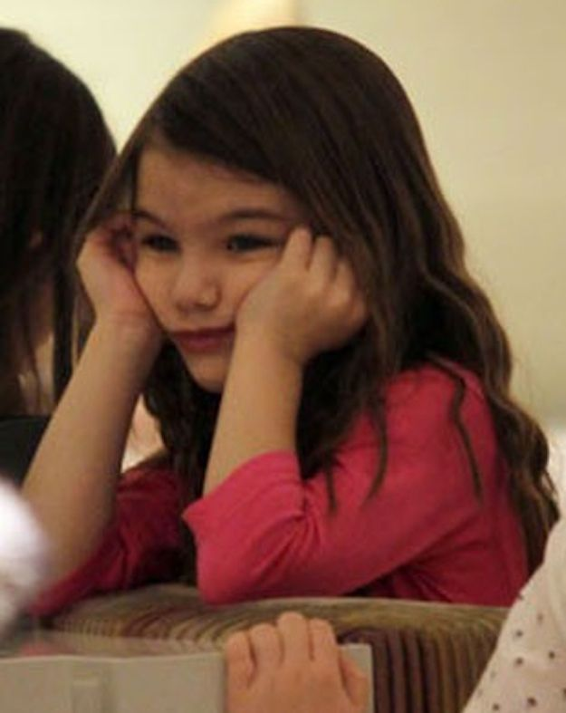
dull
https://www.pinterest.com/pin/449726712765271187/
Notes:
Here is another picture of dull.
How does this picture show the meaning of dull? Turn and talk to your partner.
The girl has a dull expression. She seems bored.
How many syllables are in the word dull? Let’s find out by clapping. Ready?
“Dull.” 1 syllable.
Now, let’s say dull three times by clapping the syllables. Ready?
“Dull, dull, dull.”

