Slide 1
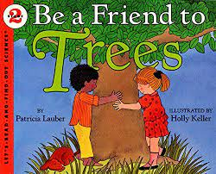
Notes:
useful: can be used for many things, helpful
sap: a sticky fluid that comes from trees
bark: the protective outer layer of a tree
shelter: a place that gives protection against weather or danger
store: to keep for future use
surface: the top layer of something
gas: a form of matter that is neither liquid, like water, nor solid like wood.

Slide 2
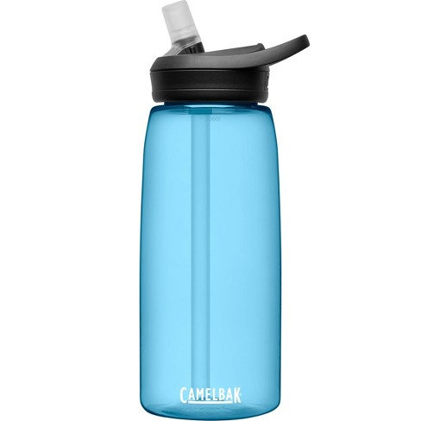
useful
https://www.target.com/p/camelbak-eddy-32oz-tritan-water-bottle/-/A-54034983
Notes:
A word in the story is useful.
In Spanish it is útil (oo-teel).
Useful means able to be used for many things, helpful.
Let’s say the word useful together. Ready?
”Useful.” When you say useful, I hear the /u/ sound at the beginning of the word.
Look, useful begins with the letter u.
Here is a picture that shows useful. It is useful to carry a water bottle when you go out to play. You can drink the water when you get thirsty, and you could use the water to wash your hands, or to pour over your knee to clean a wound if you fell and scratched it.

Slide 3
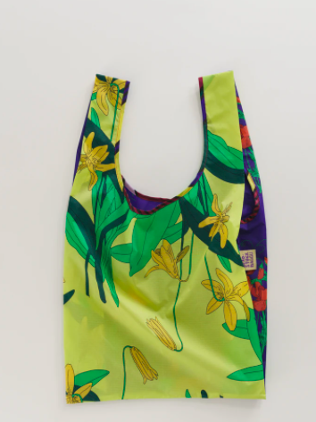
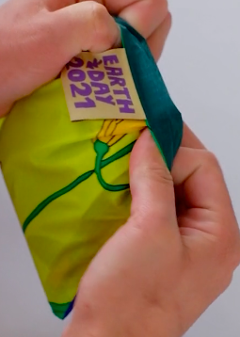
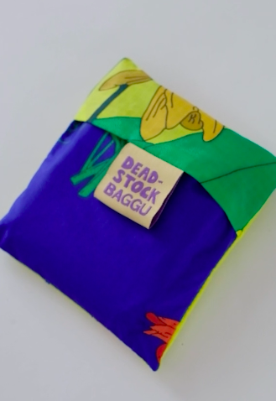
useful
https://baggu.com/collections/reusable-bags/products/standard-baggu-deadstock-garden-bed
Notes:
Here is another picture of useful.
How does this picture show the meaning of useful? Turn and talk to your partner.
This bag is very light and big but you can fold it to make it very small and easy to carry in your pocket! It is useful to have it when you go shopping, to a picnic, on a short trip, or even to carry books to school.
How many syllables are in the word useful? Let’s find out by clapping. Ready?
“Use-ful.” 2 syllables.
Now, let’s say useful three times while clapping the syllables. Ready?
“Use-ful, use-ful, use-ful.”

Slide 4
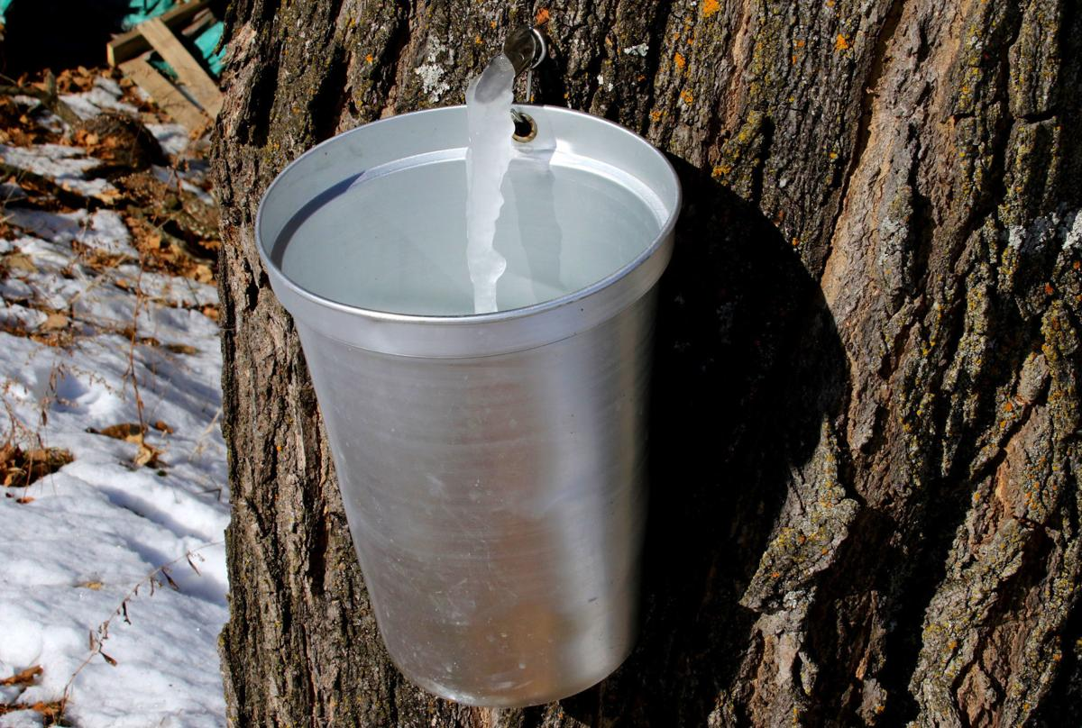
sap
https://www.wiscnews.com/portagedailyregister/sports/recreation/davis-column-march-is-maple-month/article_804dcb17-f4d6-5bd8-9224-3b608e28ab11.html
Notes:
Another word in the story is sap.
In Spanish it is savia (sah-byah).
Sap is a fluid that comes from trees.
Let’s say the word sap together. Ready?
”Sap.” When you say sap, I hear the /s/ sound at the beginning of the word.
Look, sap begins with the letter s.
This picture shows sap. We can see the fluid coming out off the tree. People tap maple trees by putting a spout into the trunk; the sap comes out when the trees start to warm up after a cold winter. People make maple syrup from the sap of sugar maple trees.

Slide 5
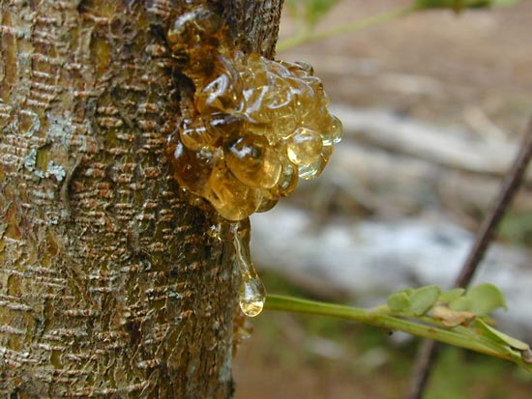
sap
https://www.britannica.com/science/sap-plant-physiology
Notes:
Here is another picture of sap.
How does this picture show the meaning of sap? Turn and talk to your partner.
Here the sap has come out of the tree and then hardened. The tree might have been cut in some way to make the sap come out.
How many syllables are in the word sap? Let’s find out by clapping. Ready?
“Sap.” 1 syllable.
Now, let’s say sap three times by clapping the syllables. Ready?
“Sap, sap,sap.”

Slide 6
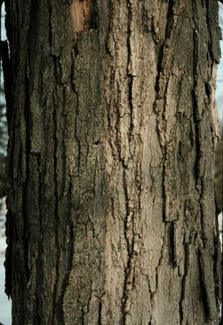
bark
https://www.pinterest.com/pin/438960294911455263/
Notes:
A word in the story is bark.
In Spanish it is corteza (kohr-teh-sah).
Have you heard this word before? What do you know about it? [Gather a few ideas from the children. Highlight the sound a dog makes as one possibility.]
In this text, bark is the protective outer layer of a tree.
Let’s say the word bark together. Ready?
”Bark.” When you say bark, I hear the /b/ sound at the beginning of the word.
Look, bark begins with the letter b.
Here is a picture that shows bark. This is a photo of the bark of a sugar maple tree.

Slide 7
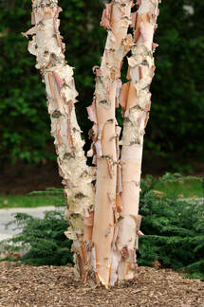
bark
https://www.treeserviceyorkpa.org/blog/which-trees-naturally-lose-their-bark
Notes:
Here is another picture of bark.
How does this picture show the meaning of bark? Turn and talk to your partner.
The bark of these birch trees is thin, and it naturally peels off as the tree grows.
How many syllables are in the word bark? Let’s find out by clapping. Ready?
“Bark.” 1 syllable.
Now, let’s say bark three times by clapping the syllables. Ready?
“Bark, bark, bark.”

Slide 8
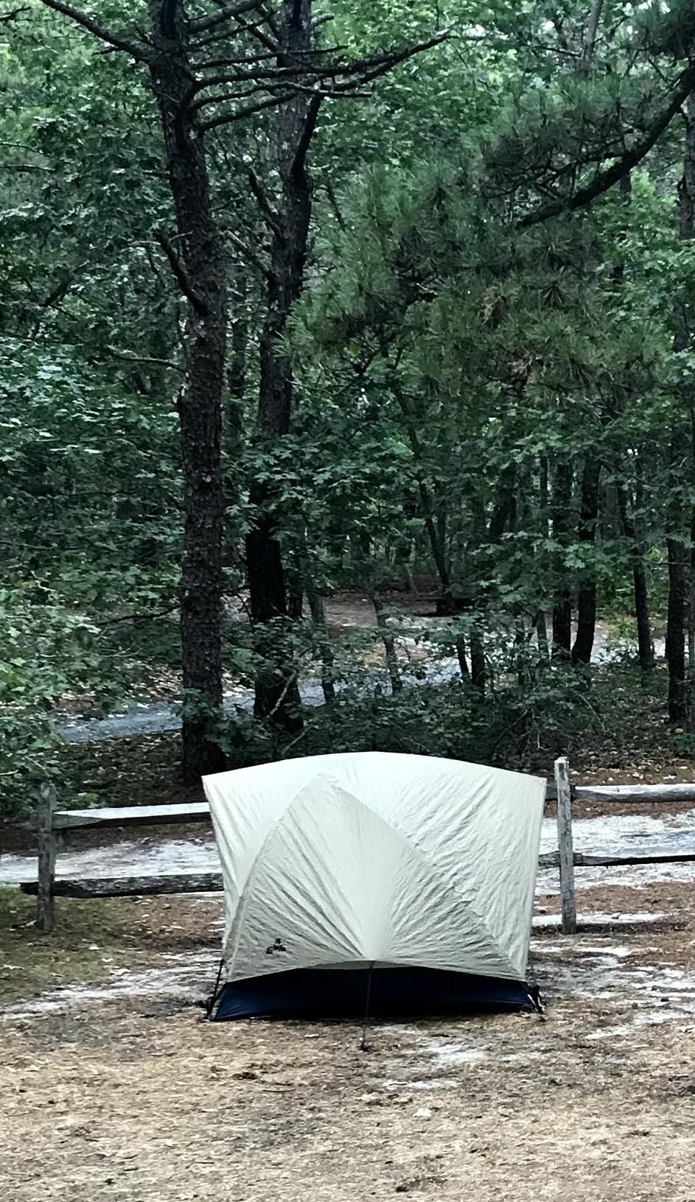
shelter
Photo by Ana Vaisenstein
Notes:
A word in the story is shelter.
In Spanish it is refugio (rreh-foo-hyoh).
Have you heard this word before? What do you know about it? [Gather a few ideas from the children.]
Shelter is a place that gives protection against weather or danger.
Let’s say the word shelter together. Ready?
”Shelter.” When you say shelter, I hear the /sh/ sound at the beginning of the word.
Look, shelter begins with the digraph sh.
Here is a picture that shows shelter. This tent offers protection from the rain, wind, and strong sun. It is a shelter for campers.

Slide 9
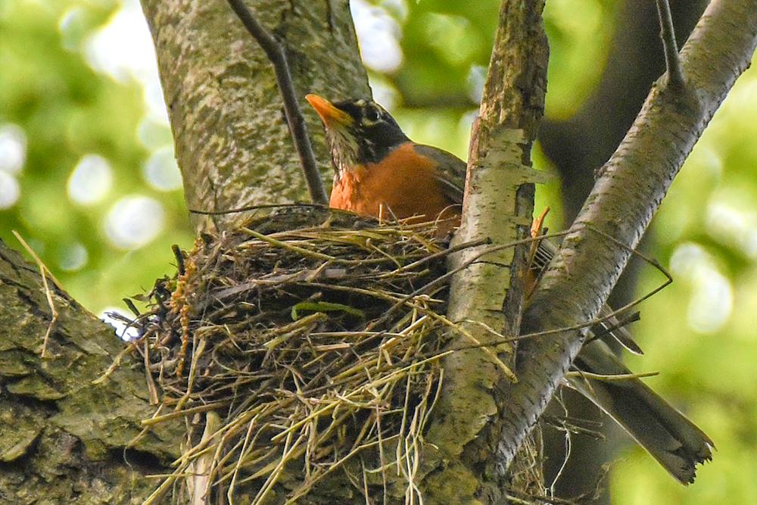
shelter
https://www.wildtones.com/birding-info/stuff-to-do-with-kids-make-a-nesting-shelter-for-robins/
Notes:
Here is another picture of shelter.
How does this picture show the meaning of shelter? Turn and talk to your partner.
The nest between the branches of the tree is a shelter for the robin and its eggs.
How many syllables are in the word shelter? Let’s find out by clapping. Ready?
“Shel-ter.” 2 syllables.
Now, let’s say shelter three times by clapping the syllables. Ready?
“Shel-ter, shel-ter, shel-ter.”

Slide 10
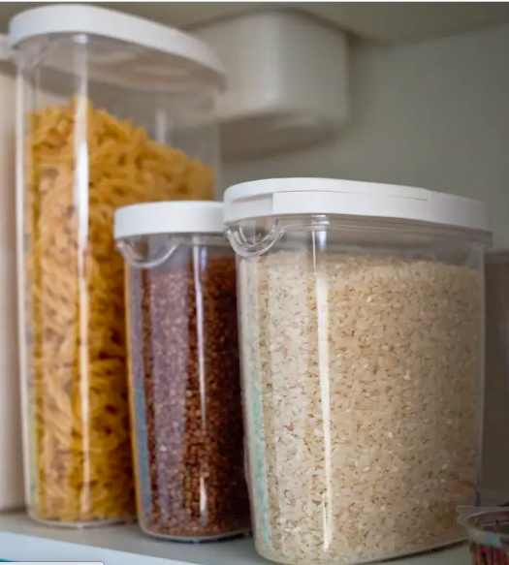
store
https://www.businessinsider.com/best-shelf-stable-food
Notes:
A word in the story is store.
In Spanish it is guardar (gwahr-dahr).
Have you heard this word before? What do you know about it? [Gather a few ideas from the children.]
In this text, store means to keep for future use.
Let’s say the word store together. Ready?
”Store.” When you say store, I hear the /s/ sound at the beginning of the word.
Look, store begins with the letter s.
Here is a picture that shows store. This family stores pasta, beans, and rice in plastic containers.

Slide 11
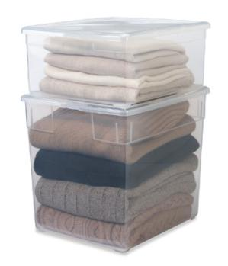
store
https://www.bestcleaners.com/best-tips-storing-winter-clothes/
Notes:
Here is another picture of store.
How does this picture show the meaning of store? Turn and talk to your partner.
When summer comes, some people choose to store their sweaters in bins until the following winter.
How many syllables are in the word store? Let’s find out by clapping. Ready?
“Store.” 1 syllable.
Now, let’s say store three times by clapping the syllables. Ready?
“Store, store, store.”

Slide 12
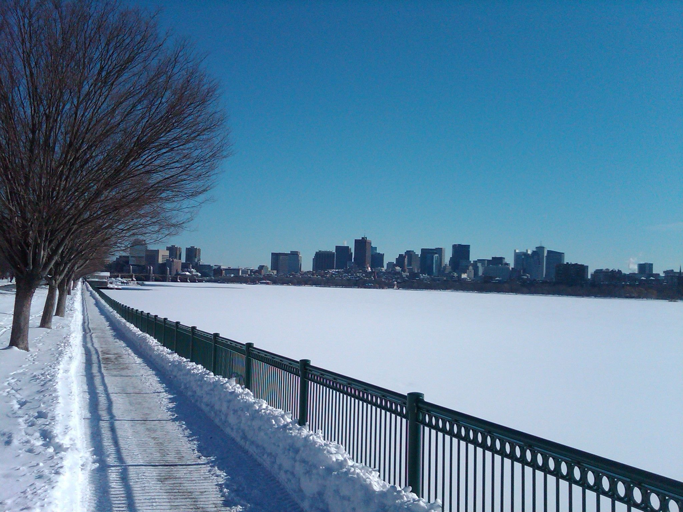
surface
https://www.pinterest.com/pin/206954545356532011/
Notes:
A word in the story is surface.
In Spanish it is superficie (soo-pehr-fee-syeh).
Surface is the top layer of something.
Let’s say the word surface together. Ready?
”Surface.” When you say surface, I hear the /s/ sound at the beginning of the word.
Look, surface begins with the letter s.
Here is a picture that shows surface. On very cold days last winter, the surface of the Charles River was frozen and covered with snow.

Slide 13
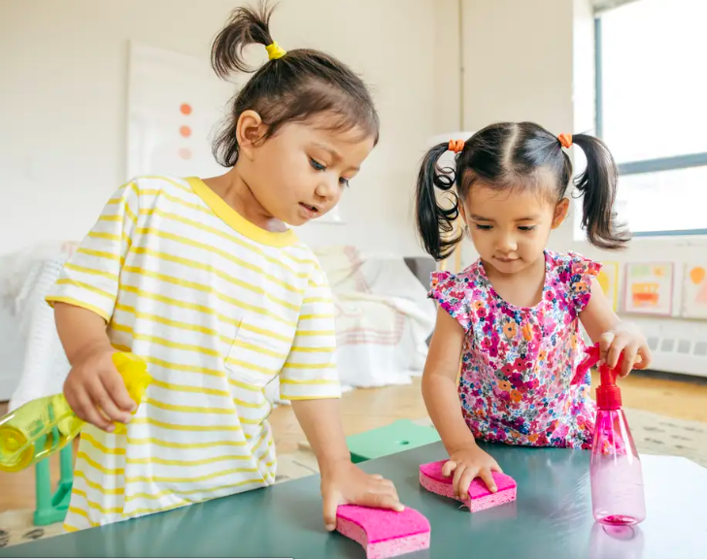
surface
https://www.businessinsider.com/how-to-disinfect-your-home-to-protect-kids
Notes:
Here is another picture of surface.
How does this picture show the meaning of surface? Turn and talk to your partner.
The children are cleaning the surface of the table after finishing their artwork.
How many syllables are in the word surface? Let’s find out by clapping. Ready?
“Sur-face.” 2 syllables.
Now, let’s say surface three times by clapping the syllables. Ready?
“Sur-face, sur-face, sur-face.”

Slide 14
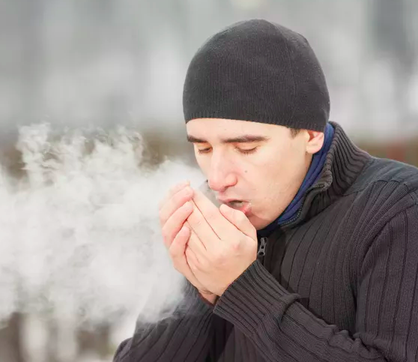
gas
https://sciencing.com/make-vapor-come-out-mouth-6171602.html
Notes:
A word in the story is gas.
In Spanish it is also gas (gahs).
Have you heard this word before? What do you know about it? [Gather a few ideas from the children.]
In this text, gas is a form of matter that is neither liquid, like water, nor solid, like wood.
Let’s say the word gas together. Ready?
”Gas.” When you say gas, I hear the /g/ sound at the beginning of the word.
Look, gas begins with the letter g.
Here is a picture that shows gas. In winter when it is very cold, we can see the air, or gas, that comes out of our mouths.

Slide 15
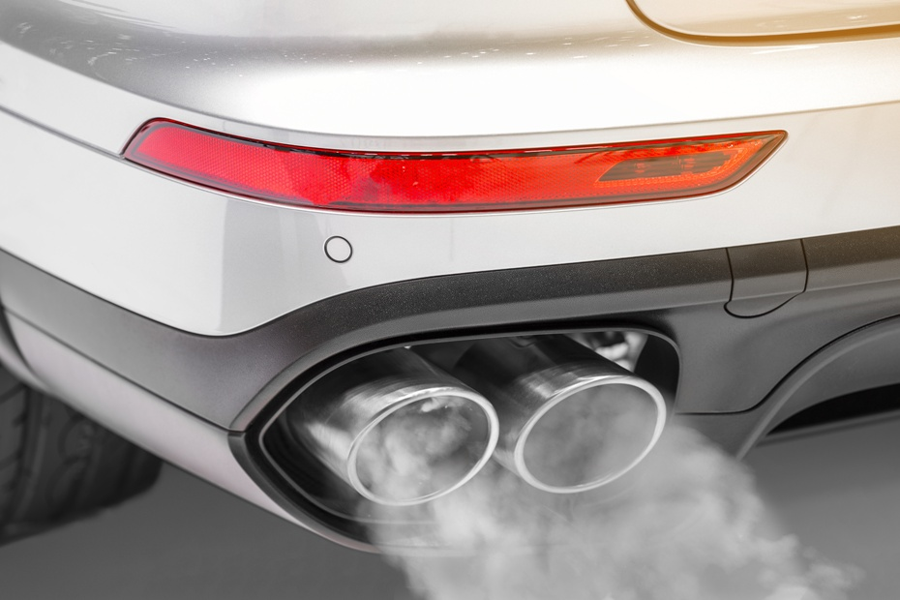
gas
https://www.elkrivertireandauto.com/tips-blog/can-a-bad-muffler-cause-loss-of-power
Notes:
Here is another picture of gas.
How does this picture show the meaning of gas? Turn and talk to your partner.
Sometimes we can see a gas coming out of the tailpipe of a car. That gas is not good for the air we breathe. It’s pollution.
How many syllables are in the word gas? Let’s find out by clapping. Ready?
“Gas” 1 syllable.
Now, let’s say gas three times by clapping the syllables. Ready?
“Gas, gas, gas.”

