Slide 1
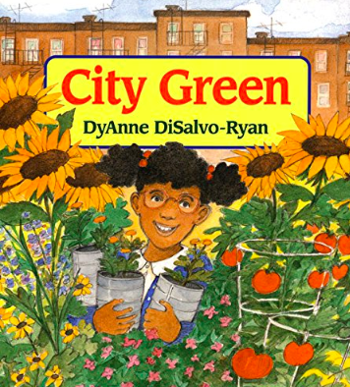
Notes:
A lot: a piece of land OR a large amount
bed: an area of ground used for plants and flowers
property: a piece of land or a building
petition: a written request by many people that is made to a person in authority

Slide 2
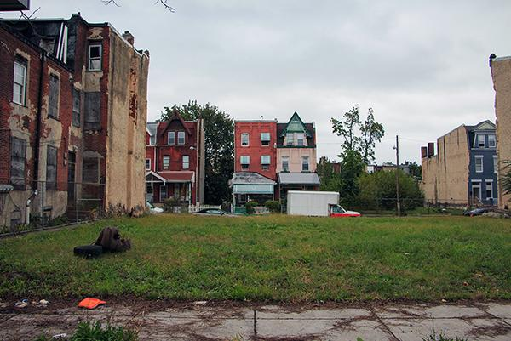
lot
https://penntoday.upenn.edu/news/wading-phillys-vacant-land-morass
Notes:
A word in the story is lot.
In Spanish it is lote (loh-teh).
Have you heard this word before? What do you know about it?
A lot is a piece of land. A lot is also a large amount. In City Green this word is used with both meanings.
Let’s say the word lot together. Ready?
”Lot.” When you say lot, I hear the /l/ sound at the beginning of the word.
Look, lot begins with the letter l.
Here is a picture that shows a lot. This is an empty lot in the city. It’s an empty piece of land.

Slide 3
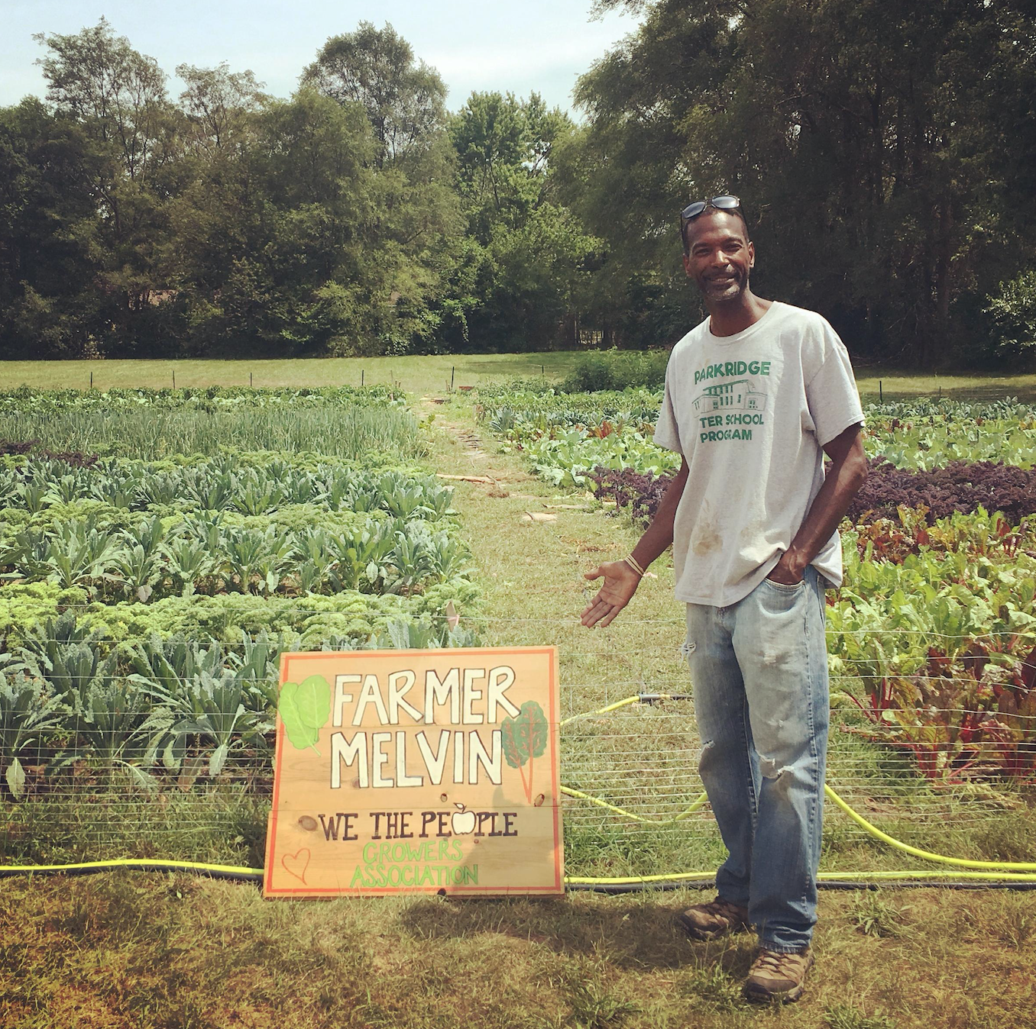
lot
https://blog.ioby.org/how-to-turn-a-vacant-lot-into-a-community-garden-a-primer/
Notes:
Here is another picture of lot.
How does this picture show the meaning of lot? Turn and talk to your partner.
Farmer Melvin developed a small farm in this lot.
How many syllables are in the word lot? Let’s find out by clapping. Ready?
“Lot.” 1 syllable.
Now, let’s say lot three times while clapping the syllables. Ready?
“Lot, lot, lot.”

Slide 4
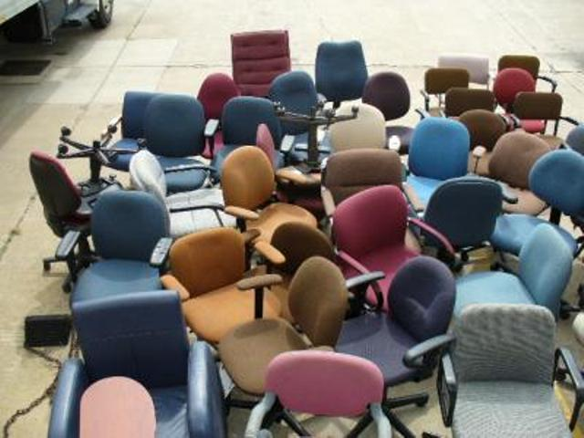
a lot
https://www.governmentauctions.org/labels/office%20chairs.asp#.YKQCIGZKg6g
Notes:
Here is another picture of a lot.
How does this picture show the meaning of a lot? Turn and talk to your partner.
These are a lot of chairs, there are many chairs.

Slide 5
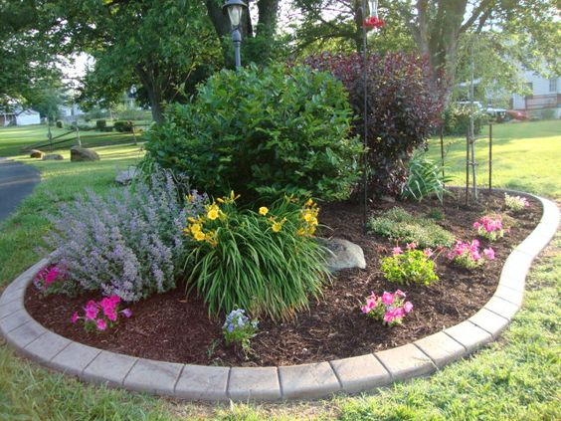
bed
https://www.architectureartdesigns.com/16-small-flower-gardens-will-beautify-outdoor-space/
Notes:
Another word in the story is bed.
In Spanish it is cantero (kahn-teh-roh).
Bed in this context is an area of ground used for plants and flowers. You know another meaning of the word—a place where people sleep.
Let’s say the word bed together. Ready?
”Bed.” When you say bed, I hear the /b/ sound at the beginning of the word.
Look, bed begins with the letter b.
This picture shows bed. There is a nice bed of flowers and bushes around the tree in the park.

Slide 6
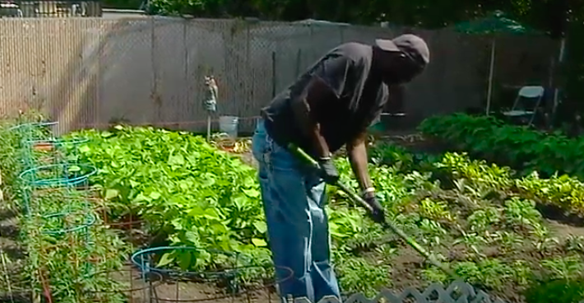
bed
https://www.wgbh.org/news/local-news/2020/07/09/in-a-time-of-uncertainty-bostonians-embrace-their-community-gardens
Notes:
Here is another picture of bed.
How does this picture show the meaning of bed? Turn and talk to your partner.
The gardener is tending a bed of vegetables.
How many syllables are in the word bed? Let’s find out by clapping. Ready?
“Bed.” 1 syllable.
Now, let’s say bed three times by clapping the syllables. Ready?
“Bed, bed, bed.”

Slide 7
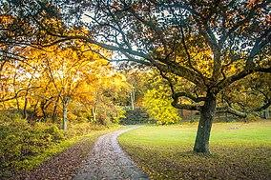
property
https://en.wikipedia.org/wiki/Franklin_Park_(Boston)
Notes:
A word in the story is property.
In Spanish it is propiedad (proh-pyeh-dahd).
Property is a piece of land or a building.
Let’s say the word property together. Ready?
”property.” When you say property, I hear the /p/ sound at the beginning of the word.
Look, property begins with the letter p.
Here is a picture that shows property. Franklin Park is a larger piece of land that belongs to the City of Boston, not to any one person. It is city property. Everyone can enjoy it.

Slide 8
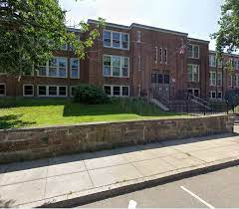
property
https://www.facebook.com/DAEELEMENTARY
Notes:
Here is another picture of property.
How does this picture show the meaning of property? Turn and talk to your partner.
The Davis Ellis School in Roxbury is also a property belonging to the City of Boston.
How many syllables are in the word property? Let’s find out by clapping. Ready?
“Prop-er-ty.” 3 syllables.
Now, let’s say property three times by clapping the syllables. Ready?
“Prop-er-ty, prop-er-ty, prop-er-ty.”

Slide 9
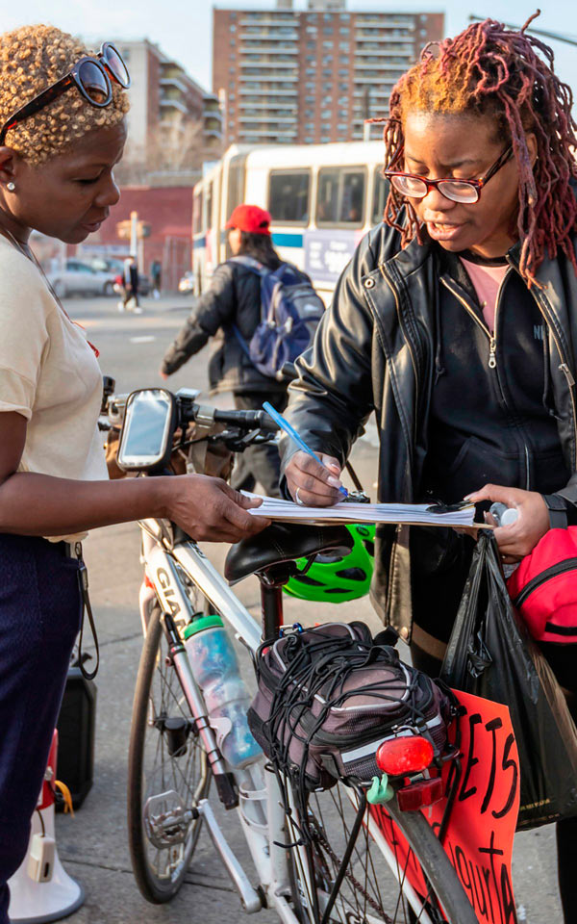
petition
https://www.bxtimes.com/transalt-petitions-for-safer-boston-road/
Notes:
A word in the story is petition.
In Spanish it is petición (peh-tee-syohn).
Petition is a written request by many people that is made to a person in authority.
Let’s say the word petition together. Ready?
”Petition.” When you say petition, I hear the /p/ sound at the beginning of the word.
Look, petition begins with the letter p.
Here is a picture that shows petition. A group of neighbors make a request for safer roads in Boston and people who agree sign a petition to present to City Hall. In that way City Hall knows that it is something many people in the city want.

Slide 10
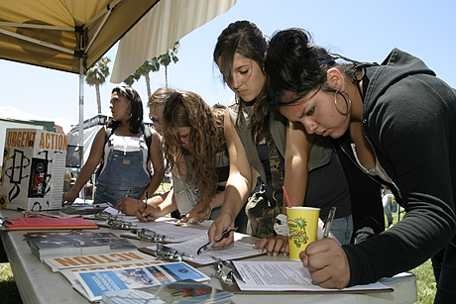
petition
https://voiceofoc.org/2010/07/does-california-need-its-petitioning-secrecy-law/
Notes:
Here is another picture of petition.
How does this picture show the meaning of petition? Turn and talk to your partner.
These people are signing a petition at a public event. The organizers will then present the petition to the leaders, and they hope the idea will be approved.
How many syllables are in the word petition? Let’s find out by clapping. Ready?
“Pe-ti-tion.” 3 syllables.
Now, let’s say petition three times by clapping the syllables. Ready?
“Pe-ti-tion, pe-ti-tion, pe-ti-tion.”

